Slide 1
Creating Triggers
Copyright © 2004, Oracle. All rights reserved.

Slide 2
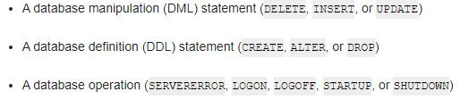
Triggers
A trigger is a named program unit that is stored in the database and fired (executed) in response to a specified event. The specified event is associated with either a table, a view, a schema, or the database, and it is one of the following:
10-2

Slide 3
How Triggers Are Used
You can also use triggers to:
  Automatically generate derived column values
  Prevent invalid transactions
  Enforce complex security authorizations
  Enforce referential integrity across nodes in a distributed database
  Enforce complex business rules
  Provide transparent event logging
  Provide auditing
  Maintain synchronous table replicates
  Gather statistics on table access
  Modify table data when DML statements are issued against views
  Publish information about database events, user events, and SQL statements to subscribing applications

Slide 4

Some Cautionary Notes about Triggers
Although triggers are useful for customizing a database, use them only when necessary.
Excessive use of triggers can result in complex interdependencies, which can be difficult to maintain in a large application.
For example, when a trigger fires, a SQL statement within its trigger action potentially can fire other triggers, resulting in cascading triggers. This can produce unintended effects

Slide 5
The Triggering Event or Statement
A triggering event or statement is the SQL statement, database event, or user event that causes a trigger to fire. A triggering event can be one or more of the following:
  An INSERT, UPDATE, or DELETE statement on a specific table (or view, in some cases)
  A CREATE, ALTER, or DROP statement on any schema object
  A database startup or instance shutdown
  A specific error message or any error message
  A user logon or logoff

Slide 6
Benefits of Database Triggers
Improved data security:
  Provide enhanced and complex security checks
  Provide enhanced and complex auditing
Improved data integrity:
  Enforce dynamic data integrity constraints
  Enforce complex referential integrity constraints
  Ensure that related operations are performed together implicitly

Slide 7
Business Application Scenarios for Implementing Triggers
You can use triggers for:
Security
Auditing
Data integrity
Referential integrity
Table replication
Computing derived data automatically
Event logging
Note: Appendix C covers each of these examples in
more detail.

Slide 8
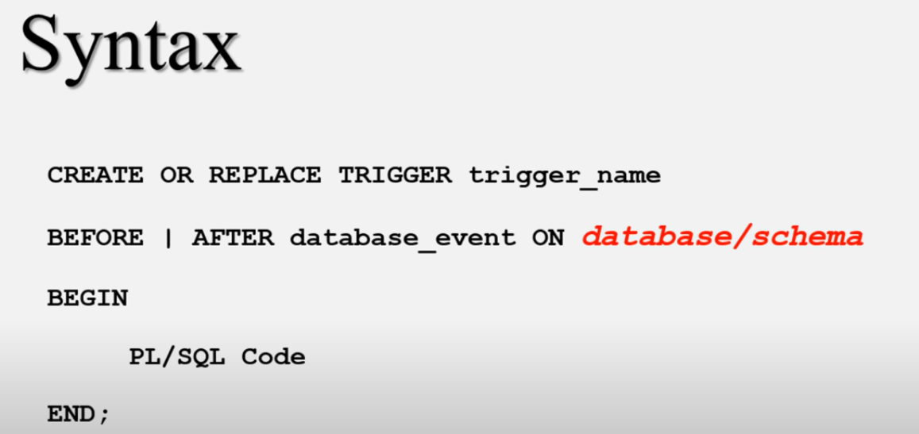

Slide 9
Creating DML Triggers
Create DML statement or row type triggers by using:
CREATE [OR REPLACE] TRIGGER trigger_name
timing
event1 [OR event2 OR event3]
ON object_name
[[REFERENCING OLD AS old | NEW AS new] FOR EACH ROW
[WHEN (condition)]]
trigger_body
A statement trigger fires once for a DML statement.
A row trigger fires once for each row affected.
Note: Trigger names must be unique with respect to other triggers in the same schema.
10-9

Slide 10
CREATE [OR REPLACE ] TRIGGER: /*Trigger verilən adda yaradır və ya dəyişdirir*/
BEFORE | AFTER | INSTEAD OF: /*Triggerin nə zaman tətiklənəcəyini təyin edir*/
BEFORE: /*Trigger içindəki əməliyyat cədvəl üzərində işləmədən əvvəl gerçəkləşir*/
AFTER: /*Trigger içindəki əməliyyat cədvəl üzərindəki əməliyyatdan sonra gerçəkləşir */
INSTEAD OF: /*SQL ifadesi yerine Trigger'ın içerisindeki ifadeler çalıştırılır.*/
/*View üzerinde ki işlemlerde, view’ a ulaşmak yerine içerisinde ki tablo oluşturulur.*/
INSERT [OR] | UPDATE [OR] | DELETE: /*Seçilən DML əmrinə görə trigger planlanır.*/
OF: /*Hansı sütunlar üçün trigger ediləcəyi təyin edilir.*/
ON: /* Hansı sütunlar üçün trigger ediləcəyi təyin edilir.*/
REFERENCING OLD AS o NEW AS n: /*n DML sorgularındaki eski ve yeni değerleri verir.*/

Slide 11
Types of DML Triggers
The trigger type determines if the body executes for
each row or only once for the triggering statement.
A statement trigger:
  Executes once for the triggering event
  Is the default type of trigger
  Fires once even if no rows are affected at all
A row trigger:
  Executes once for each row affected by the triggering event
  Is not executed if the triggering event does not affect any rows
  Is indicated by specifying the FOR EACH ROW clause
10-11

Slide 12
Trigger Timing
When should the trigger fire?
BEFORE: Execute the trigger body before the
triggering DML event on a table.
AFTER: Execute the trigger body after the triggering DML event on a table.
INSTEAD OF: Execute the trigger body instead of the triggering statement. This is used for views that are not otherwise modifiable.
Note: If multiple triggers are defined for the same object, then the order of firing triggers is arbitrary.
10-12

Slide 13
CREATE TRIGGER
create table mylog(
note varchar2(20),
write_date date);
CREATE or REPLACE TRIGGER test1
AFTER INSERT ON emp
BEGIN
insert into mylog values(USER,sysdate);
END;

Slide 14
CREATE TRIGGER
create or replace trigger control_dmls
before insert or update or delete on dept
BEGIN
if (to_char(sysdate,'HH24:MI') NOT BETWEEN '09:00' and '17:00') then
raise_application_error(-20124,'You are allowed to manipulate only between 09:00 AM and 6:00 pm. TRY AGAIN ☺!');
end if;
end;

Slide 15
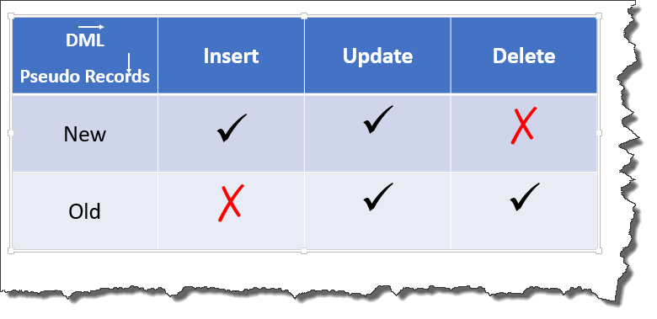
Using OLD and NEW Qualifiers
:old and :new are pseudorecords referred to access row level data when using row level trigger.
:old - refers to Old Value
:new - refers to New value
For Below operation, respective old and new values:
INSERT- :old.value= NULL, :new value= post insert value
DELETE- :old.value= Pre Delete value, :new value= null
UPDATE- :old.value= Pre update value, :new value= Post Update value

Slide 16
Using OLD and NEW Qualifiers
:New and :Old Value can be differentiated in DML Statements .
Insert -- :Old = NULL :New= Inserted new value
Update -- :Old = Value present in table before the Update statement Triggered :New = Given new value to Update
Delete -- :Old = Value before deletion :New = NULL

Slide 17
CREATE TRIGGER for AUTOINCREMENT
create sequence id_seq
increment by 1
start with 1
nocache;
CREATE OR REPLACE TRIGGER myseq
BEFORE INSERT ON test22
FOR EACH ROW
WHEN (new.ID IS NULL)
BEGIN
:new.ID := id_seq.NEXTVAL;
END;

Slide 18
Using OLD and NEW Qualifiers
CREATE OR REPLACE TRIGGER mytrigger1
before DELETE OR INSERT OR UPDATE ON emp
FOR EACH ROW
BEGIN
if inserting then
dbms_output.put_line('Your new value is: '||:new.e_name);
end if;
if updating then
dbms_output.put_line('Your old value is:'||:old.e_name);
dbms_output.put_line('Your new value is:'||:new.e_name);
end if;
END;

Slide 19
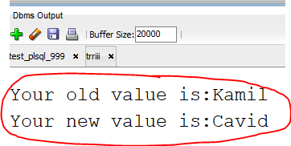
Using OLD and NEW Qualifiers
update emp
set e_name='Cavid'
WHERE e_id=11;

Slide 20
Using OLD and NEW Qualifiers
CREATE OR REPLACE TRIGGER audit_emp_values AFTER DELETE OR INSERT OR UPDATE ON employees
FOR EACH ROW
BEGIN
INSERT INTO audit_emp(user_name, time_stamp, id, old_last_name, new_last_name, old_title, new_title, old_salary, new_salary)
VALUES (USER, SYSDATE, :OLD.employee_id,
:OLD.last_name, :NEW.last_name, :OLD.job_id,
:NEW.job_id, :OLD.salary, :NEW.salary);
END;
/

Slide 21
Using OLD and NEW Qualifiers: Example Using audit_emp
INSERT INTO employees
(employee_id, last_name, job_id, salary, ...) VALUES (999, 'Temp emp', 'SA_REP', 6000,...);
UPDATE employees
SET salary = 7000, last_name = 'Smith'
WHERE employee_id = 999;
SELECT user_name, timestamp, ...
FROM audit_emp;

Slide 22
Restricting a Row Trigger: Example
CREATE OR REPLACE TRIGGER derive_commission_pct BEFORE INSERT OR UPDATE OF salary ON employees FOR EACH ROW
WHEN (NEW.job_id = 'SA_REP') BEGIN
IF INSERTING THEN
:NEW.commission_pct := 0;
ELSIF :OLD.commission_pct IS NULL THEN
:NEW.commission_pct := 0;
ELSE
:NEW.commission_pct := :OLD.commission_pct+0.05; END IF;
END;
/

Slide 23
Summary of Trigger Execution Model
Execute all BEFORE STATEMENT triggers.
Loop for each row affected:
  Execute all BEFORE ROW triggers.
  Execute the DML statement and perform integrity constraint checking.
  Execute all AFTER ROW triggers.
Execute all AFTER STATEMENT triggers. Note: Integrity checking can be deferred until the
COMMIT operation is performed.

Slide 24
Managing Triggers
Disable or reenable a database trigger:
ALTER TRIGGER trigger_name DISABLE | ENABLE
Disable or reenable all triggers for a table:
ALTER TABLE table_name DISABLE | ENABLE
ALL TRIGGERS
Recompile a trigger for a table:
ALTER TRIGGER trigger_name COMPILE

Slide 25
Removing Triggers
To remove a trigger from the database, use the DROP
TRIGGER statement:
DROP TRIGGER trigger_name;
Example:
DROP TRIGGER secure_emp;
Note: All triggers on a table are removed when the table is removed.
NOTE: select * from user_triggers;

Slide 26
Applications for Triggers
Copyright © 2004, Oracle. All rights reserved.

Slide 27
Creating Database Triggers
Triggering a user event:
  CREATE, ALTER, or DROP
  Logging on or off
Triggering database or system event:
  Shutting down or starting up the database
  A specific error (or any error) being raised

Slide 28
Creating Triggers on DDL Statements
Syntax:
CREATE [OR REPLACE] TRIGGER trigger_name Timing
[ddl_event1 [OR ddl_event2 OR ...]] ON {DATABASE|SCHEMA}
trigger_body

Slide 29
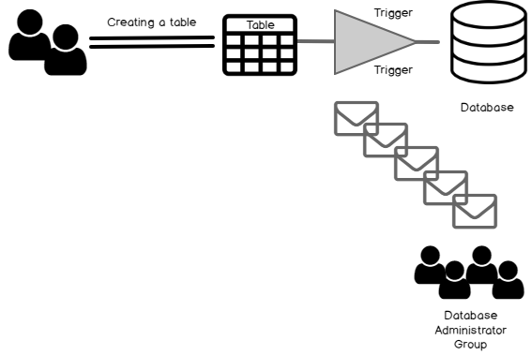
DDL Triggers
DDL triggers: Using the Data Definition Language (DDL) triggers, the Oracle DBA can automatically track all changes to the database, including changes to tables, indexes, and constraints. The data from this trigger is especially useful for change control for the Oracle DBA.

Slide 30
DDL Triggers
CREATE TABLE ddl_info
(
ddl_date DATE,
ddl_user VARCHAR2(15),
object_created VARCHAR2(15),
object_name VARCHAR2(15),
ddl_operation VARCHAR2(15)
);
CREATE OR REPLACE TRIGGER ddl_trigger
AFTER DDL ON database
BEGIN
INSERT INTO ddl_info VALUES (
sysdate,
sys_context('USERENV','CURRENT_USER'),
ora_dict_obj_type,
ora_dict_obj_name,
ora_sysevent);
END;
/

Slide 31
DDL Triggers
create table user_ddls(
object_name varchar2(20),
create_date varchar2(50));
drop table user_ddls;
select * from user_ddls;
create or replace trigger test_ddl
after create on database
begin
insert into user_ddls values(ora_dict_obj_name,to_char(sysdate,'MM-DAY-YYYY HH-MI-SS'));
END;
/

Slide 32
Creating Triggers on System Events
Syntax:
CREATE [OR REPLACE] TRIGGER trigger_name timing
[database_event1 [OR database_event2 OR ...]] ON {DATABASE|SCHEMA}
trigger_body

Slide 33
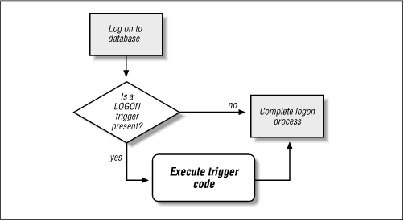
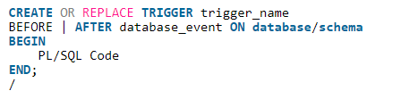
LOGON TRIGGER
Database event triggers also known as system event triggers come into action when some system event occurs such as database log on, log off, start up or shut down. These types of triggers are majorly used for monitoring activity of the system events and have been proved quite a powerful tool for a DBA.
Types of Database Event Triggers.
Schema Level Event Triggers
Database Level Event Triggers

Slide 34
LOGON TRIGGER
CREATE TABLE hr_evnt_audit
(
event_type VARCHAR2(30),
logon_date DATE,
logon_time VARCHAR2(15),
logof_date DATE,
logof_time VARCHAR2(15)
);
CREATE OR REPLACE TRIGGER hr_lgon_audit
AFTER LOGON ON SCHEMA
BEGIN
INSERT INTO hr_evnt_audit VALUES(
ora_sysevent,
sysdate,
TO_CHAR(sysdate, 'hh24:mi:ss'),
NULL,
NULL
);
COMMIT;
END;
/

Slide 35
LOGOFF TRIGGER
CREATE TABLE hr_evnt_audit
(
event_type VARCHAR2(30),
logon_date DATE,
logon_time VARCHAR2(15),
logof_date DATE,
logof_time VARCHAR2(15)
);
CREATE OR REPLACE TRIGGER log_off_audit
BEFORE LOGOFF ON SCHEMA
BEGIN
INSERT INTO hr_evnt_audit VALUES(
ora_sysevent,
NULL,
NULL,
SYSDATE,
TO_CHAR(sysdate, 'hh24:mi:ss')
);
COMMIT;
END;
/

