Slide 1
TCL Commands
MySQL

Slide 2
What’s TCL ?
Transaction Control Language(TCL) commands are used to manage transactions in the database.
TCL commands are used to manage the changes made to the data in a table by DML statements. It also allows statements to be grouped together into logical transactions.

Slide 3
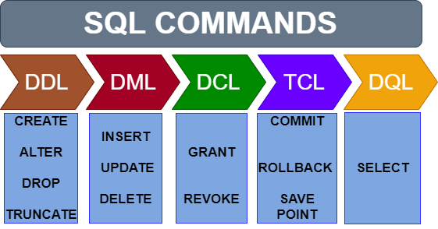
What commands are in TCL ?
COMMIT
SAVEPOINT
ROLLBACK

Slide 4
COMMIT command
COMMIT command is used to permanently save any transaction into the database.
When we use any DML command like INSERT, UPDATE or DELETE, the changes made by these commands are not permanent, until the current session is closed, the changes made by these commands can be rolled back.
To avoid that, we use the COMMIT command to mark the changes as permanent.
Following is commit command's syntax,
COMMIT;

Slide 5
ROLLBACK command
This command restores the database to last commited state. It is also used with SAVEPOINT command to jump to a savepoint in an ongoing transaction.
If we have used the UPDATE command to make some changes into the database, and realise that those changes were not required, then we can use the ROLLBACK command to rollback those changes, if they were not commited using the COMMIT command.
Following is rollback command's syntax,
ROLLBACK TO savepoint_name;

Slide 6
SAVEPOINT command
SAVEPOINT command is used to temporarily save a transaction so that you can rollback to that point whenever required.
Following is savepoint command's syntax,
SAVEPOINT savepoint_name;
In short, using this command we can name the different states of our data in any table and then rollback to that state using the ROLLBACK command whenever required.

Slide 7
Using Savepoint and Rollback
Following is the table class,
id | name
1 | Murad
2 | Nazim
3 | Yusif

Slide 8
Lets use some SQL queries on the above table and see the results.
INSERT INTO class VALUES (4, ‘Nicat');
COMMIT;
START TRANSACTION;
UPDATE class SET name = ‘Cəlal' WHERE id = ‘4';
SAVEPOINT A;
INSERT INTO class VALUES(5, ‘Həsən');
SAVEPOINT B;
INSERT INTO class VALUES (6, ‘Təranə');
SAVEPOINT C;
SELECT * FROM class;

Slide 9
Now SELECT statement will be used to show the data stored in the table.
id | name
1 | Murad
2 | Nazim
3 | Yusif
4 | Cəlal
5 | Həsən
6 | Təranə

Slide 10
Now let's use the ROLLBACK command to roll back the state of data to the savepoint B.
ROLLBACK TO B;
SELECT * FROM class;
Now our class table will look like,
id | name
1 | Murad
2 | Nazim
3 | Yusif
4 | Cəlal
5 | Həsən

Slide 11
Now let's again use the ROLLBACK command to roll back the state of data to the savepoint A
ROLLBACK TO A;
SELECT * FROM class;
Now the table will look like,
id | name
1 | Murad
2 | Nazim
3 | Yusif
4 | Cəlal

Slide 12
So now you know how the commands COMMIT, ROLLBACK and SAVEPOINT works.

