Slide 1
Introduction to SQL
Rasim Mahmudov (https://rasimmax.com)

Slide 2
What tools you need to use SQL ?
1. AppServ 8.5.0 (http://prdownloads.sourceforge.net/appserv/appserv-win32-8.5.0.exe?download)
2. MySql installer (https://dev.mysql.com/downloads/installer/)
3. Database Controller (https://products.agarmen.com/view?p=1001)
4. MySql Workbench (https://www.mysql.com/products/workbench/)
2 is an alternative of 1 and vice versa
4 is an alternative of 3 and vice versa
*Note: Use selection [ 1 or 2 ] and [ 3 or 4 ]
*Note: You can use Oracle Sql, MS-SQL and others as you wish

Slide 3
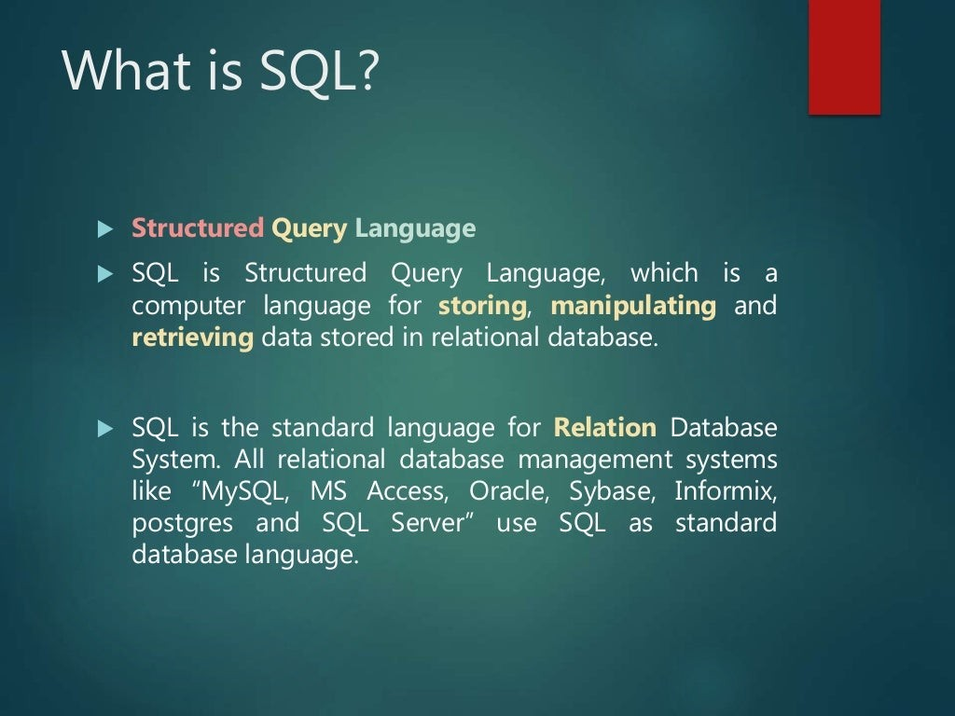

Slide 4
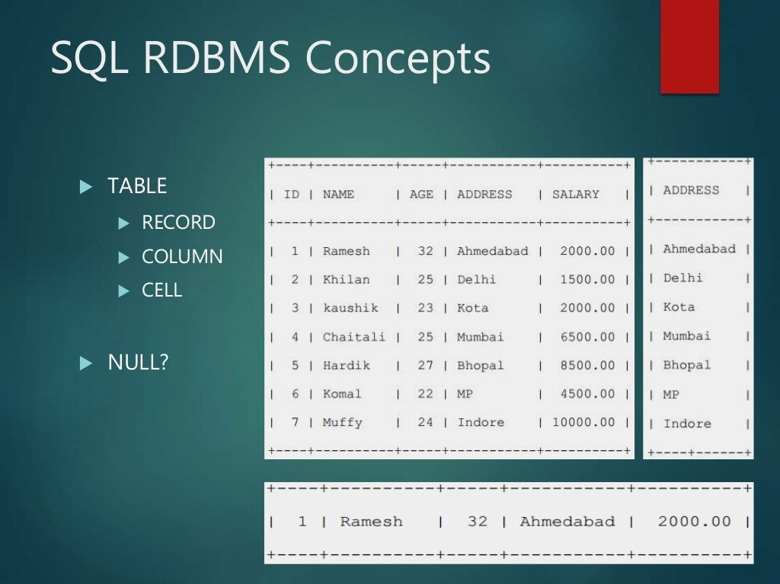

Slide 5
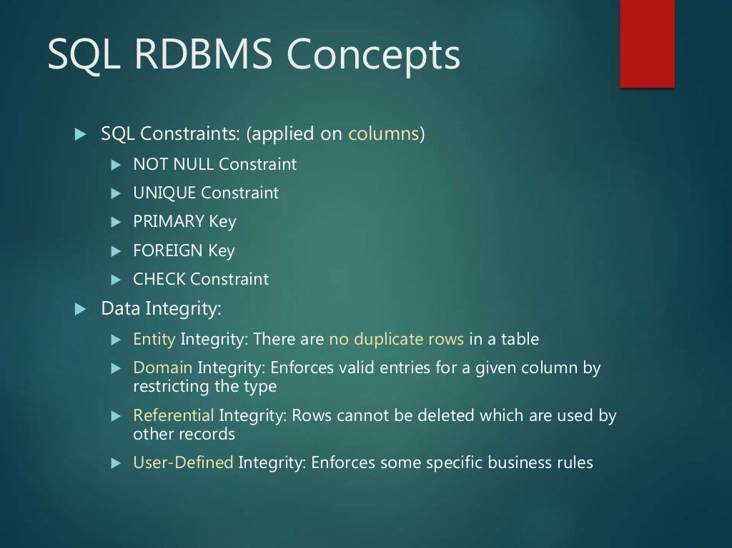

Slide 6
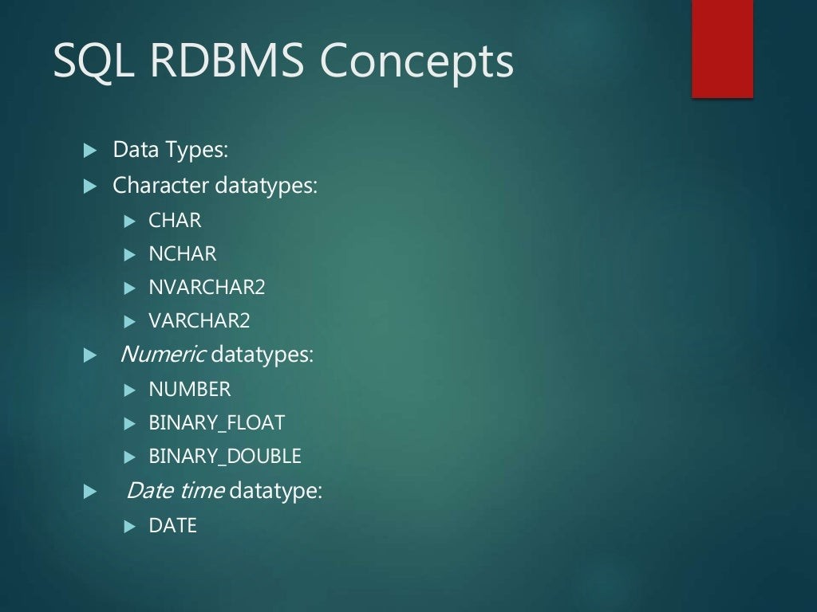

Slide 7
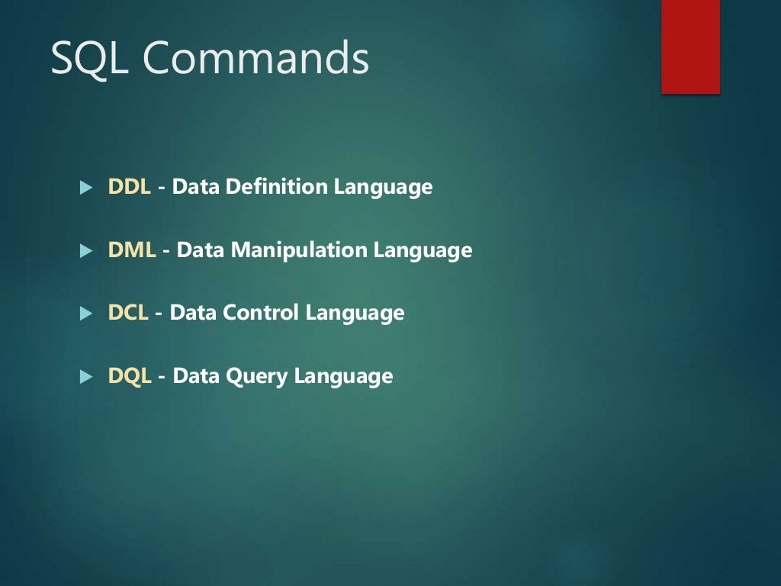

Slide 8
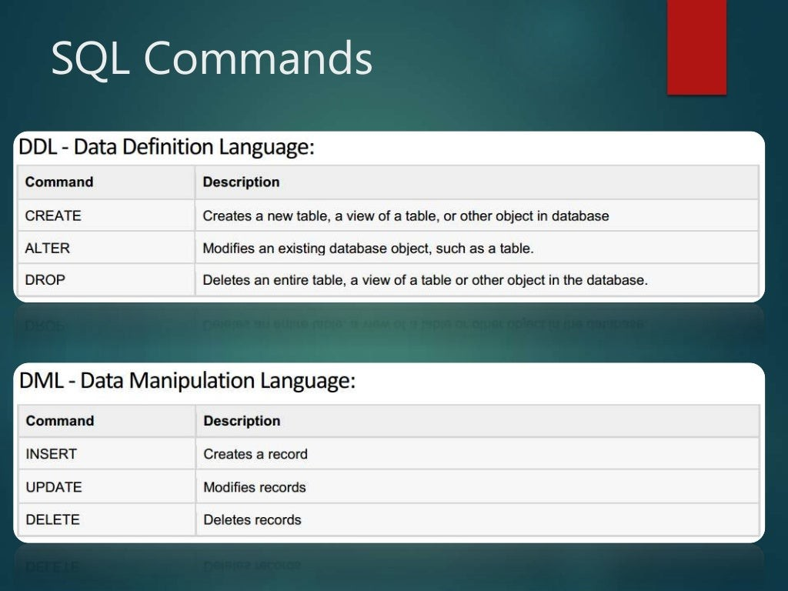

Slide 9
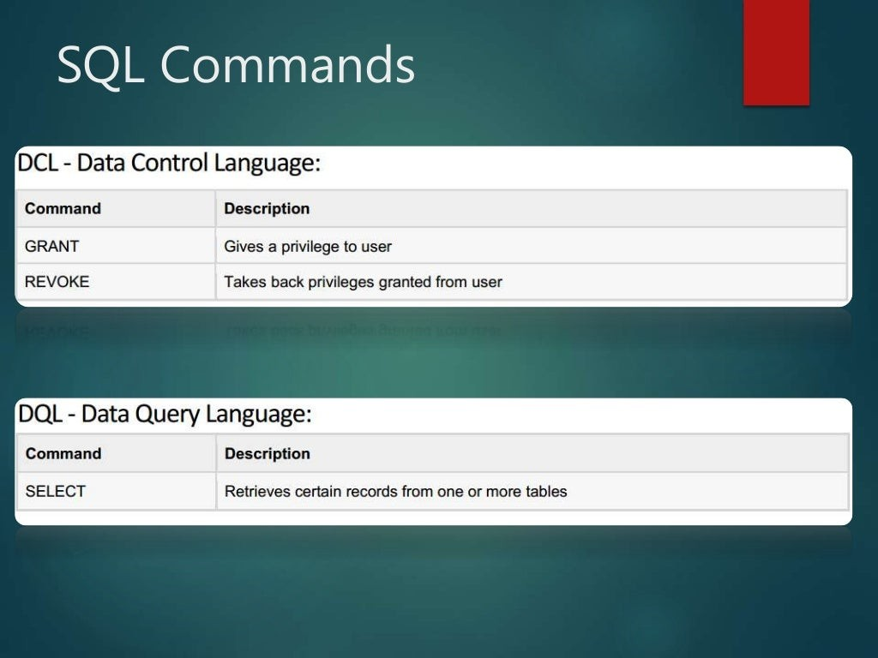

Slide 10
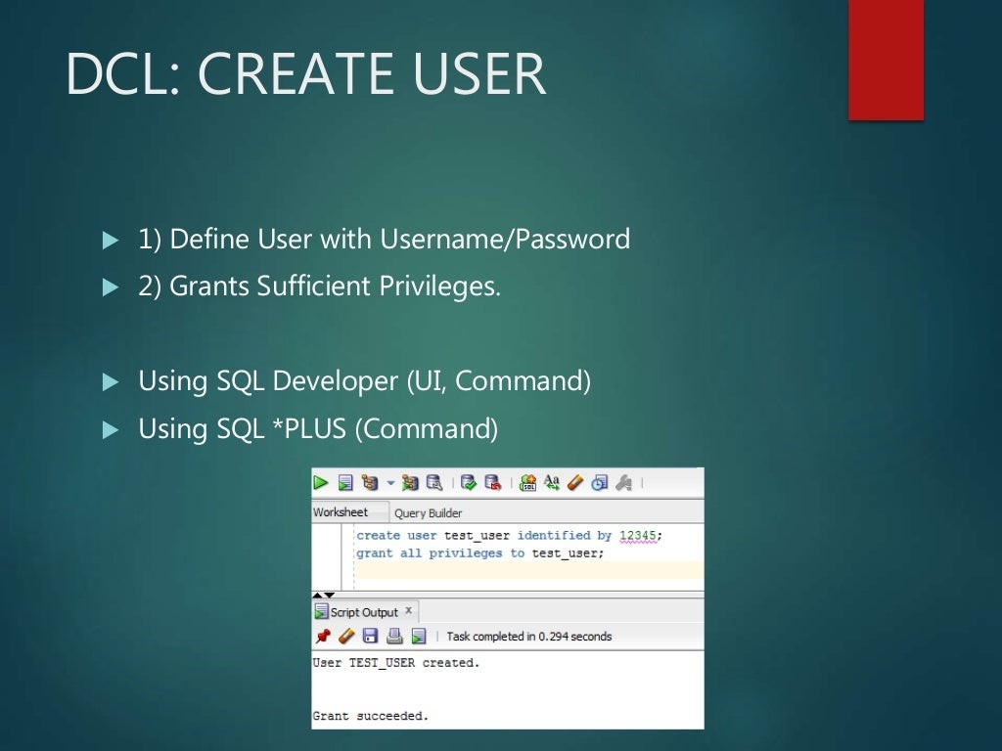

Slide 11
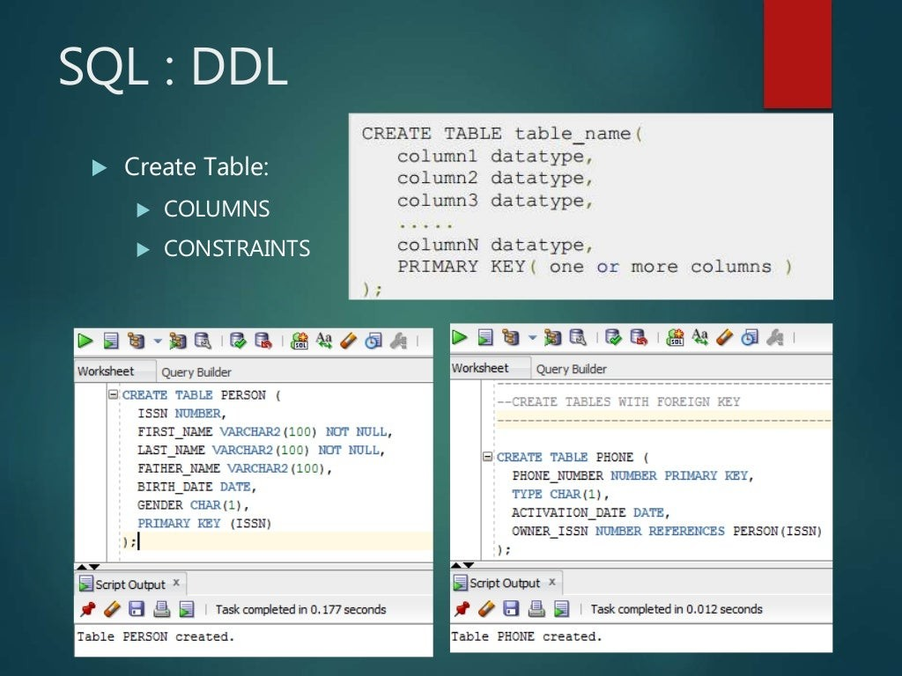

Slide 12
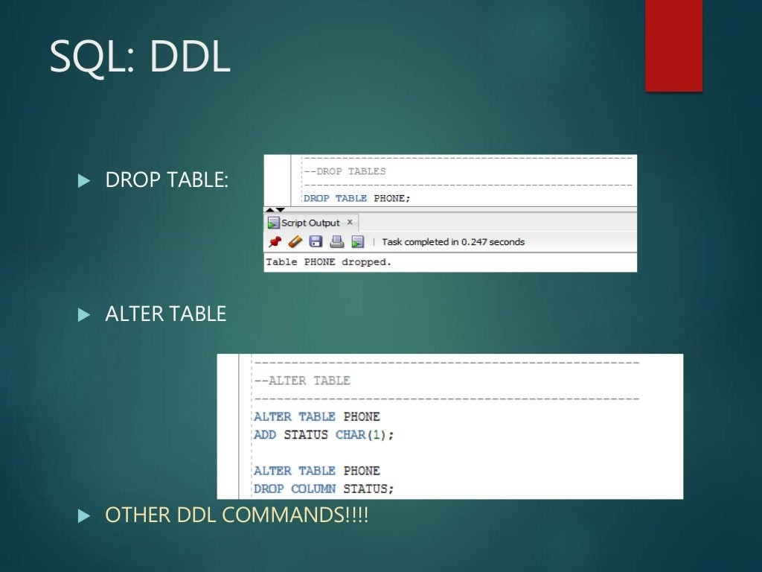

Slide 13
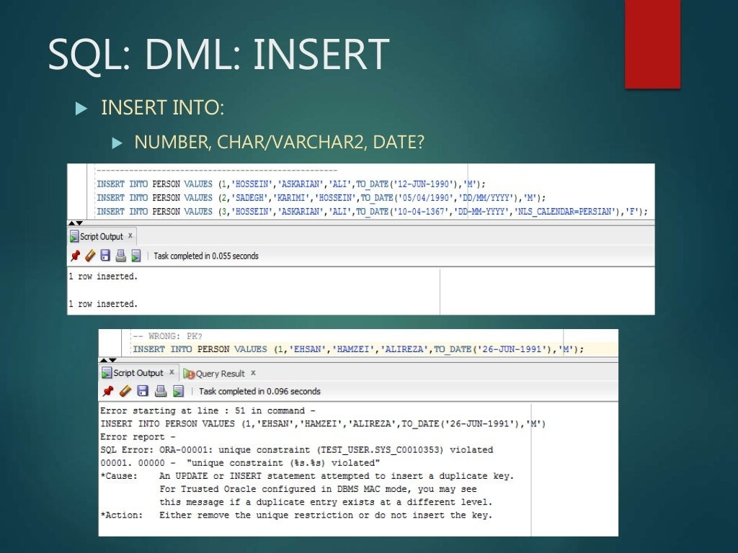

Slide 14
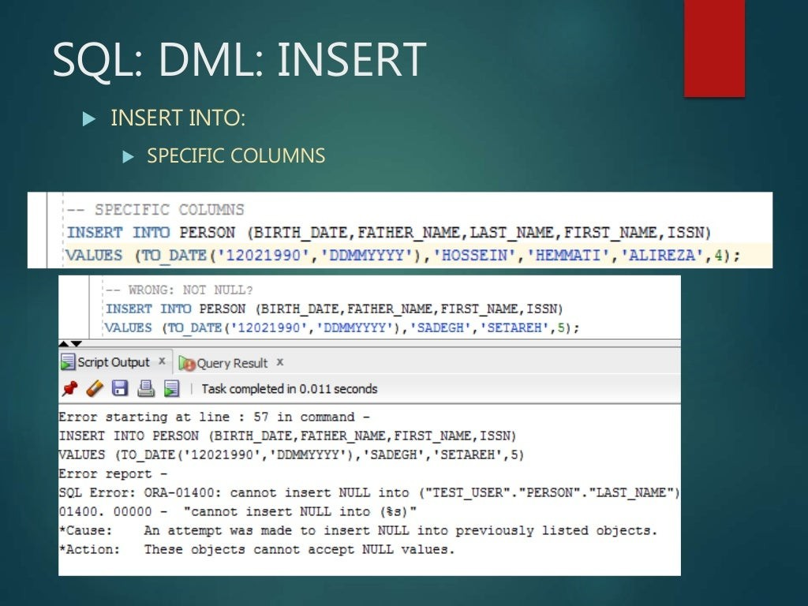

Slide 15
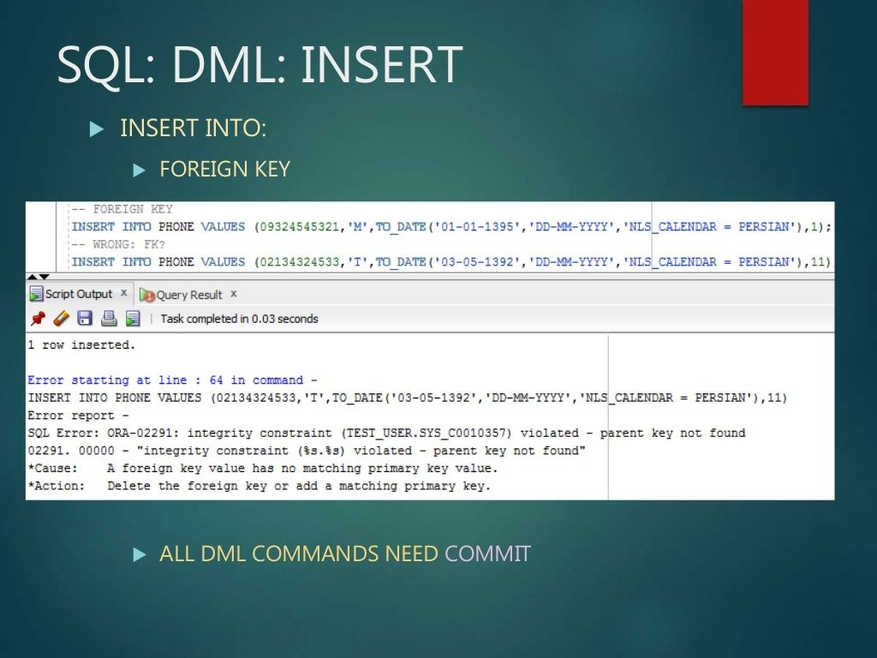

Slide 16
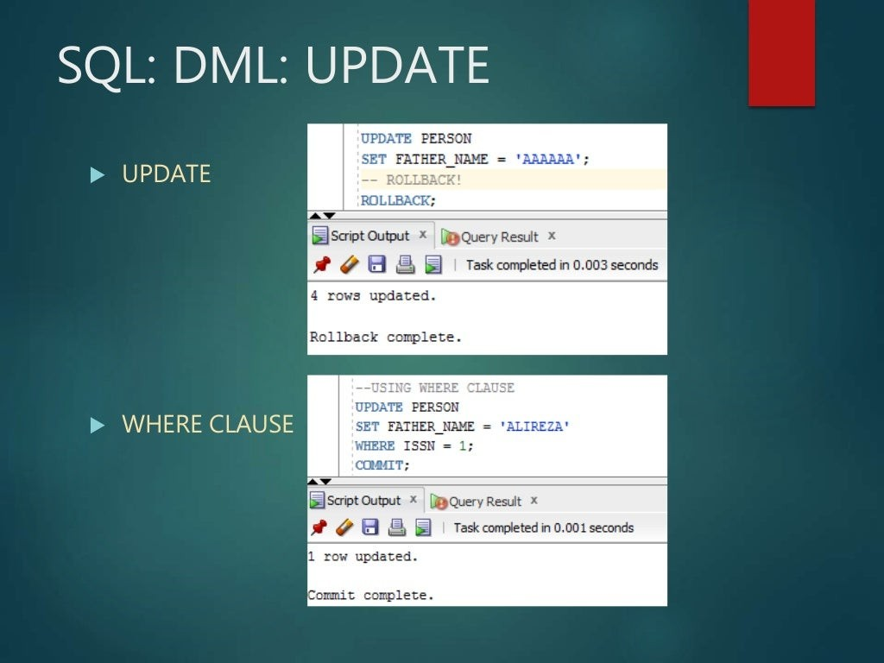

Slide 17
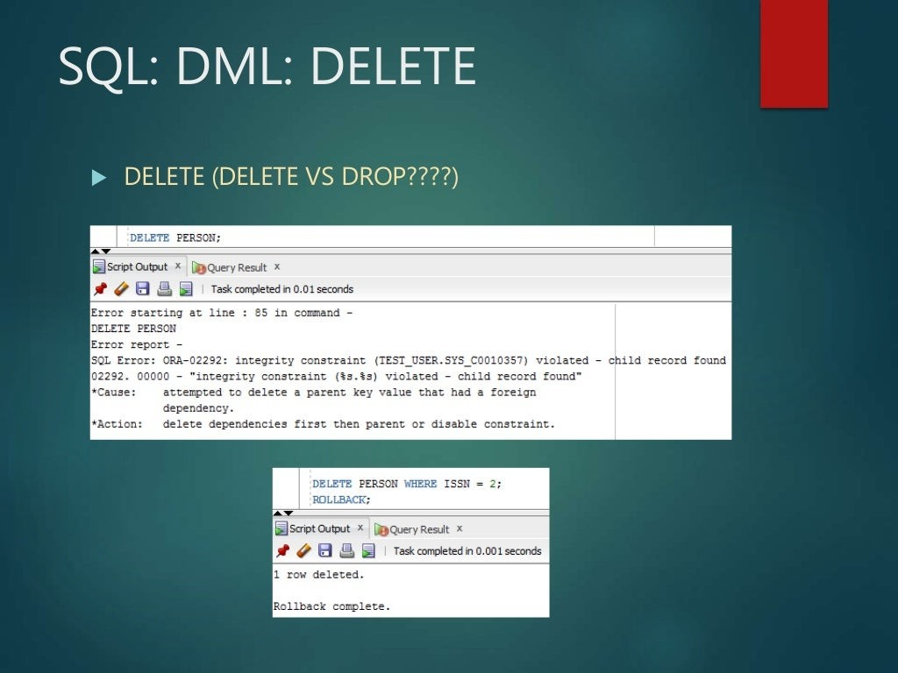

Slide 18
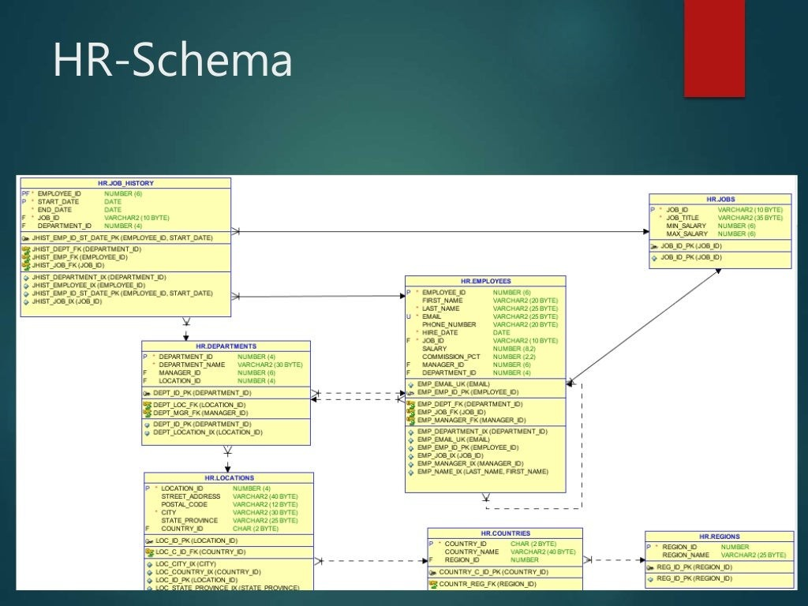

Slide 19
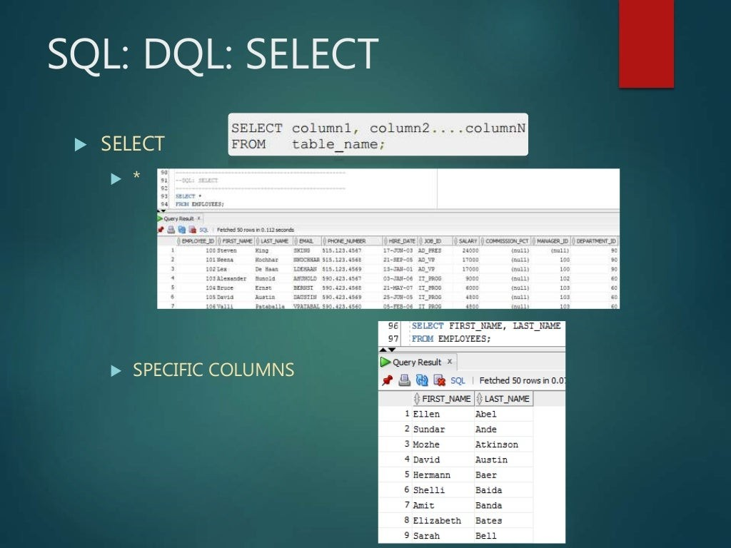

Slide 20
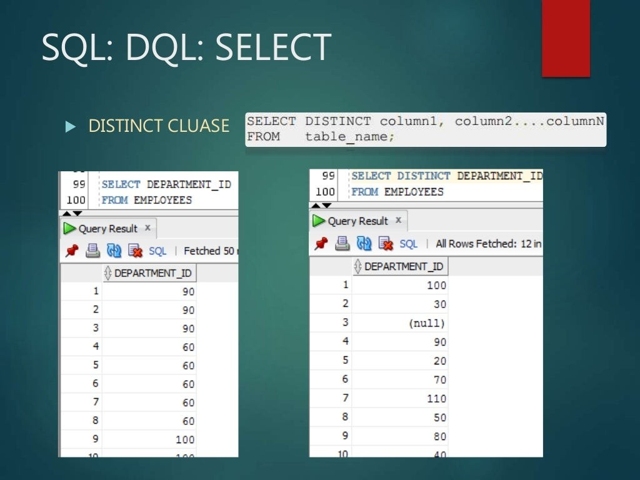

Slide 21
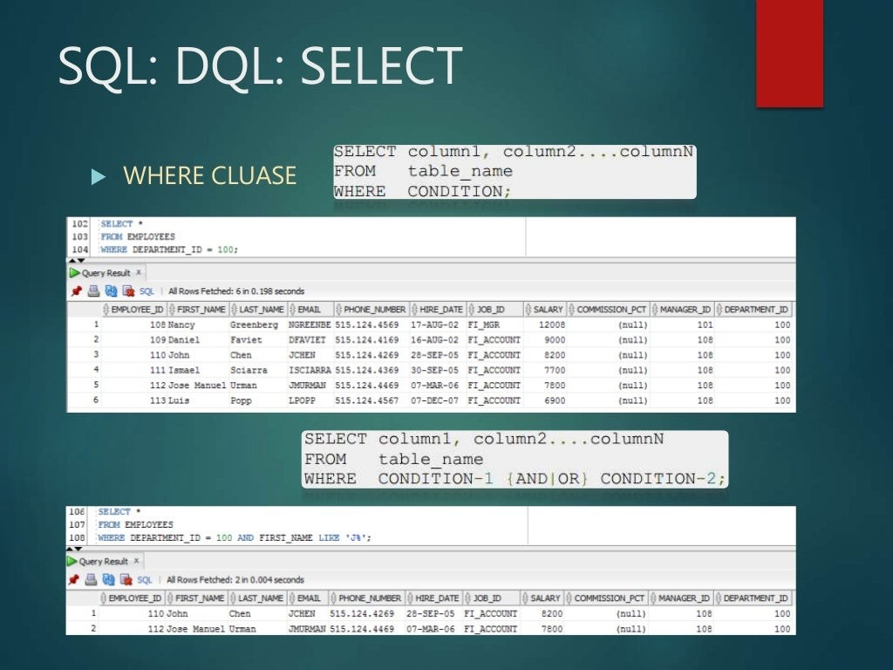

Slide 22
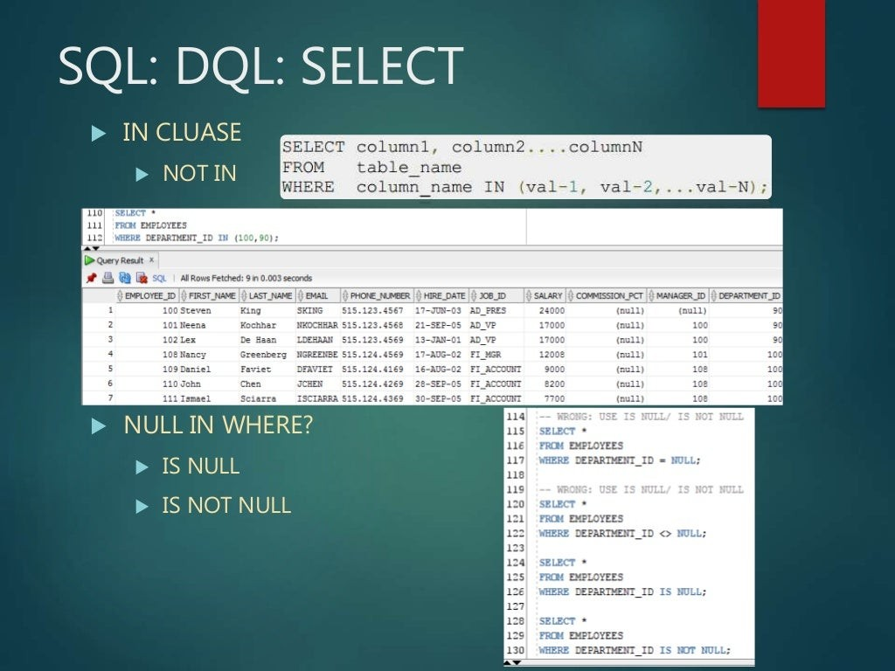

Slide 23
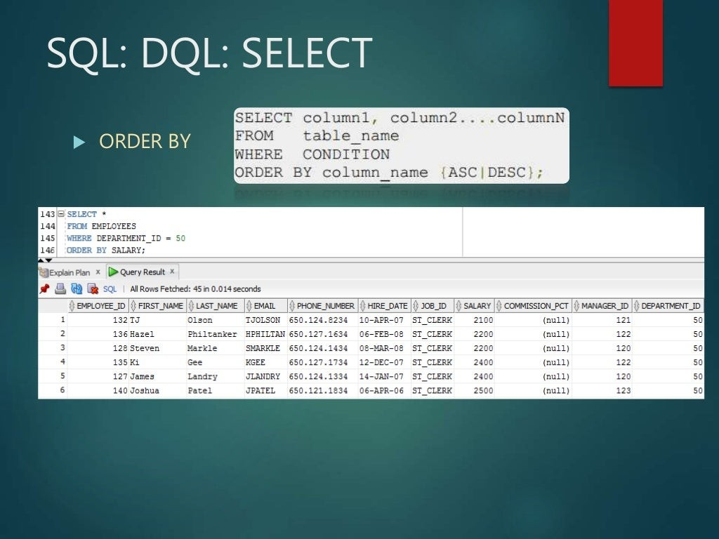

Slide 24
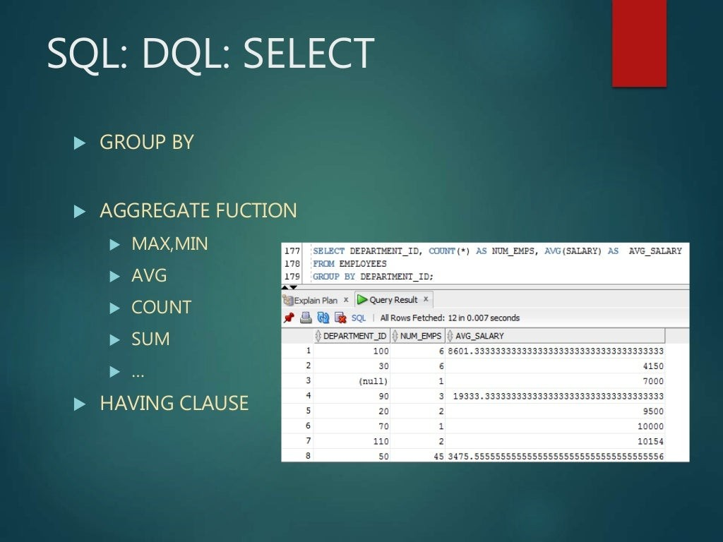

Slide 25
