Slide 1
Oracle CASE expression
Oracle CASE expression allows you to add if-else logic to SQL statements without having to call a procedure. The CASE expression evaluates a list of conditions and returns one of the multiple possible results.
You can use a CASE expression in any statement or clause that accepts a valid expression. For example, you can use the CASE expression in statements such as SELECT, UPDATE, or DELETE, and in clauses like SELECT, WHERE, HAVING, and ORDDER BY.

Slide 2
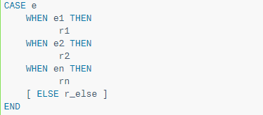
Oracle CASE expression
The simple CASE expression matches an expression to a list of simple expressions to determine the result.
The following illustrates the syntax of the simple CASE expression:

Slide 3
Oracle CASE expression
If the input expression equals any comparison expression, the CASE expression returns the corresponding result expression (r).
If the input expression e does not match any comparison expression, the CASE expression returns the expression in the ELSE clause if the ELSE clause exists, otherwise, it returns a null value.

Slide 4
Oracle CASE expression
Returns
The CASE statement returns any datatype such as a string, numeric, date, etc. (BUT all results must be the same datatype in the CASE statement.)
If all conditions are not the same datatype, an ORA-00932 error will be returned.
If all results are not the same datatype, an ORA-00932 error will be returned.
If no condition is found to be true, then the CASE statement will return the value in the ELSE clause.
If the ELSE clause is omitted and no condition is found to be true, then the CASE statement will return NULL.
Note
You can have up to 255 comparisons in a CASE statement. Each WHEN ... THEN clause is considered 2 comparisons.

Slide 5
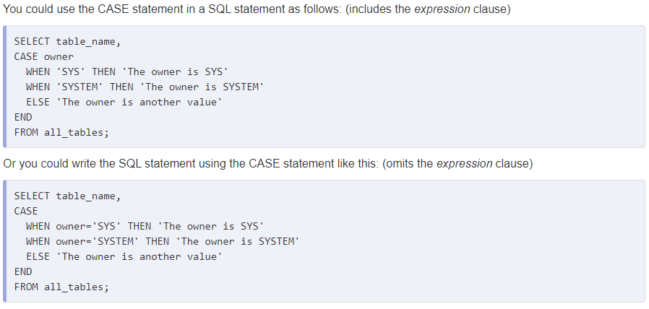

Slide 6
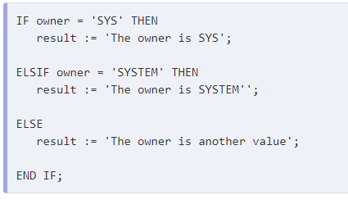

Slide 7
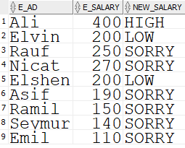
EXAMPLE
select e_ad, e_salary,
(case E_SALARY
when 400 then 'HIGH'
when 200 then 'LOW'
ELSE 'SORRY'
END) NEW_SALARY
from employee;

Slide 8
EXAMPLE
select e_ad, e_salary,
(case E_SALARY
when 400 then 'HIGH'
when 200 then 'LOW'
ELSE 'SORRY'
END) NEW_SALARY
from employee;
IF E_SALARY = 400 THEN
result := ‘HIGHEST’;
ELSIF E_SALARY = 200 THEN
result := ‘LOWEST”;
ELSE
result := ‘SORRY’;
END IF;

Slide 9
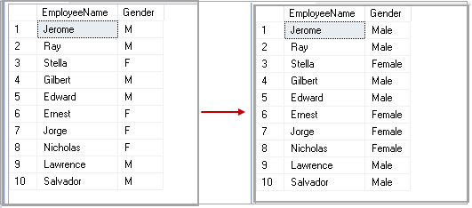

Slide 10
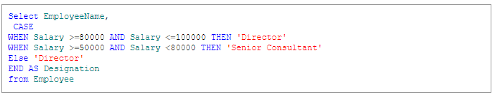

Slide 11
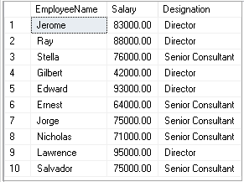

Slide 12
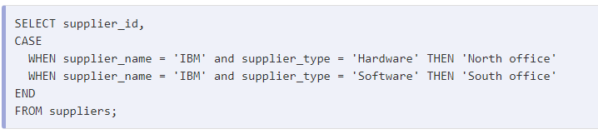
You can use case statement that evaluates two different fields.

Slide 13
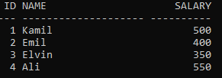
UPDATE in CASE expression
Update values of employee table. If salary is greater than 500, then multiply salary with two. Else if, salary is between 400 and 499, then divide salary by 2. Else, add 100 to salary.

Slide 14
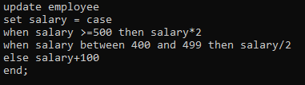
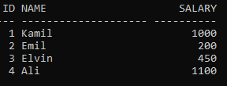
UPDATE in CASE expression

