Slide 1
Introduction 2 Python
The role of Python in AI & Machine Learning
Presenter: Rasim Mahmudov
Date: 07-Mar-24

Slide 2
Contents
Introduction
Operators
If-Else
Loops
Directories
Arrays or Lists
Matrix
Functions
Classes
Inheritance
Modules
Jupyter Notebook
Pandas
Machine Learning sample

Slide 3
What is Python ?
Python is a free, open-source programming language that is available for everyone to use.
It is a so popular programming language. It was created by Guido van Rossum, and released in 1991.
It is used for:
  web development (server-side),
  software development,
  mathematics,
  system scripting.

Slide 4
Why Python?
Python works on different platforms (Windows, Mac, Linux, Raspberry Pi, etc).
Python has a simple syntax similar to the English language.
Python has syntax that allows developers to write programs with fewer lines than some other programming languages.
Python runs on an interpreter system, meaning that code can be executed as soon as it is written. This means that prototyping can be very quick.
Python can be treated in a procedural way, an object-oriented way or a functional way.

Slide 5
Installation
Many PCs and Macs will have python already installed.
To check if we have python installed on a Windows PC: python –version command should be run
Example:
print("IESL") (without semicolon ‘;’)

Slide 6
Python Indentation
Indentation refers to the spaces at the beginning of a code line.
if 5 > 2:
print("Five is greater than two!")
if 5 > 2:
print("Five is greater than two!")
if 5 > 2:
print("Five is greater than two!")
print("Five is greater than two!")

Slide 7
Required tools to run Python code
Python core: https://www.python.org/downloads/
Code editor: PhCharm Community version
https://www.jetbrains.com/pycharm/download/other.html
Or Jupyter Notebook
https://jupyter.org/

Slide 8
Variables
x = 5
y = "John“
is_published = False
print(x)
print(y)
Comments
x = 4 # x is of type int
x = 9 # x is float
x = "Sally" # x is now of type str
print(x)

Slide 9
Strings
course = 'Python'
print(course.upper()) #PYTHON
print(course.find('for’)) #If finds, the index, otherwise -1
print('Python' in course) #True
print("Title: "+course.title()) #Sentence case
print(len(course)) #6
txt = 'rasim'
rep = txt.replace('m', 'mmax')
print(rep) #rasimmax

Slide 10
Formatted strings
first_name = 'Rasim'
last_name = 'Mahmudov'
message = first_name + ' [' + last_name + '] is a student.' #Hard to visualize the output
msg = f'{first_name} [{last_name}] is a student.' #formatted string
#Easy to understand
print(message) # Rasim [Mahmudov] is a student.
print(msg) # Rasim [Mahmudov] is a student.

Slide 11
Type Conversion (Casting)
birth_year = input("Enter your birth year: ")
age = 2024 – birth_year
print(type(age)) #prints the type of age <class 'str'>
print(age) #Can cause an error (int - string)
How to solve ?
birth_year = int(birth_year)
OR
birth_year = int(input("Enter your birth year: "))

Slide 12
Arithmetic Operators
a = 10
b = 3
print(a / b) #divison (3.3333333333333335)
print(a // b) #division integer (3)
print(a % b) #remainder (1)
print(a ** 3) # (1000)

Slide 13
Math module
import math
print(math.floor(2.9)) #2
print(math.abs(-13)) #13
print(math.ceil(2.6)) #3

Slide 14
If, Else
temperature = 25
if temperature > 30:
print('It is a hot day')
print('Drink plenty of water')
elif temperature > 20:
print('It is a nice day')
elif temperature > 10:
print('It is a bit cold')
else:
print('It is cold')
print(' === Done ===‘)
#Results:
It is a nice day
=== Done ===

Slide 15
Ternary Operator
weight = float(input("Weight: "))
unit = input ("(K)g or (L)bs: ")
if unit.upper() == "K":
converted = weight / 0.45
else:
converted = weight * 0.45
print(f"Weight in {unit}{'g' if unit.lower() == 'k' else 'bs'} " + str(converted)) #ternary
Weight: 15, (K)g or (L)bs: K
Weight in Kg 33.333333333333336

Slide 16
While Loop, Guess Game
secret_number = 9
guess_count = 0
guess_limit = 3
while guess_count < guess_limit:
guess = int(input('Guess: '))
guess_count += 1
if guess == secret_number:
print('You won!')
break
#exit()
else:
print('Sorry you failed!')

Slide 17
For Loop
#1,2,3,4,5
range (3, 5)
3 is included
5 is NOT included
#3, 4
numbers = [1, 2, 3, 4, 5]
for item in numbers:
print(item)
for i in range(3, 5):
print(i)

Slide 18
Lists
Max number in list: 9
append() – to append new element
copy() – copies the list
sort() – sorts the list
reverse() – reverses the list
Matrix list
print(matrix[0][1]) #2
print(matrix[3][1])
#list index out of range
numbers = [2, -5, 7, 3, 9, 1]
max = numbers[0]
for number in numbers:
if number > max:
max = number
print("Max number in list: ", max)
matrix = [
[1, 2, 3],
[4, 5, 6],
[7, 8, 9]
]

Slide 19
Tuple and Unpacking
numbers = (1,2,3,3)
print(numbers.count(3)) #2
print(numbers.index(3)) #2
#numbers[0] = 10 #Returns error, read only
numbers2 = range(1, 20)
for i in numbers2:
print(i)
#tuples are immutable and inchangable
coordinates = (1,2,3)
#x = coordinates[0]
#y = coordinates[1]
#z = coordinates[2]
x,y,z = coordinates
print(x,y,z) #1 2 3

Slide 20
Disctionaries
customer = {
"name": “Rasim Mahmudov",
"age": 27,
"is_verified": True
}
print(customer)
print(customer['name']) #Rasim Mahmudov
#print(customer['Name']) #KeyError
print(customer.get("Name")) #If key not found, then returns "None" instead error
print(customer.get('birthdate', 'Jan 1 1982')) #second parameter is default value
print(customer) #{'name': 'Rasim Mahmudov', 'age': 27, 'is_verified': True}
customer['birthdate'] = '09 May 1996'
print(customer.get('birthdate’)) #09 May 1996

Slide 21
Functions
#greet_user() - can not be invoked before define
def greet_user(var='User', var2 = 'Nici'):
print('Hello ', var)
print(f'Function is called variable is {var}')
def greet():
print('Greeting') #Greeting
def square(number):
return number*number if number != 0 else -1 # number if number is not None else 1 - None = null
print('Start’) #Start
greet() #Greeting
greet_user(var2='Rasim', var='Jikyu’) #Hello Jikyu
print(square(10)) #100
print('Finish’) #Finish

Slide 22
Exceptions
Input> Splitter: 0
Output> Splitter cannot be 0!
try:
var = int(input("Splitter: "))
defined = 20000
div = defined / var
print(div)
except ValueError:
print('Invalid value!')
except ZeroDivisionError:
print('Splitter cannot be 0!')

Slide 23
Classes
Classes are extremely important in programming and they're not specific to python, in fact, a lot of other programming languages do support the notion of classes.
We use classes to define new types.
class Point:
def __init__(self,x,y):#Constructor
self.x = x
self.y = y
def move(self):
print("move")
def draw(self):
print("draw")
#point1 = Point()# creating a new instance of the Point class
#point1.x = 10 #attributes can be assigned to the object
#point1.y = 20
#print(point1.x)
point2 = Point(10, 20)
#point2.x = 10
print(point2.x)# returns above sent value
#point1.draw() #draw

Slide 24
Inheritance
class Animal:
def walk(self):
print("walk")
class Dog(Animal):
#pass #means nothing just continue
def bark(self):
print("bark")
class Cat(Animal):
pass # if we add `pass` here it does not mean just continues to next line
def be_annoying(self):
print("Be annoying")
dog1 = Dog()
dog1.walk() #walk
cat1 = Cat()
cat1.be_annoying() #Be annoying

Slide 25
Modules
#Converters.py
def lbs_to_kg(weight):
return weight * 0.45
def kg_to_lbs(weight):
return weight / 0.45
#Modules.py
#import converters
#import converters as con
from converters import kg_to_lbs, lbs_to_kg
res = kg_to_lbs(100)
#res2 = converters.lbs_to_kg() #if has alias, then con.lbs_to_kg()
res2 = lbs_to_kg(22.222)
print(res) # 222.22222222222223
print(res2) # 9.9999

Slide 26
Directories
from pathlib import Path
#Absolute path
#C:\Program Files\Microsoft\
#Relative path
#ecommerce
path = Path("ecommerce")
print(path.exists()) #True
path2 = Path("email")
print(path2.exists()) #False
#path2.mkdir() #Creates a new Directory
path3 = Path()
#path.glob('*.py') #Search for files
for file in path3.glob('*.py'):
print(file) # returns files in that (related to path3) directory

Slide 27
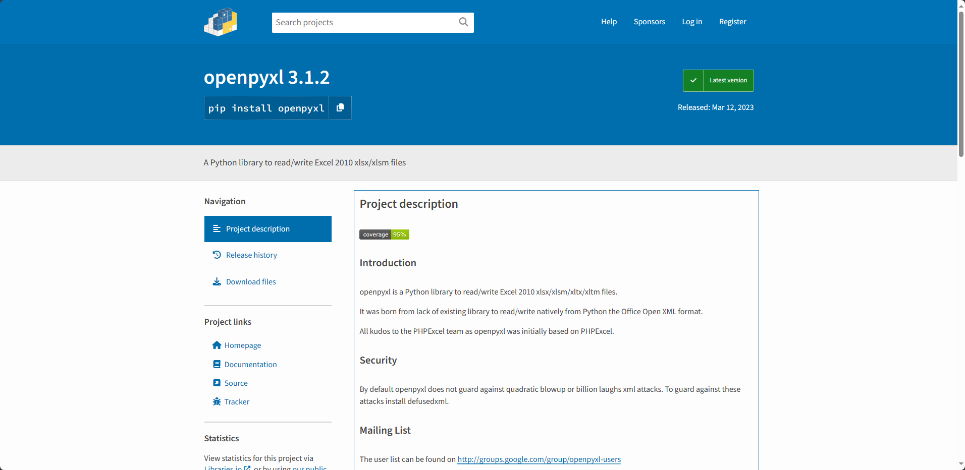
PyPi · The Python Package Index
openpyxl

Slide 28
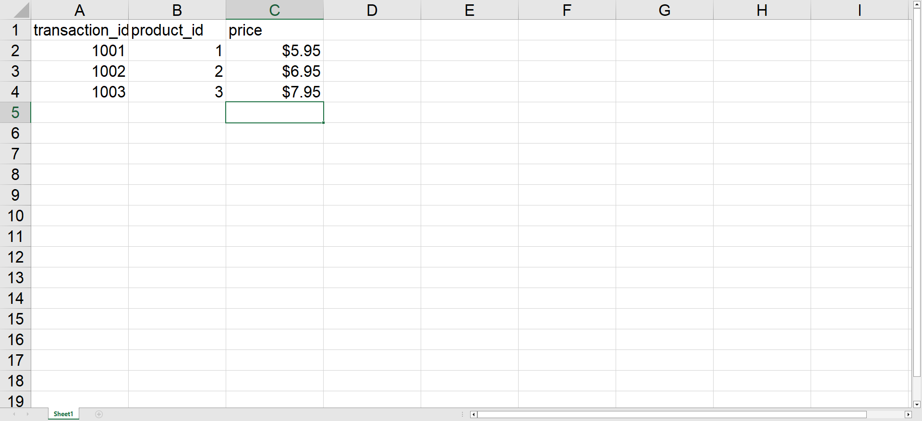
transactions.xlsx

Slide 29
import openpyxl as xl
from openpyxl.chart import BarChart, Reference
wb = xl.load_workbook('transactions.xlsx')
sheet = wb['Sheet1']#Sheet name
#cell = sheet['A1'] #Cell number
#cell = sheet.cell(1, 1) #by row and column number
#print(sheet.max_row) #row count
for row in range(2, sheet.max_row + 1):
#print(row)
cell = sheet.cell(row, 3)
#every row's 3rd column
corrected_price = cell.value * 0.9;
#Corrects price
corrected_price_cell = sheet.cell(row, 4)
#Writing to the new cell
corrected_price_cell.value = corrected_price
#Updates new price to new cell
#print(cell.value)
values = Reference(
sheet,
min_row=2,
max_row = sheet.max_row,
min_col=4,
max_col=4)
chart = BarChart()
chart.add_data(values)
sheet.add_chart(chart, 'e2')
wb.save('transactions2.xlsx’)
#Savin as a new file

Slide 30
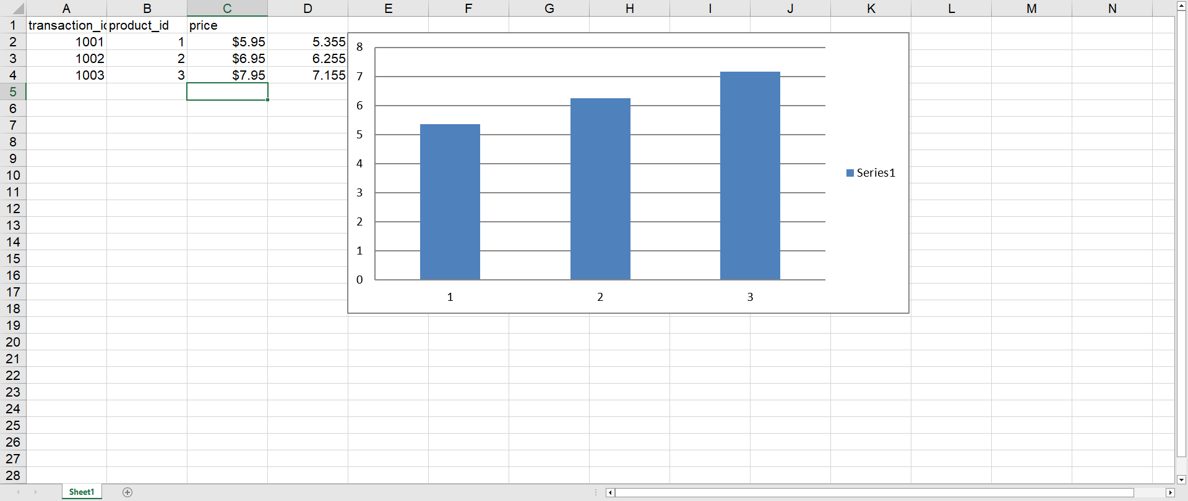

Slide 31
Machine Learning
Machine learning is a branch of artificial intelligence where computers learn from data instead of being explicitly programmed.
It enables computers to make predictions or decisions based on patterns in the data they've been trained on. It's used in various applications like image recognition, natural language processing, and recommendation systems.

Slide 32
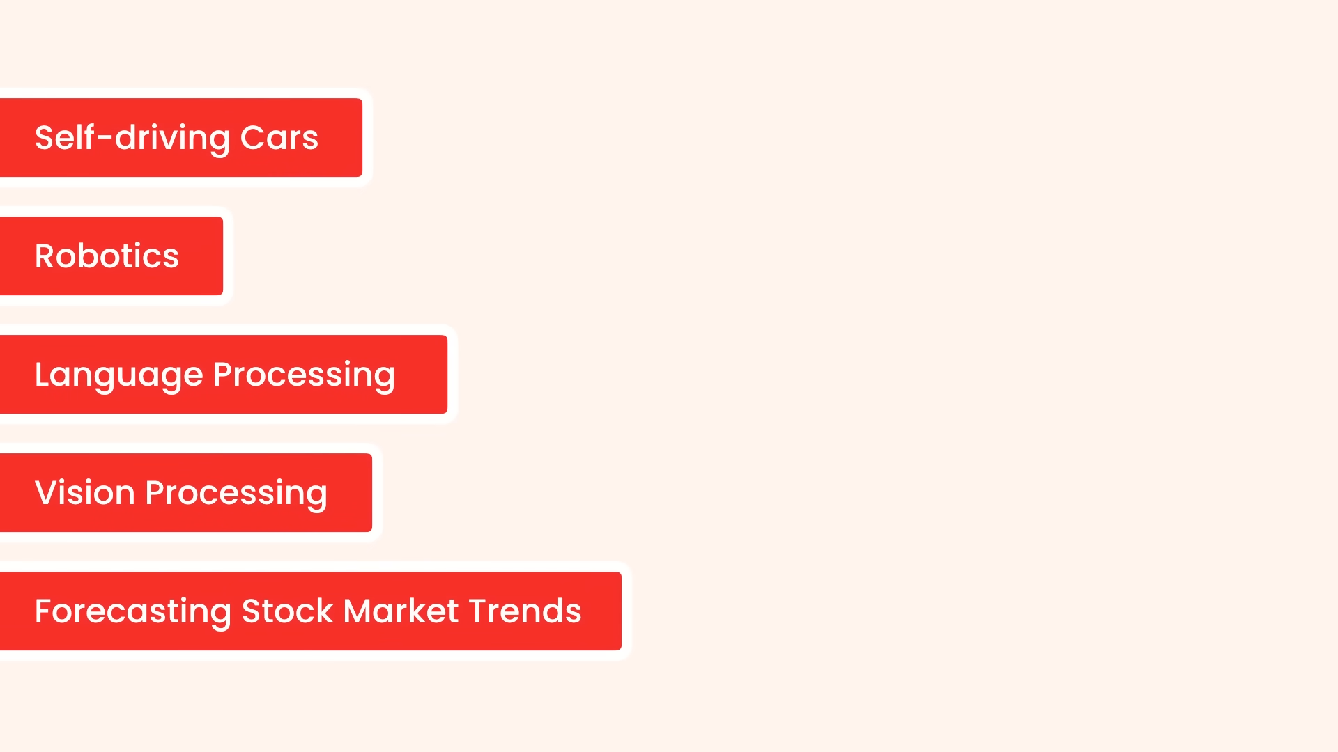
Machine Learning
Example, the field we are using ML
E

Slide 33
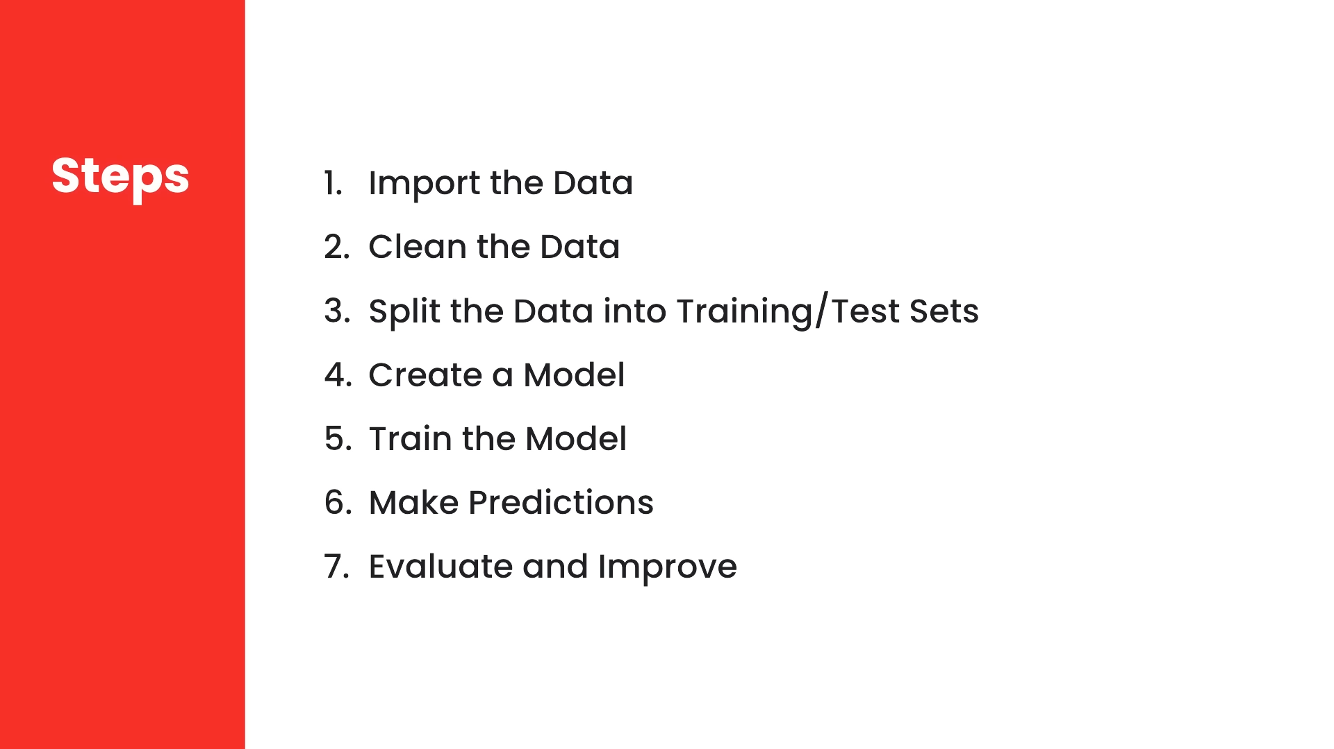

Slide 34
Need to import data
Need to clean the data, unnecessary things should be cleaned
After clean data set, we need to split it into two segments. One for training our model, and the other for testing it, to make sure our model produces the right result.
Decision trees, Neurol Networks as Models, can be used
next we need to train our model. So we feed it our training data. Our model will then look for the patterns in the data
we can ask it to make predictions.
We need to evaluate the predictions and measure their accuracy. Then, we need to revisit our model and either select a different algorithm.

Slide 35
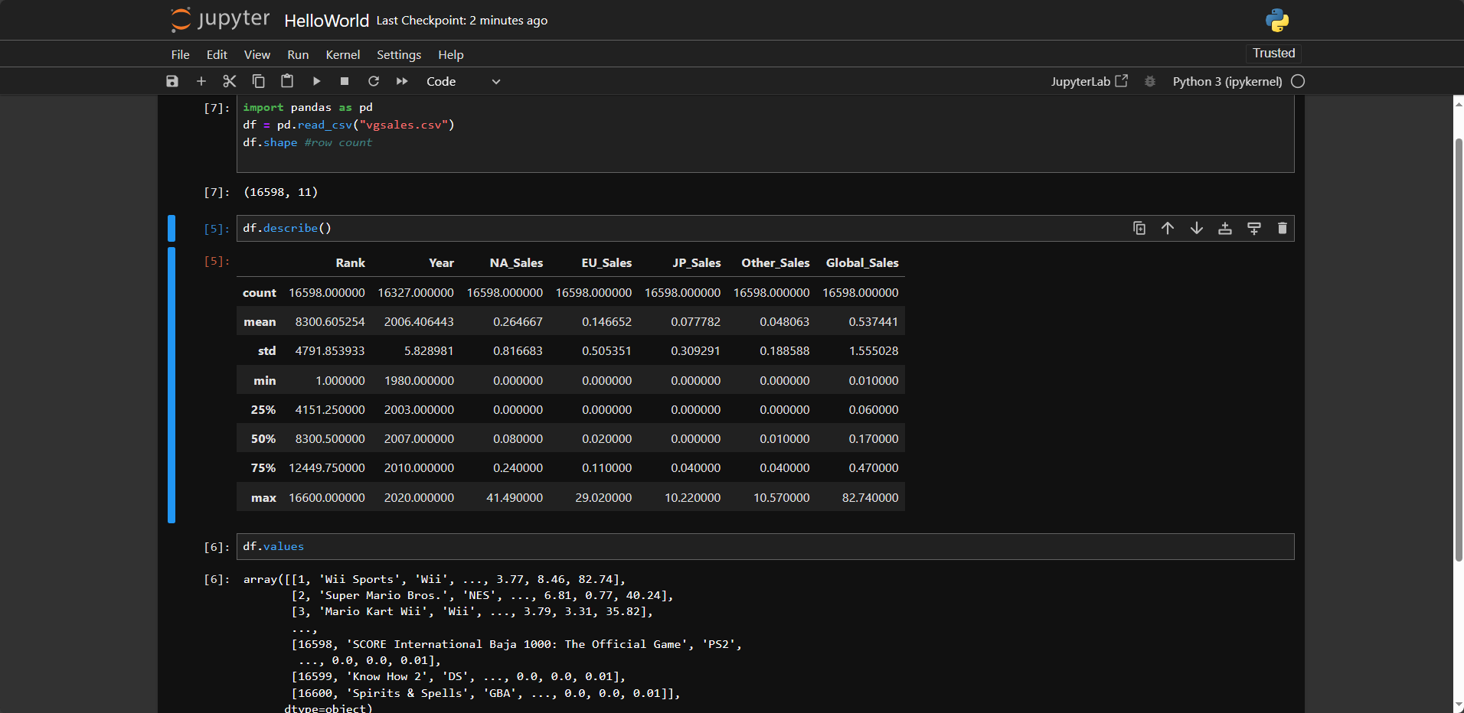
Sample with Python for Video Game Sales [R4] Dataset

Slide 36
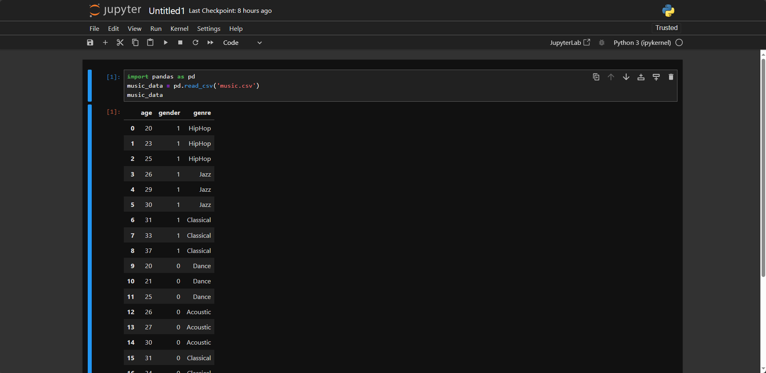
Music Data set [R6]

Slide 37
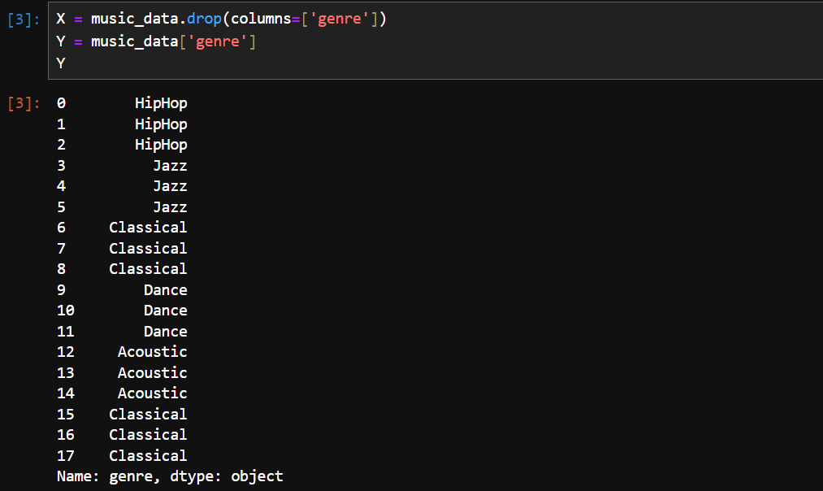
To train we need to split data

Slide 38
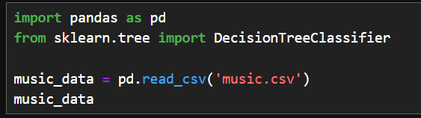
Importing scikit-learn
We can install it using
pip install scikit-learn

Slide 39
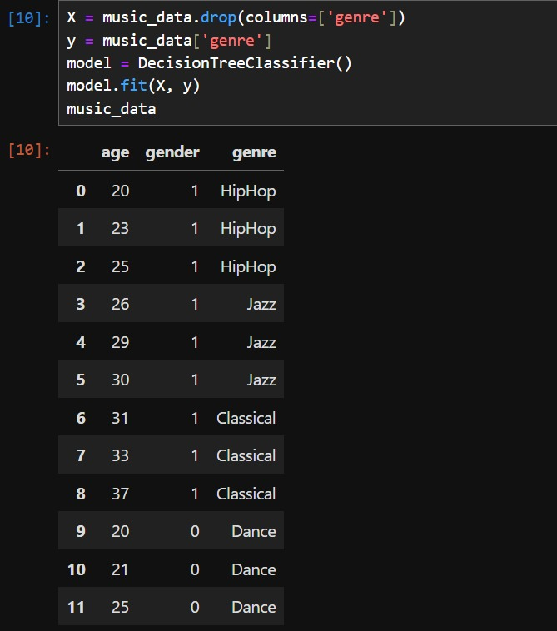
The result

Slide 40
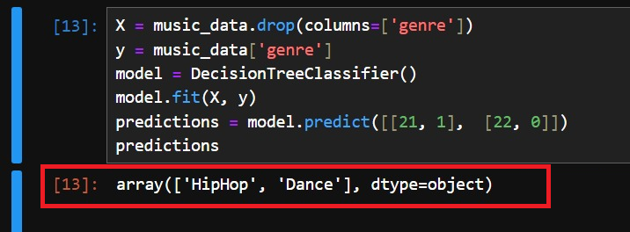
We don’t have a kind of music for 22 year old woman
It’s expected to say Dance
Now we ask to our model to predict it.
21 Years old men like HipHop,
22 Years old women like Dance

Slide 41
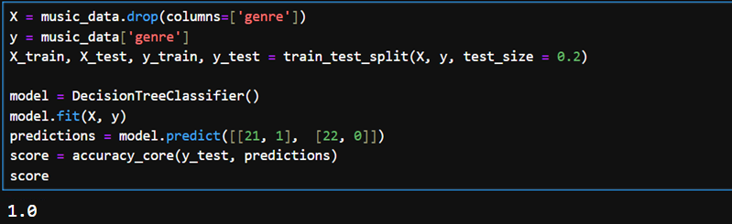
It can return 0.75, 0.766666.., 1 .etc
For more beautiful result, we need more data

Slide 42


Slide 43
References
[R1] Python Tutorial - Python Full Course for Beginners
https://www.youtube.com/watch?v=_uQrJ0TkZlc
[R2] PyPI · The Python Package Index
[R3] Python Cheat Sheet - Mosh Hamedani
https://rasimmax.com/fs/pybook/PythonCheatSheet.pdf
[R4] Video Game Sales, DataSet
[R5] Introduction to Python (w3schools.com)
[R6] Simple Music dataset
https://rasimmax.com/fs/pybook/Python_Tutorial_Supplementary_Materials.zip

