Slide 1
Computer Programming Python Practice
(Computer Programming Python)
Chapter 13. Windows and GUI
The contents of this lecture's textbook are quoted / excerpted from " Eutumn Python Revised Edition ( written by Dong-gyu Park / Young-min Kang ) "

Slide 2
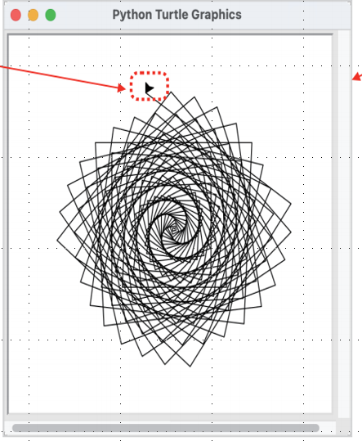
turtle Graphics
import turtle turtle.setup (width = 400, height = 400) t = turtle.Turtle () for i in range(200): t.forward(i) t.left(93) turtle.done()

Slide 3
터틀 그래픽 – 삼각형 그리기
import turtle t = turtle.Turtle() t.shapesize(2,2) t.shape("turtle") t.forward(100) t.left(120) t.forward(100) t.left(120) t.forward(100) t.left(120) turtle.done()
import turtle t = turtle.Turtle() for _ in range(3): t.forward(100) t.left(120) turtle.done()

Slide 4
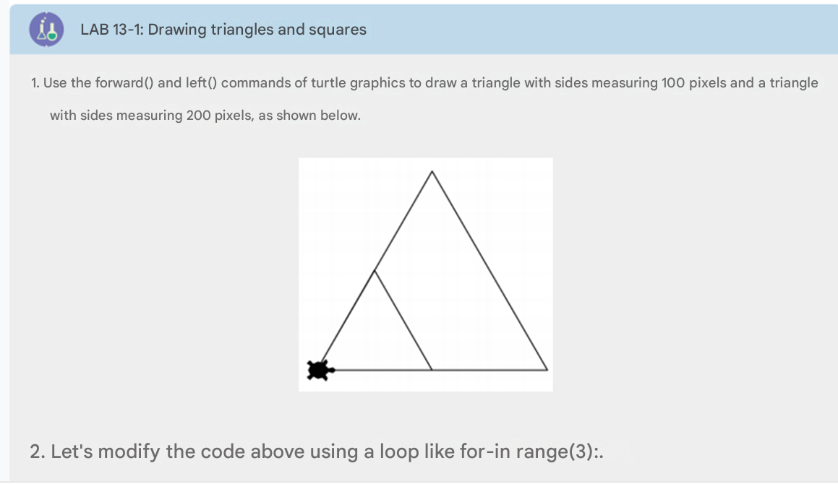
Turtle Graphics

Slide 5
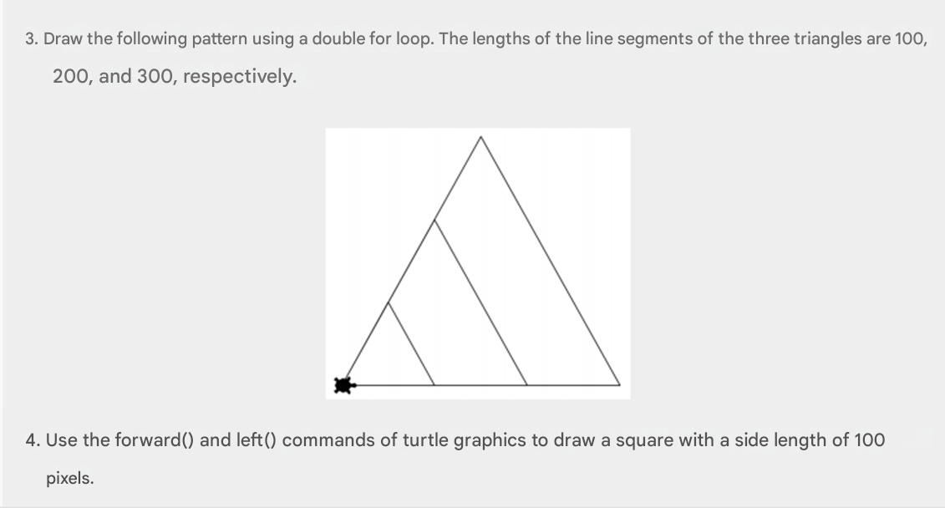
Turtle Graphics

Slide 6
Code
import turtle
turtle.setup(width=600, height=600)
t = turtle.Turtle()
side_lengths = [100, 200]
  for length in side_lengths:
for _ in range(3):
t.forward(length)
t.left(120)

Slide 7
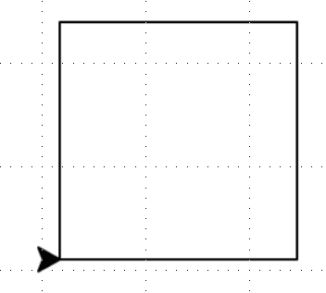
turtle Graphics – Square Drawing
import turtle t = turtle.Turtle () for _ in range( 4 ): t.forward (100) t.left ( 90 ) turtle.done ()

Slide 8
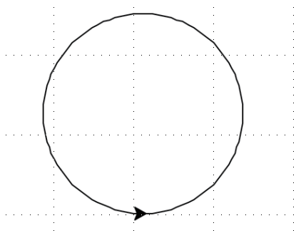
turtle Graphics – Drawing Circles
import turtle t = turtle.Turtle () n = 100 length = 5 for i in range(n): t.left (360/n) t.forward (length) turtle.done ()

Slide 9
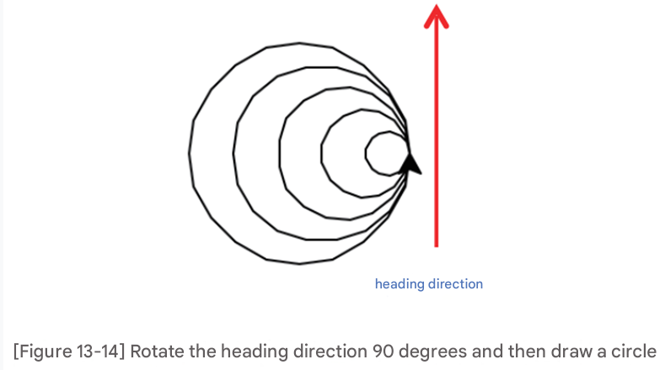
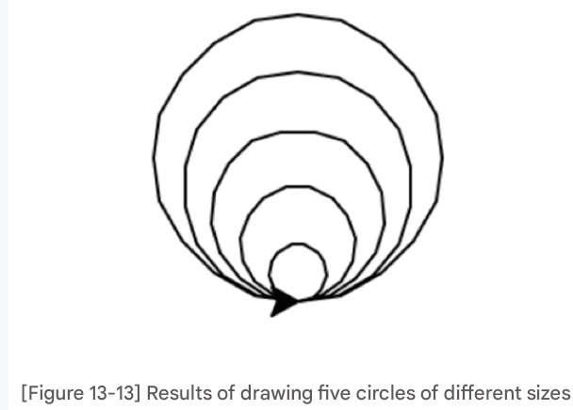
turtle Graphics – Drawing Circles

Slide 10
Code: 13-13, 13-14
import turtle
t = turtle.Turtle()
# Draw 5 "circles" using polygons
for size in [10, 20, 30, 40, 50]:
for _ in range(36): #36 steps make a rough circle
t.forward(size)
t.left(10) # 10° × 36 = 360°
turtle.done()
import turtle
t = turtle.Turtle()
# Draw 5 "circles", rotating the turtle before each
for size in [10, 20, 30, 40, 50]:
t.left(90) # Turn to face up
for _ in range(36):
t.forward(size)
t.left(10)
t.right(90) # Turn back to normal
turtle.done()

Slide 11
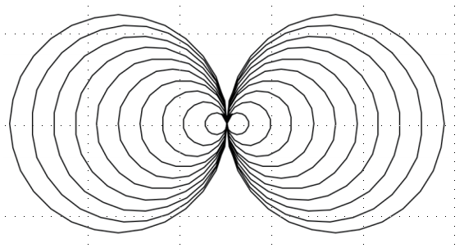
turtle Graphics – Drawing Circles
import turtle as t t1 = t.Turtle() t1.setheading(90) # Point upward # Draw 10 circles growing upward for i in range(1, 11): t1.circle(10 * i) t1.setheading(270) # Point downward # Draw 10 circles growing downward for i in range(1, 11): t1.circle(10 * i) t.done()

Slide 12
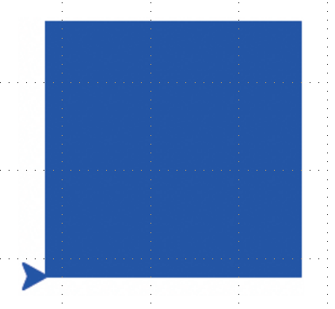
turtle Graphics – Coloring
import turtle t = turtle.Turtle () t.color('blue') t.begin_fill() for _ in range(4): t.forward(100) t.left(90) t.end_fill() turtle.done()

Slide 13
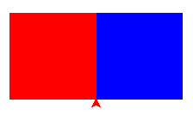
import turtle t = turtle.Turtle() t.color('blue') t.begin_fill() for _ in range(4): t.forward(100) t.left(90) t.end_fill() t.setheading(90) t.color('red') t.begin_fill() for _ in range(4): t.forward(100) t.left(90) t.end_fill() turtle.done()
Turtle Graphics – Coloring

Slide 14
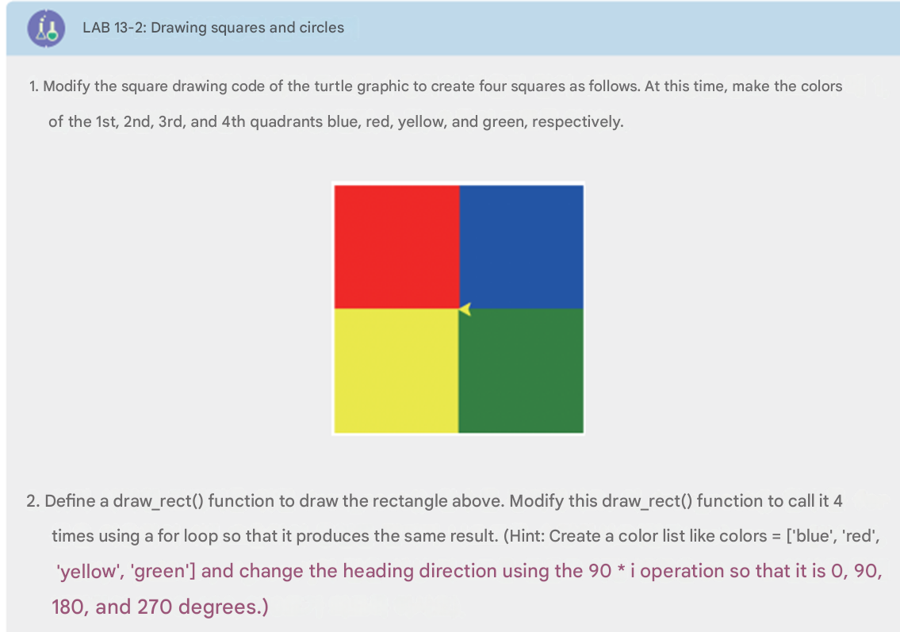
turtle Graphics – Coloring

Slide 15
Code
import turtle
t = turtle.Turtle()
t.speed(0)
colors = ['blue', 'red', 'yellow', 'green'] # Quadrant 1 to 4
def draw_rect(color):
t.fillcolor(color)
t.begin_fill()
for _ in range(4):
t.forward(100)
t.left(90)
t.end_fill()
for i in range(4):
t.setheading(90 * i) # 0, 90, 180, 270
draw_rect(colors[i])
turtle.done()

Slide 16
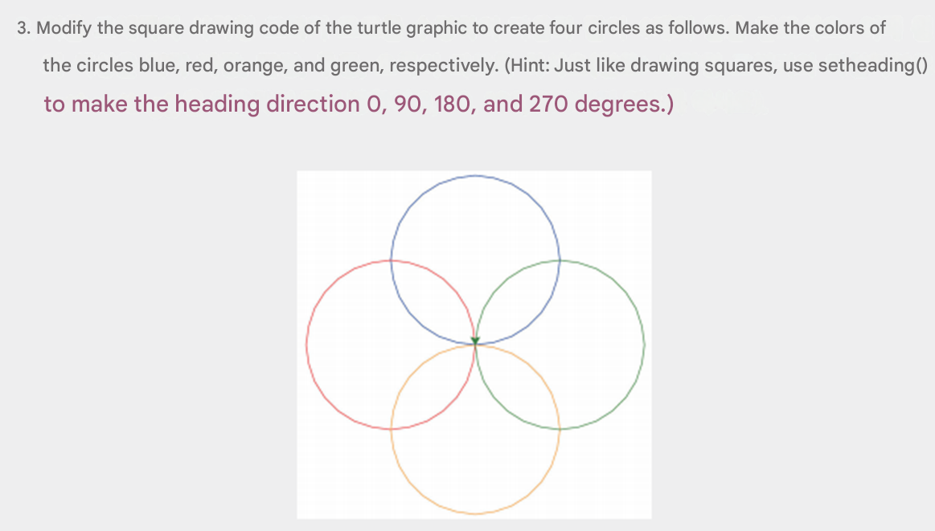
turtle Graphics – Coloring

Slide 17
Code
import turtle
t = turtle.Turtle()
t.speed(0)
colors = ['blue', 'red', 'orange', 'green']
for i in range(4):
t.pencolor(colors[i])
t.setheading(90 * i) # 0, 90, 180, 270
t.circle(100)
turtle.done()

Slide 18
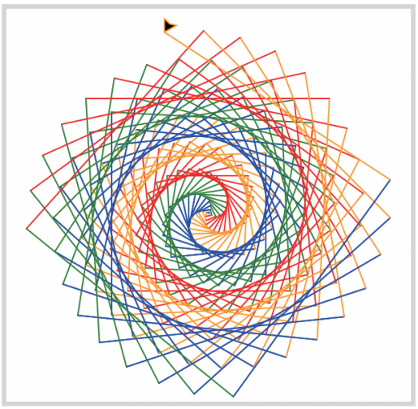
painting Drawing
import turtle t = turtle.Turtle () colors = ['red', 'green', 'blue', 'orange'] for i in range(200): t.pencolor (colors[ i % 4]) t.forward ( i ) t.left (93) turtle.done ()

Slide 19
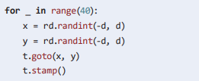
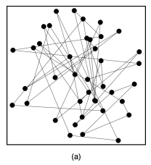
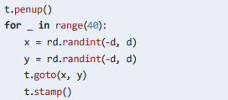
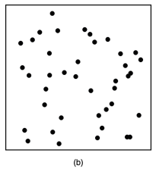
painting
import turtle import random as rd t = turtle.Turtle () t.shape ("circle") d = 300
After drawing a straight line, stamp it.
Just stamp without drawing a straight line

Slide 20
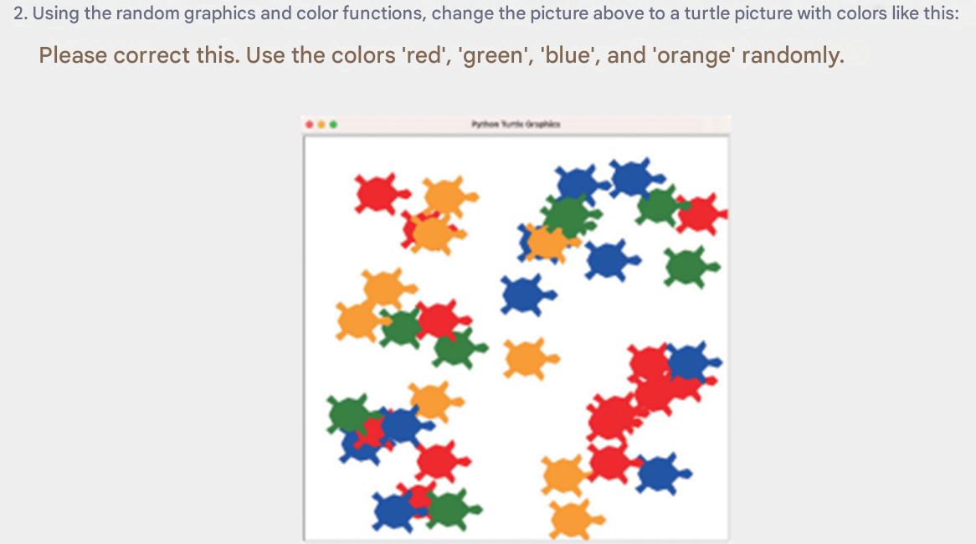
painting

Slide 21
Code
import turtle
import random
# Setup screen
screen = turtle.Screen()
screen.bgcolor("white")
# Make turtle object
t = turtle.Turtle()
t.shape("turtle")
t.penup()
t.speed(0)
#Colors to use
colors = ['red', 'green', 'blue', 'orange']
# Draw 50 turtles at random spots and colors
for _ in range(50):
x = random.randint(-200, 200)
y = random.randint(-200, 200)
color = random.choice(colors)
t.goto(x, y)
t.color(color)
t.stamp() # Leave a turtle stamp
turtle.done()

Slide 22
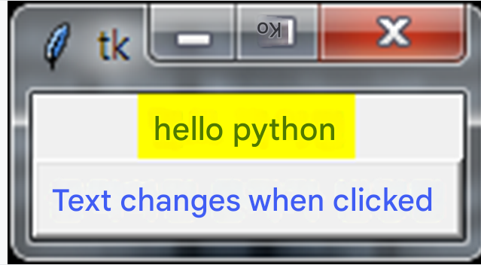
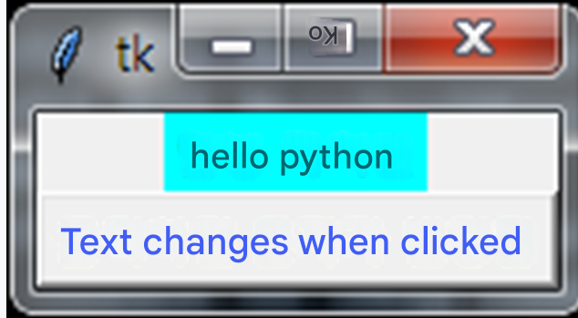
Tkinter Module

Slide 23
from tkinter import * def change_label (): if label.cget ("text") == ' hello Python ': label.config (text = ' Hello Python ') label.config ( bg = 'cyan') else : label.config (text = ' Hello Python ') label.config ( bg = 'yellow') window = Tk() label = Label(window, text = ' Hello Python ', bg = 'yellow') label.pack () btn = Button(window, text = ' Click to change text ', fg = 'blue', command = change_label ) btn.pack () window.mainloop ()
Tkinter
Module

Slide 24
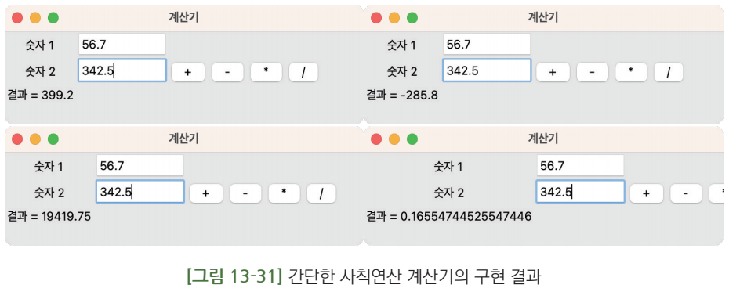
Tkinter Module - Calculator

Slide 25
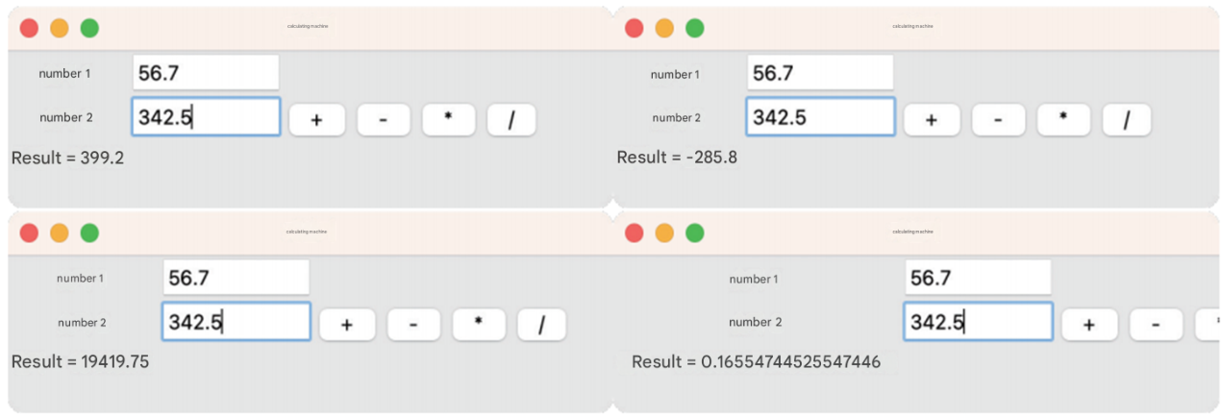
Tkinter Module - Calculator

Slide 26
def subtract(): res_text = "결과 = " + str(float(num1.get()) - float(num2.get())) res_label.configure(text = res_text) def multiplication(): res_text = "결과 = " + str(float(num1.get()) * float(num2.get())) res_label.configure(text = res_text) def division(): res_text ="결과 = " + str( float(num1.get()) / float(num2.get())) res_label.configure(text = res_text) btn_plus = Button(window, text = "+", command = add) btn_minus = Button(window, text = "-", command = subtract) btn_mult = Button(window, text = "*", command = multiplication) btn_div = Button(window, text = "/", command = division) btn_plus.grid(column = 2, row = 1) btn_minus.grid(column = 3, row = 1) btn_mult.grid(column = 4, row = 1) btn_div.grid(column = 5, row = 1) window.mainloop()
Tkinter 모듈 - 계산기
from tkinter import * window = Tk() window.title("계산기") window.geometry('350x200’) Label(window, text = "숫자 1").grid(column = 0, row = 0) Label(window, text = "숫자 2").grid(column = 0, row = 1) res_label = Label(window, text = "결과 :") res_label.grid(column = 0, row = 2) num1 = Entry(window, width = 10) num2 = Entry(window, width = 10) num1.grid(column = 1, row = 0) num2.grid(column = 1, row = 1) def add(): res_text = "결과 = " + str(float(num1.get()) + float(num2.get())) res_label.configure(text = res_text)

