Slide 1
Computer Programming Python Practice (Computer Programming
Chapter 12. NumPy
The contents of this lecture's textbook are quoted / excerpted from " Eutumn Python Revised Edition ( written by Dong-gyu Park / Young-min Kang ) "

Slide 2
NumPy library
>>> import numpy as np >>> a = np.array ([1, 2, 3]) # numpy ndarray Creating an object >>> a >>> a.shape #This returns the shape of the array (it's a 1-dimensional array with 3 elements) >>> a.ndim #This returns the number of dimensions (It's a 1-dimensional array.) >>> a.dtype #This returns the data type of the elements >>> a.itemsize #This gives the size (in bytes) of each element in the array (8 for int64, or 4 for int32) >>> a.size #This returns the total number of elements

Slide 3
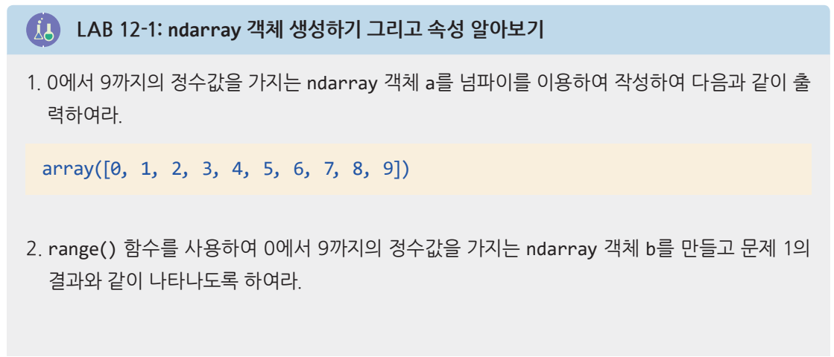
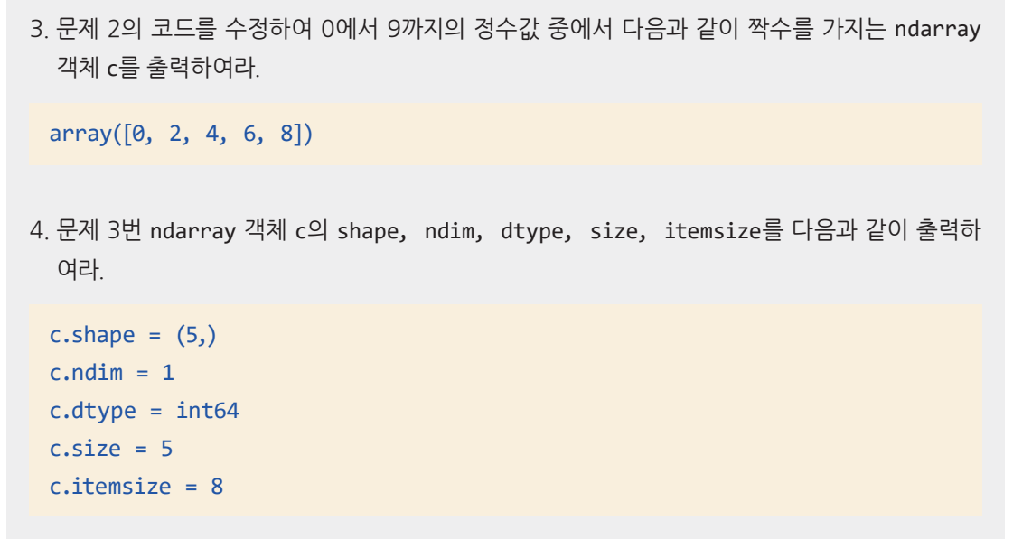
ndarray generation

Slide 4
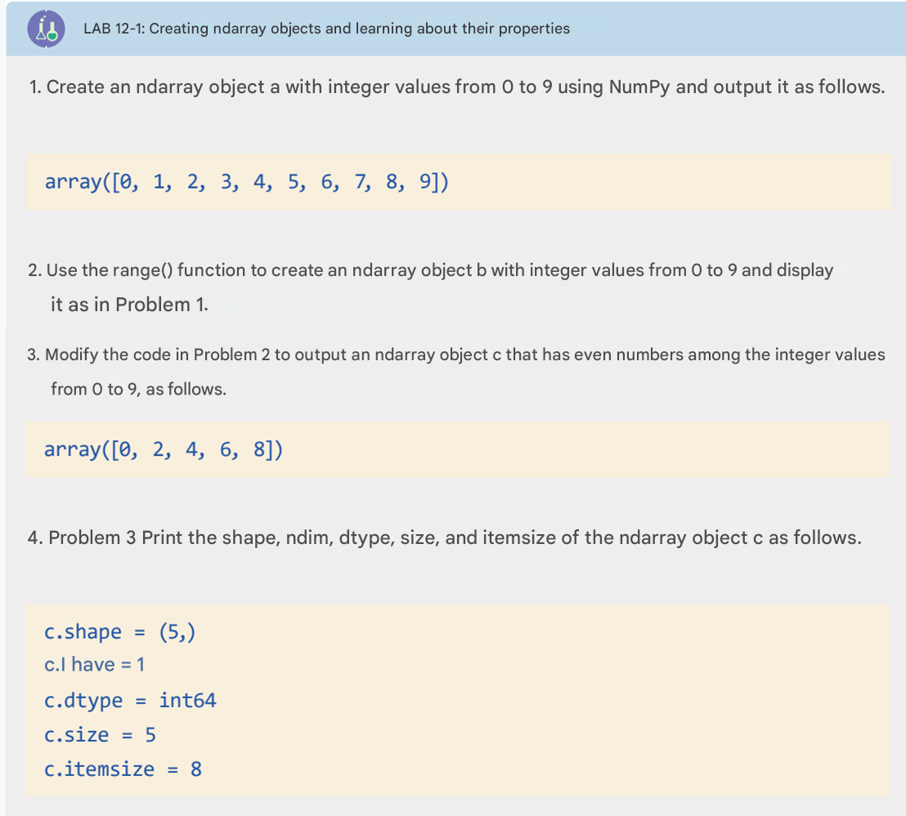
ndarray generation

Slide 5
Solved Problem: 1
import numpy as np
a = np.array([0, 1, 2, 3, 4, 5, 6, 7, 8, 9])
print(a)
Solved Problem: 3
c = np.array([0, 2, 4, 6, 8])
print(c)
Or
c = np.arange(0, 10, 2)
print(c)
Solved Problem: 2
b = np.array(range(10))
print(b)
Solved Problem: 4
print("c.shape =", c.shape)
print("c.ndim =", c.ndim)
print("c.dtype =", c.dtype)
print("c.size =", c.size)
print("c.itemsize =", c.itemsize)

Slide 6
ndarray Methods and main functions
>>> a = np.array([1, 2, 3]) >>> a.max() #Returns the maximum value → 3 >>> a.min() # Returns the minimum value → 1 >>> a.mean() # Returns the mean (average) → 2.0 >>> a = np.array([[1, 1], [2, 2], [3, 3]]) >>> a.flatten() #Flattens the 2D array into a 1D array: array([1, 1, 2, 2, 3, 3]) >>> a = np.array([1, 2, 3]) >>> b = np.array([[4, 5, 6], [7, 8, 9]]) >>> np.append(a, b) #Appends b (flattened) to a: array([1, 2, 3, 4, 5, 6, 7, 8, 9]) >>> np.append([a], b, axis = 0) >>> np.random.rand (3, 3) #Creates a 3×3 array of random floats in [0, 1] >>> np.random.randint (0, 10, size = 10)

Slide 7
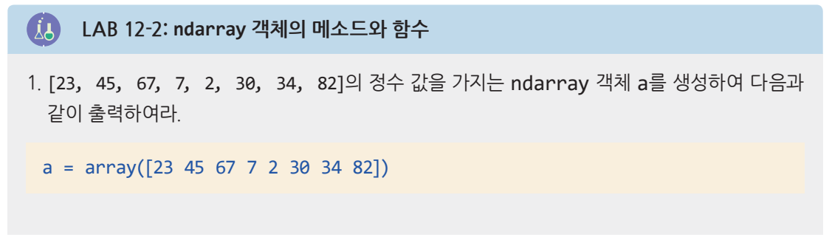
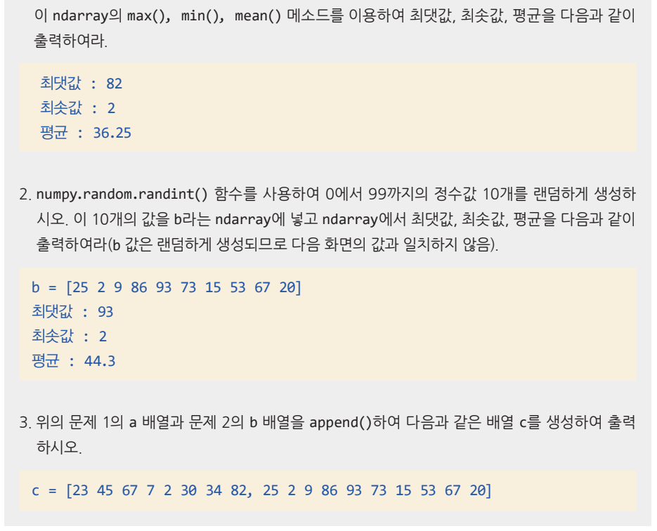
ndarray Methods and main functions

Slide 8
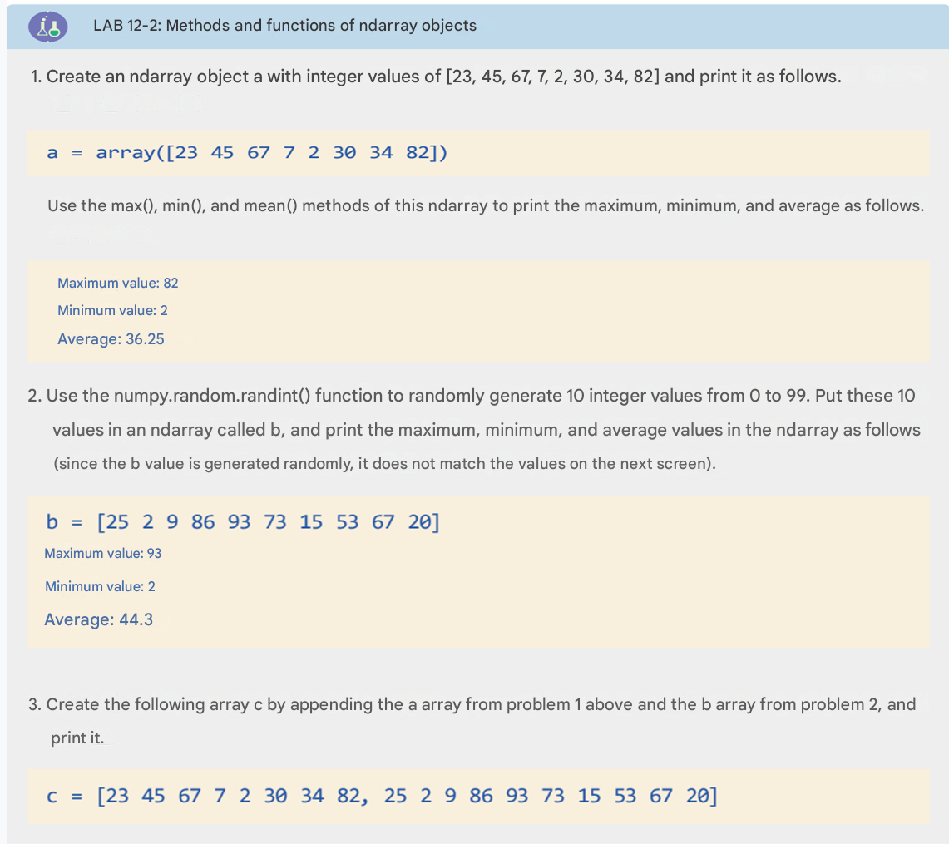
ndarray Methods and main functions

Slide 9
Solved Problem 1
import numpy as np
a = np.array([23, 45, 67, 7, 2, 30, 34, 82])
print("a =", a)
print("Maximum value:", a.max())
print("Minimum value:", a.min())
print("Average:", a.mean())
Solved Problem 3
c = np.append(a, b)
print("c =", c)
Solved Problem 2
b = np.random.randint(0, 100, size=10)
print("b =", b)
print("Maximum value:", b.max())
print("Minimum value:", b.min())
print("Average:", b.mean())

Slide 10
Operations on
>>> a = np.array ([1, 2, 3]) >>> b = np.array ([4, 5, 6]) >>> c = a + b >>> c #Each element is added with the corresponding element from the other array: → [1+4, 2+5, 3+6]
>>> sal = np.array ([300, 360, 400, 380]) >>> sal_w_bonus = sal + 100 # Adds a flat bonus >>> sal_inc = sal * 1.2 # Applies a 20% increase >>> print( sal_w_bonus, sal_inc) # [400 460 500 480] [360. 432. 480. 456.]

Slide 11
ndarray의 연산
>>> a = np.array([[1, 2], [3, 4]]) >>> b = np.array([[10, 20], [30, 40]]) >>> a + b >>> a - b >>> a * b >>> a / b

Slide 12
ndarray의 연산
>>> a = np.array([[1, 2], [3, 4]]) >>> b = np.array([[10, 20], [30, 40]]) >>> np.matmul(a, b) >>> a @ b >>> a[0,0] * b[0,0] + a[0,1] * b[1,0] >>> a[0,0] * b[0,1] + a[0,1] * b[1,1] >>> a[1,0] * b[0,0] + a[1,1] * b[1,0] >>> a[1,0] * b[0,1] + a[1,1] * b[1,1] >>> a = [[1, 2], [3, 4]] >>> b = [[1, 0], [0, 1]] >>> np.matmul(a, b)
a = [[1, 2],
[3, 4]]
b = [[10, 20],
[30, 40]]
[
[1*10 + 2*30, 1*20 + 2*40], → [70, 100]
[3*10 + 4*30, 3*20 + 4*40] → [150, 220]
]

Slide 13
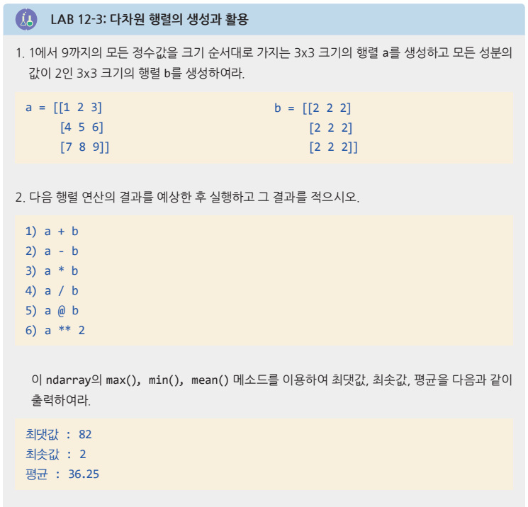
Operations on

Slide 14
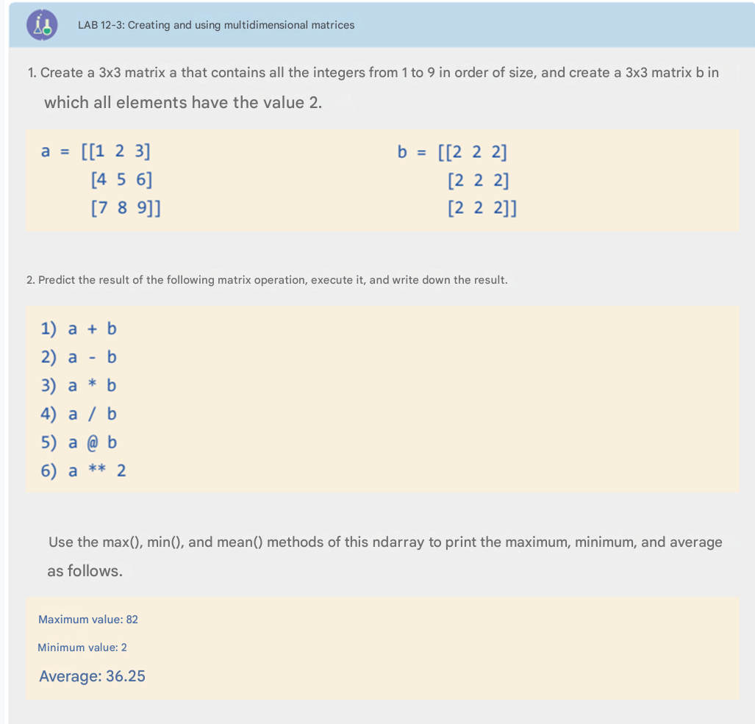
Operations on

Slide 15
import numpy as np
a = np.array([[1, 2, 3],
[4, 5, 6],
[7, 8, 9]])
b = np.array([[2, 2, 2],
[2, 2, 2],
[2, 2, 2]])
a+b
[[ 3 4 5]
[ 6 7 8]
[ 9 10 11]]

Slide 16
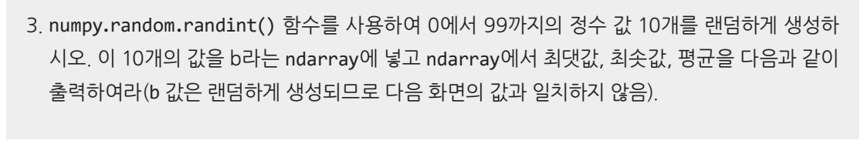
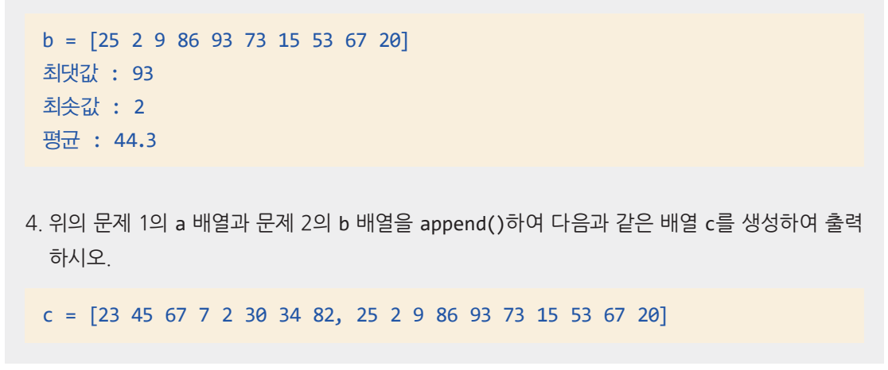
Operations on

Slide 17
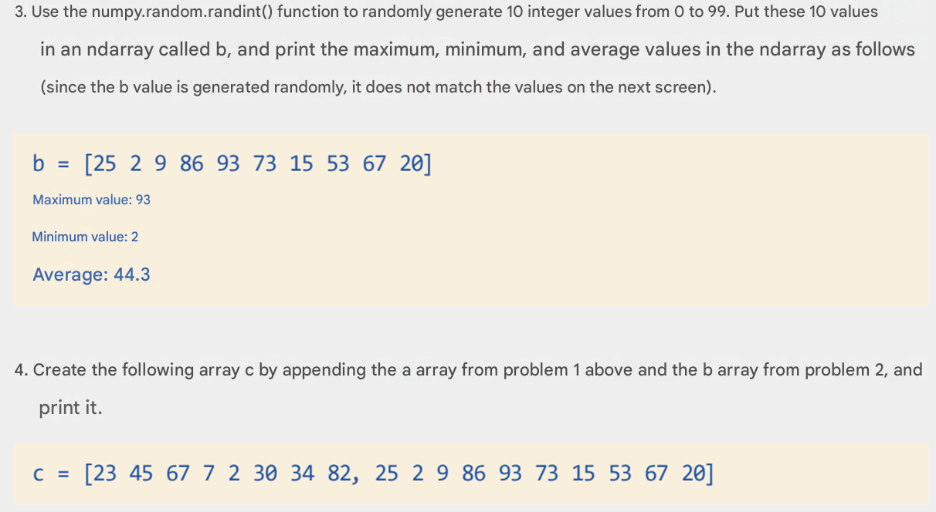
Operations on

Slide 18
Step 3:
import numpy as np
b = np.random.randint(0, 100, size=10)
print("b =", b)
print("최댓값 (Max):", b.max())
print("최솟값 (Min):", b.min())
print("평균 (Mean):", b.mean())
Step 4:
a = np.array([23, 45, 67, 7, 2, 30, 34, 82])
c = np.append(a, b)
print("c =", c)
c = [23 45 67 7 2 30 34 82 25 2 9 86 93 73 15 53 67 20]

Slide 19
various Creating a matrix
>>> np.zeros ((2, 3)) #Creates a 2×3 array filled with zeros >>> np.ones((2, 3)) #Creates a 2×3 array filled with ones >>> np.full((2, 3), 100) #Creates a 2×3 array filled with 100 >>> np.eye(3) #Creates a 3×3 identity matrix >>> np.random.random((2, 3)) #Creates a 2×3 array of random floats between 0 and 1 >>> np.arange(0, 10, 2) #Creates a 1D array starting at 0, stopping before 10, in steps of 2 >>> np.arange(0.0, 1.0, 0.2) #Creates a 1D array of floats >>> np.linspace(0, 10, 4) #Creates 4 evenly spaced numbers between 0 and 10

Slide 20
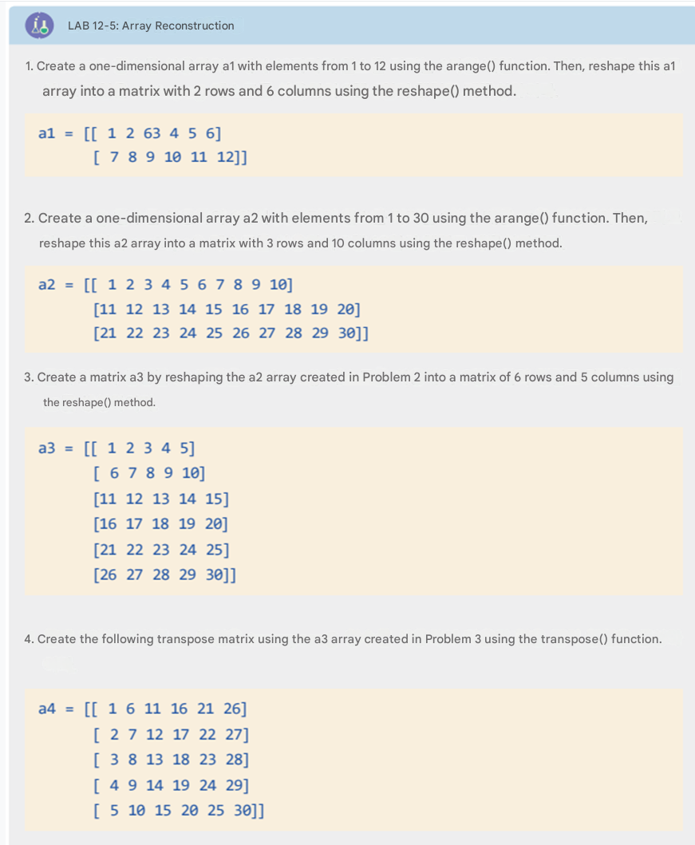
ndarray의 재구성

Slide 21
import numpy as np
# Step 1: Create a 4x4 array with values from 0 to 15
a = np.arange(16).reshape(4, 4)
print("Original 4x4 Array (a):\n", a)
# -------------------------------
# Extracting specific slices
# -------------------------------
# b = [1, 5, 9, 13] → 2nd column
b = a[:, 1]
print(“\nb (2nd column):", b)
# c = [9, 10, 11] → row 3, columns 2 to 4
c = a[2, 1:]
print("c (row 3, columns 2–4):", c)
# d = [[0, 1], [4, 5]] → top-left 2×2 submatrix
d = a[0:2, 0:2]
print("d (top-left 2x2):\n", d)
# e = [[5, 6], [9, 10]] → middle 2x2 block
e = a[1:3, 1:3]
print("e (middle 2x2):\n", e)
# -------------------------------
# Step 2: Flattened slices
# -------------------------------
# f = [0, 1, 2, 4, 5, 6] → first 2 rows, first 3 columns
f = a[0:2, 0:3].flatten()
print("\nf (flattened top-left 2x3):", f)
# g = [8, 9, 10, 11, 12, 13, 14, 15] → bottom 2 rows
g = a[2:4, :].flatten()
print("g (flattened bottom 2 rows):", g)
# h = [5, 6, 7, 13, 14, 15] → last 3 columns of 2nd and 4th rows
h = np.concatenate((a[1, 1:], a[3, 1:]))
print("h (combined row 2 and 4, cols 2–4):", h)

Slide 22
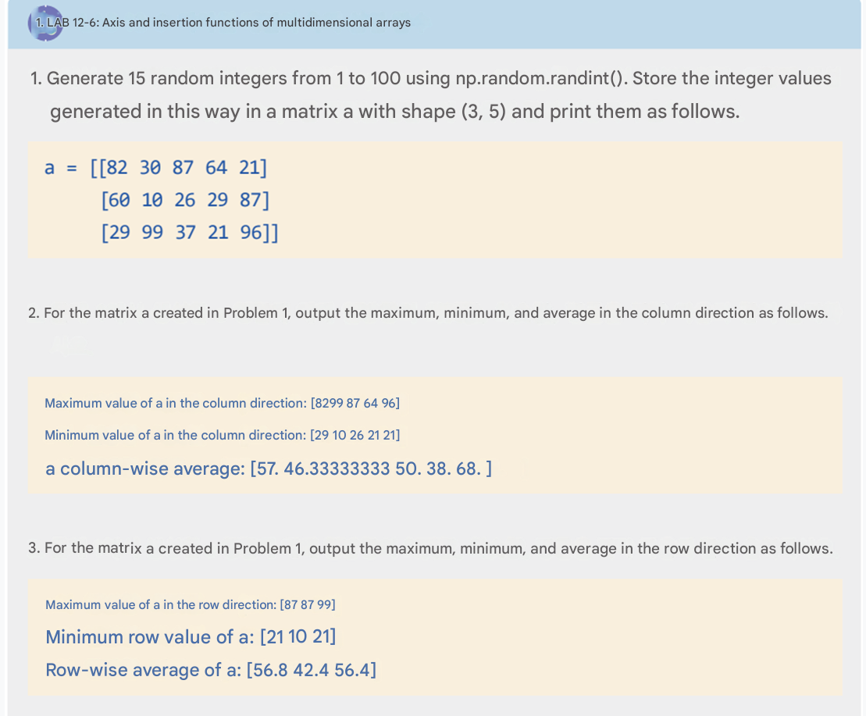
다차원 배열의 축

Slide 23
import numpy as np
# Step 1: Create a 3×5 matrix of random integers (1 to 100)
a = np.random.randint(1, 101, size=(3, 5))
print("Matrix a:\n", a)
# Step 2: Column-wise stats (axis=0)
col_max = np.max(a, axis=0)
col_min = np.min(a, axis=0)
col_mean = np.mean(a, axis=0)
print("\nColumn-wise maximum:", col_max)
print("Column-wise minimum:", col_min)
print("Column-wise average:", col_mean)
# Step 3: Row-wise stats (axis=1)
row_max = np.max(a, axis=1)
row_min = np.min(a, axis=1)
row_mean = np.mean(a, axis=1)
print("\nRow-wise maximum:", row_max)
print("Row-wise minimum:", row_min)
print("Row-wise average:", row_mean)

Slide 24
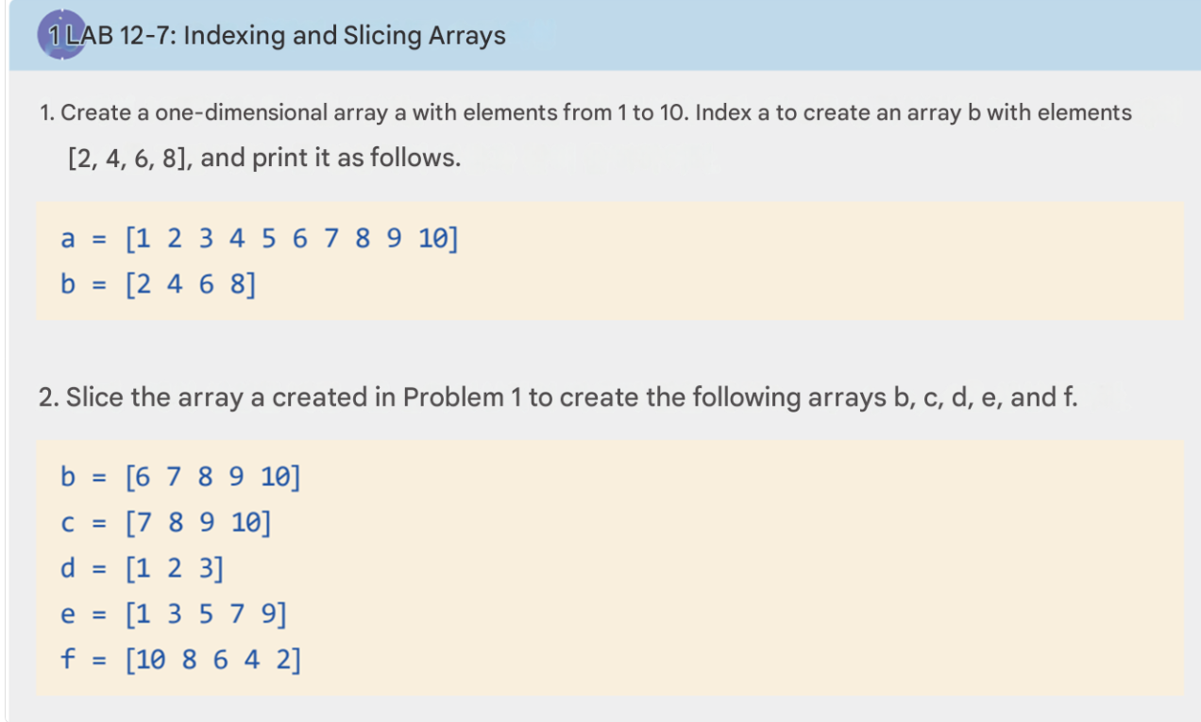
slicing

Slide 25
import numpy as np
# Step 1: Create a one-dimensional array with values 1 to 10
a = np.array([1, 2, 3, 4, 5, 6, 7, 8, 9, 10])
print("a =", a)
# Create array b using specific indexing: [2, 4, 6, 8]
b1 = a[[1, 3, 5, 7]] # Indexing is 0-based
print("b (indexed) =", b1)
# Step 2: Slicing to create b, c, d, e, and f
b2 = a[5:10] # [6 7 8 9 10]
c = a[6:] # [7 8 9 10]
d = a[:3] # [1 2 3]
e = a[::2] # [1 3 5 7 9]
f = a[::-2] # [10 8 6 4 2] → reverse with step 2
print("\nb (slice) =", b2)
print("c =", c)
print("d =", d)
print("e =", e)
print("f =", f)
a[[i1, i2, i3]] → fancy indexing (specific positions)
a[start:stop] → standard slicing
a[::step] → step slicing
a[::-1] → reverse array

Slide 26

slicing

Slide 27
import numpy as np
# Step 1: Create array a with elements 1 to 10
a = np.array([1, 2, 3, 4, 5, 6, 7, 8, 9, 10])
print("a =", a)
# Create b using specific indexing (elements 2, 4, 6, 8)
# Note: Python uses 0-based indexing, so positions: 1, 3, 5, 7
b1 = a[[1, 3, 5, 7]]
print("b (indexed elements 2, 4, 6, 8) =", b1)
# Step 2: Create slices b, c, d, e, f from array a
b = a[5:] # [6, 7, 8, 9, 10]
c = a[6:] # [7, 8, 9, 10]
d = a[:3] # [1, 2, 3]
e = a[::2] # [1, 3, 5, 7, 9] → every second element
f = a[::-2] # [10, 8, 6, 4, 2] → reversed with step of 2
print("\nb =", b)
print("c =", c)
print("d =", d)
print("e =", e)
print("f =", f)
Array Name | Output | Description
b1 | [2, 4, 6, 8] | Indexed values from array a
b | [6, 7, 8, 9, 10] | Slice from index 5 to end
c | [7, 8, 9, 10] | Slice from index 6 to end
d | [1, 2, 3] | Slice from start to index 3
e | [1, 3, 5, 7, 9] | Every second element (step = 2)
f | [10, 8, 6, 4, 2] | Reverse with step 2

Slide 28
Indexing of 2D & High
>>> a = np.arange (0, 6).reshape(3, 2) #a = [[0, 1], [2, 3], [4, 5]] >>> a >>> print(a[0, 0]) # → 0 >>> print(a[0, 1]) # → 1 >>> print(a[0, 2]) # ❌ IndexError (only 2 columns: indices 0 and 1)
>>> a = np.arange (0, 24).reshape(4, 3, 2) >>> a >>> print(a[1, 2, 1]) >>> a[0] # 2D block: shape (3, 2) >>> a[0, 0] # 1st row of 1st block: shape (2,) >>> a[0, 1] # Element at position [0][1] >>> a[0, 2] # 3rd row of 1st block: shape (2,) >>> np.concatenate ((a[0, 0], a[0, 2]), axis = 0) #a[0, 0] and a[0, 2] are both 1D arrays of shape (2,) Concatenating along axis 0 results in a 1D array of length 4 *Note: reshape is a NumPy method that allows you to change the shape (dimensions) of an array without changing its data.

Slide 29
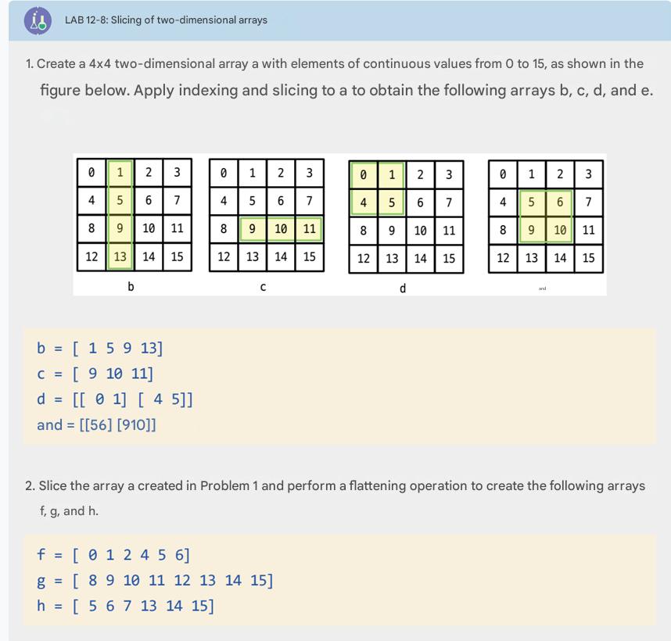
Indexing of 2D & High

Slide 30
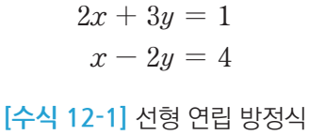
Solving linear equations , determinants
import numpy as np a = np.array ([[2, 3], [1, -2]]) b = np.array ([1, 4]) x = np.linalg.solve (a, b) print(x)

Slide 31
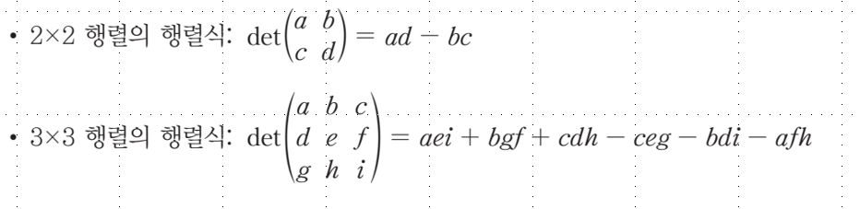
Solving linear equations , determinants
>>> a = np.array ([[1, 2], [3, 4]]) >>> np.linalg.det (a) >>> b = np.array ([[1, 2], [3, -6]]) >>> np.linalg.det (b) >>> b = np.array ([[1, 2], [1, 2]]) >>> np.linalg.det (b)

