Slide 1
Robot OS
Prof: Ryu Jaehwan
Presenter: Rasim Mahmudov
Date: 20-May-25

Slide 2
Related papers
SmoothQuant: Accurate and Efficient Post-Training Quantization for Large Language Models (Ref1)
LLM-QAT: Data-Free Quantization Aware Training for Large Language Models (Ref2)
PrefixQuant: Eliminating Outliers by Prefixed Tokens for Large Language Models Quantization (Ref3)
MobileQuant: Mobile-friendly Quantization for On-device Language Models (Ref4)
EfficientQAT: Efficient Quantization-Aware Training for Large Language Models (Ref5)
HAWQ-V3: Dyadic Neural Network Quantization (Ref6)

Slide 3
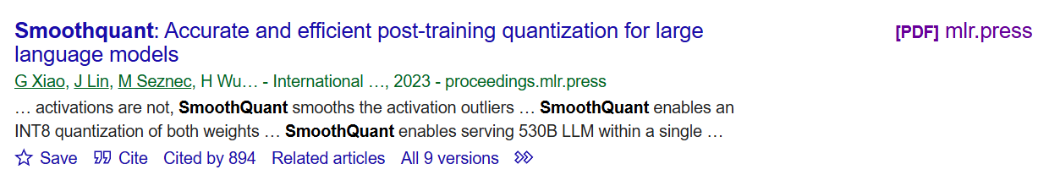
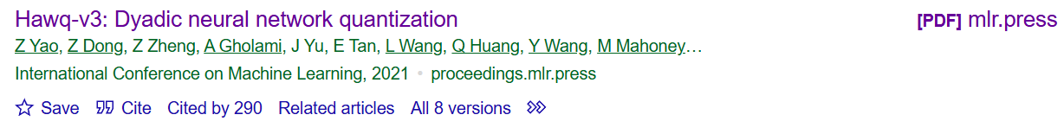
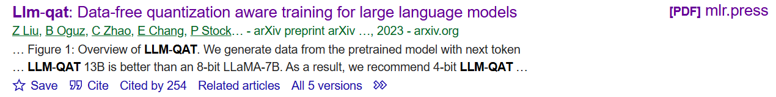

Slide 4
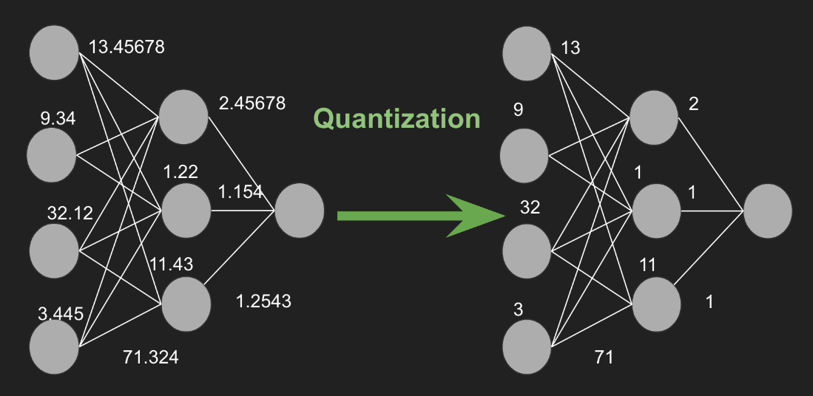
🔹 What is Quantization?🔹
Quantization is a technique used to reduce the precision of numerical values (like weights and activations) in a neural network to make models smaller, faster, and more efficient.
Why Use Quantization?
✅ Reduces model size → Saves memory (RAM, storage).
✅ Speeds up inference → Lower precision means faster computations.
✅ Consumes less power → Useful for edge AI, mobile devices, and IoT.
✅ Enables deployment on specialized hardware → Optimized for CPUs, GPUs, TPUs, and NPUs.

Slide 5
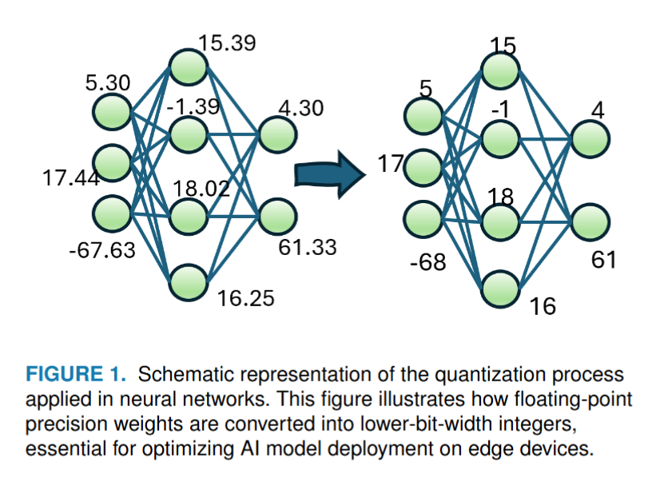

Slide 6
🔹 How Does Quantization Work? 🔹
Floating-Point to Integer Conversion
  Standard AI models use FP32 (32-bit floating point) for weights and activations.
  Quantization maps FP32 values to lower-precision formats like int8 (8-bit integer) or int4 (4-bit integer).
Scaling & Zero-Point Adjustments
  Quantization uses a scale factor and zero-point to maintain numerical accuracy.
  Formula: Q=round (X/S)+Z
  where:
    Q = Quantized value
    X = Original value
    S = Scale factor
    Z = Zero-point (offset)

Slide 7
🔹 Types of Quantization 🔹
These are the most famous and main types of DL Quantization.
Post-Training Quantization (PTQ)
  Converts a trained FP32 model into a lower-bit version (int8, int4).
  Faster inference, but may lose accuracy.
Quantization-Aware Training (QAT)
  Model is trained while simulating quantization effects.
  Better accuracy than PTQ.

Slide 8
🔹 Common Quantization Formats 🔹
Format | Precision | Example Use Case
FP32 | 32-bit floating point | Standard deep learning models
FP16 | 16-bit floating point | GPUs & TPUs for efficient training
int8 | 8-bit integer | Most common for AI inference
int4 | 4-bit integer | Extreme compression, edge AI
binary (1-bit) | 1-bit (0/1) | Highly efficient, but less accurate

Slide 9
🔹 Where is Quantization Used? 🔹
Mobile AI (TensorFlow Lite, Core ML, ONNX Runtime)
Edge devices (NVIDIA Jetson, Raspberry Pi)
Large Language Models (GPT, Llama, BERT)
Computer Vision (YOLO, MobileNet, ResNet)

Slide 10
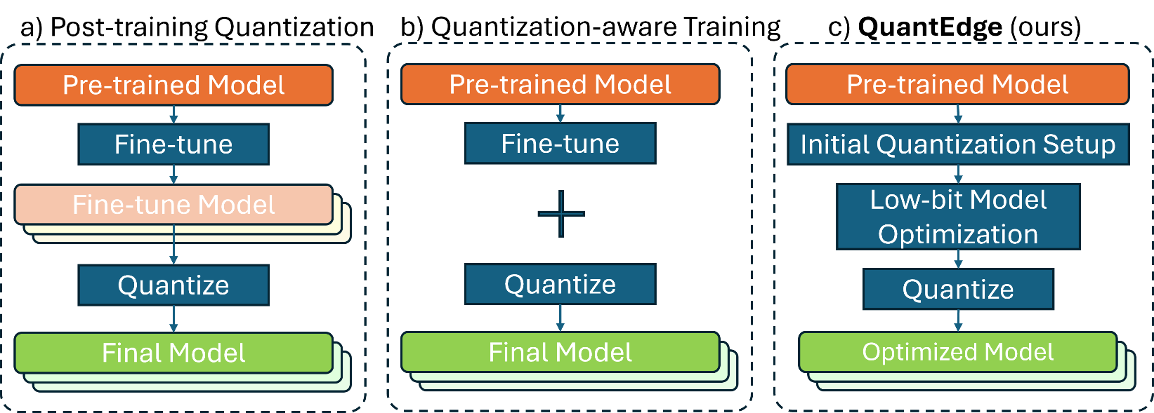
Post-Training Quantization (PTQ) vs Quantization-Aware Training (QAT)
Aspect | PTQ | QAT
Timing | After model training | During model training
Process | Quantizes weights and activations based on distributions | Simulates quantization effects during training
Pros | Quick, easy to implement | Better preserves accuracy; allows detailed tuning
Cons | Can reduce accuracy; less precision control | More resource-intensive; complex to implement
Usage | Fast deployment with acceptable accuracy loss | Optimal accuracy in resource-available scenarios

Slide 11
🔹 My contributions 🔹
A novel approach for memory optimization in Edge devices: QuantEdge
Dynamic PU adaptivity.
Optimization, evaluation, and comparison of AI models for Emotion Recognition, Driver Profiling, Speech Recognition, and Object Detection using Post-Training Quantization (PTQ) and Quantization-Aware Training(QAT).
Evaluation of optimization frameworks like TensorFlowLite, OpenVINO, TensorFlow TensorRT, TensorRT, and model quantization for edge deployment.
Benchmarking of various hardware platforms, including Raspberry Pi 4, NVIDIA Jetson AGX Xavier, Kubernetes powered cluster, Asus Edge R / T (R as NPU, T as TPU).
Provision of open-source benchmarking templates using publicly available vision libraries, ensuring easy reproducibility.

Slide 12
Arc | Device Name | Memory | TOPS | Power C. (W) | Architecture | Precision Support | Framework Compatibility
CPU/GPU | AGX Xavier | 16GB | 32 | 30 | Volta | FP32, FP16, INT8 | CUDA, cuDNN, TensorRT
 | AGX ORIN | 64GB | 200 | 60 | Ampere | FP32, FP16, INT8 | CUDA, cuDNN, TensorRT
 | Edge Cluster 5X AGX | 160GB | 160 | 250 | Volta | FP32, FP16, INT8 | CUDA, cuDNN, TensorRT
 | Raspberry Pi 4 | 2GB | 0.02 | 2.7 – 7 | Cortex-A72 | FP16, INT8 | TensorFlow Lite, PyTorch
NPU | S22 Ultra | 12GB | 0.4 | 0.5 – 5 | Exynos/Qua. | FP32, FP16 | One UI SDK (ML only)
 | Asus Tinker Edge R | 4GB | 1.5 | 3 | Rockchip RK3399Pro | FP32, FP16 | TensorFlow Lite, Edge TPU
TPU | Asus Tinker Edge T | 1GB | 1 | 2 | Cortex-A53 | FP32 | TensorFlow Lite
GPU | RTX 3080Ti | 12GB | 150 | 300 | Ampere | FP32, FP16, INT8 | CUDA, cuDNN, TensorRT
 | RTX A6000 | 48GB | 320 | 400 | Ampere | FP32, FP16, INT8 | CUDA, cuDNN, TensorRT
Specs for various devices can be AI deployed

Slide 13
🔹 Comparison the other papers / methods 🔹
Paper / Method | Type | Pros | Cons | Contributions | Model Performance | Resource Efficiency
Efficient QAT | QAT | Efficient training, reduced accuracy loss | High computational cost | Two-phase QAT, enhanced solution space | High accuracy in low-bit models | More efficient than traditional QAT
Prefix Quant | PTQ and QAT | Handles token-wise outliers, faster inference | Requires token calibration | Novel outlier management, speed improvements | Improved accuracy and speed | High efficiency in dynamic/static settings
LLM-QAT | QAT | Data-free, handles weights and activations | Complex implementation | First data-free QAT, comprehensive quantization | High performance in zero-shot and low-bit settings | High, given the data-free approach
Smooth Quant | PTQ | Simple implementation, minimal downtime | Limited in lower bit precision | Smoothing errors effectively | Good performance with minimal loss | Low resource demand
Zero Quant | QAT | Optimized for zero-shot, synthetic data use | High computational demand, data quality concerns | Enhances zero-shot learning with QAT | Tailored for high-performance zero-shot learning | Requires significant resources for data generation
Mobile Quant | PTQ | Optimized for On-Device systems | Slow performance on some unsupported devices | Adaptability for devices which have less power consumption | High accuracy, less memory usage | Low resource demand on on-device AI systems

Slide 14
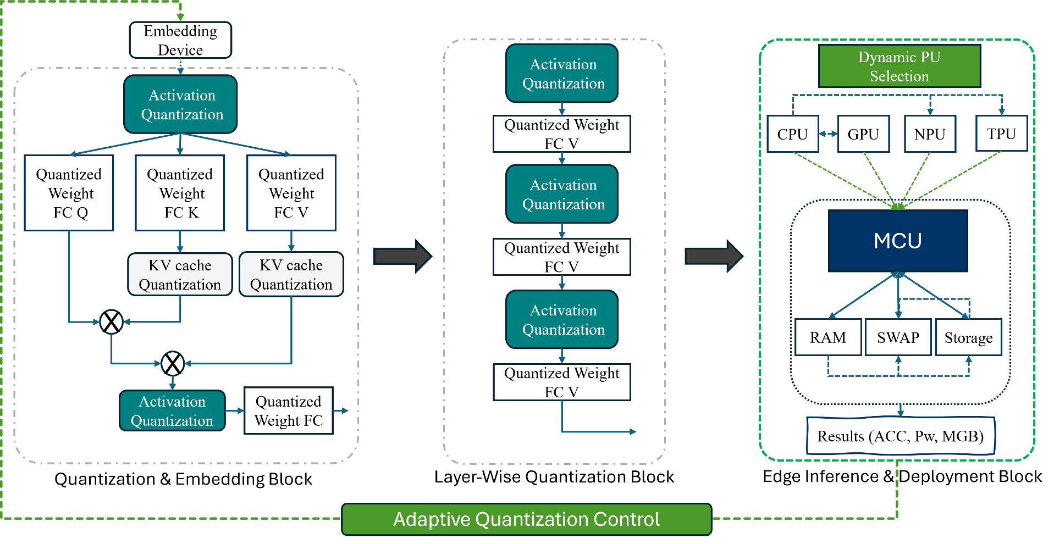
🔹 QuantEdge: Architecture 🔹
Quantized Weight FC Q (Query): Reduces compute cost in self-attention.
Quantized Weight FC K (Key): Lowers storage, speeds up attention processing.
Quantized Weight FC V (Value): Optimizes memory, accelerates inference.
Activation Quantization: Saves RAM by reducing activation precision.
Quantized Weight FC (Final Layer): Speeds up final computation with minimal accuracy loss.
Result → Efficient, fast, and optimized for Edge/On-Device AI.
PU: Processing Unit
MCU: Memory Controller Unit
ACC: Accuracy
Pw: Power Usage
MGB: Memory in GB

Slide 15
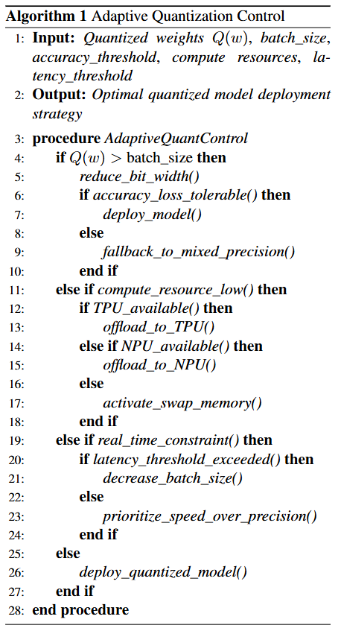
In-MCU Processing

Slide 16
🔹 Comparison with the other methods 🔹
Feature / Technique | Efficient QAT | Prefix Quant | LLM-QAT | Smooth Quant | MobileQuant | QuantEdge (Ours)
Type of Quantization | QAT | PTQ + QAT | QAT | PTQ | PTQ | PTQ + QAT
NPU Support | ✔ | ✗ | ✗ | ✔ | ✔ | ✔
TPU Support | ✗ | ✗ | ✗ | ✗ | ✔ | ✔
GPU Support | ✔ | ✔ | ✔ | ✔ | ✔ | ✔
CPU Support | ✔ | ✔ | ✔ | ✔ | ✔ | ✔
Accuracy Loss | Low | Moderate | Low | Low | Low | Low
Memory Usage | High | Moderate | High | Low | High | Low
Computational Cost | High | Moderate | High | Low | Low | Optimized for Edge
Edge Deployment Feasibility | ✗ | Limited | Limited | Limited | ✔ | ✔

Slide 17
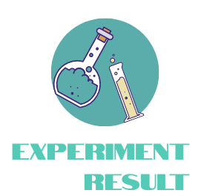

Slide 18
Evaluation Setup
A) Experiment Overview
Devices Used:
  Low-power: Raspberry Pi, Asus Tinker Edge R / T
  High-performance: Jetson AGX, Dell T5820
AI Tasks Evaluated:
  Driver Profiling (Small-Scale Model)
  Speech Recognition (Medium-Scale Model)
  Object Detection (Large-Scale Model)
B) Performance Evaluation Criteria
  Latency (ms): Time taken for the model to process and produce an output.
  Power Usage (mW): Energy consumption during inference on respective devices.
  Memory Usage (MB): Memory footprint of the quantized model.
  Accuracy (%): Accuracy of the quantized model compared to the original full-precision model.
  Model Size (MB): Overall size of the quantized model.

Slide 19
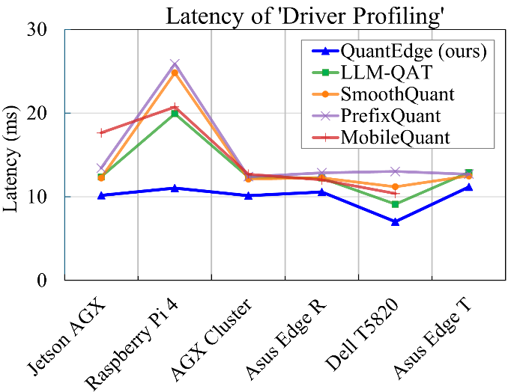
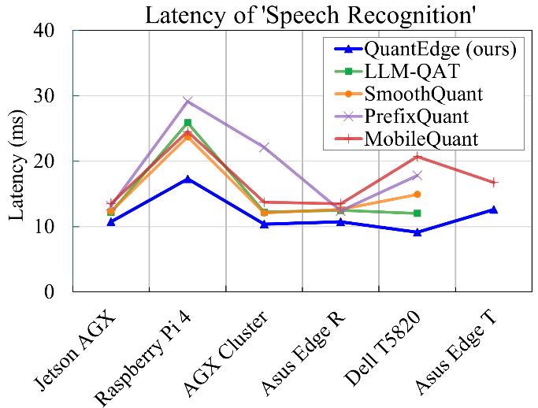
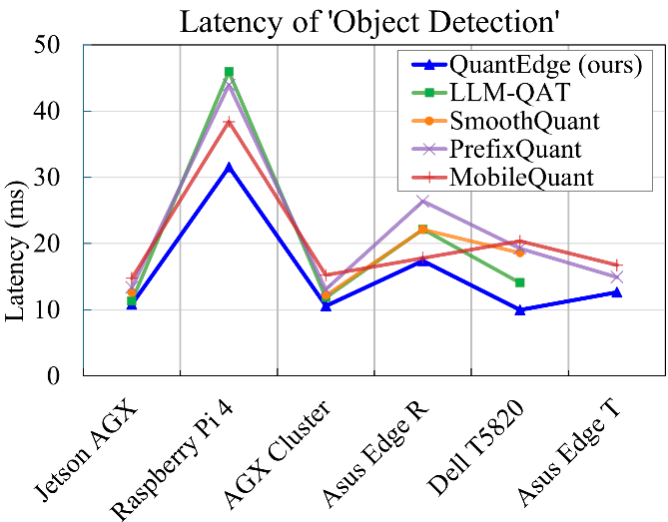
Latency Comparison of Quantization Techniques
Goal: Compare the latency of different quantization methods across edge devices.
Key Insights:
QuantEdge consistently achieves the lowest latency across all tested devices.
MobileQuant and PrefixQuant exhibit the highest latency, particularly on Raspberry Pi 4.
LLM-QAT and SmoothQuant have intermediate latency with some variations across tasks.
Latency spikes on Raspberry Pi 4 for Speech Recognition and Object Detection, indicating hardware limitations.
AGX Cluster and Dell T5820 show stable performance, favoring QuantEdge's optimization.

Slide 20
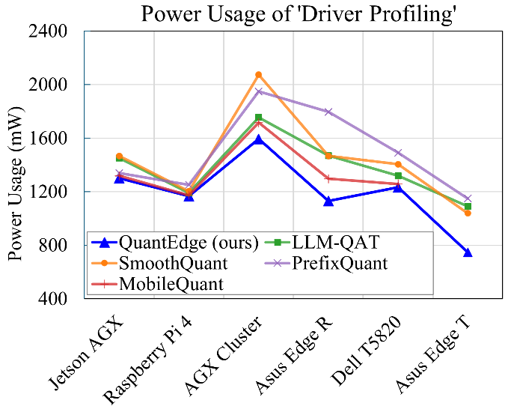
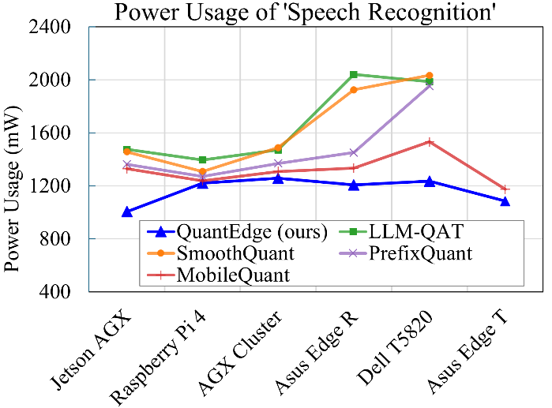
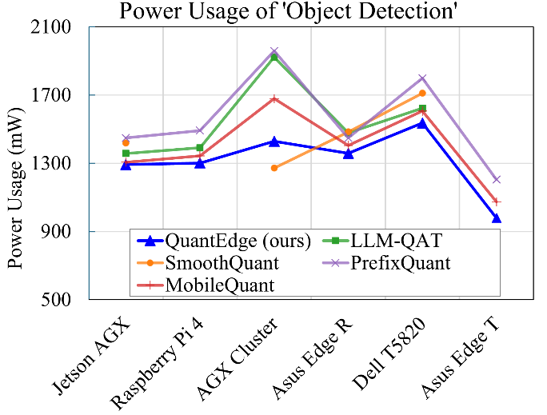
Power Consumption Across Quantization Techniques
Goal: Compare power efficiency of different quantization methods across edge devices.
Key Insights:
QuantEdge consistently achieves the lowest power consumption across all tasks.
LLM-QAT and PrefixQuant consume the most power, especially on Speech Recognition tasks.
Raspberry Pi 4 and AGX Cluster exhibit the highest power usage for Speech Recognition and Object Detection.
QuantEdge reduces power usage by up to ~25% compared to other methods, enhancing efficiency for battery-powered devices.
Trade-off: Some methods (e.g., LLM-QAT, PrefixQuant) sacrifice power efficiency for accuracy.

Slide 21
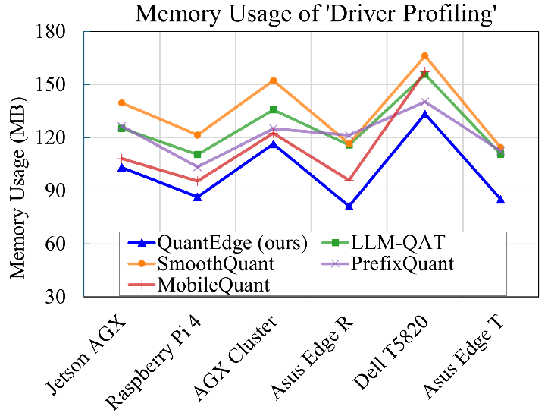
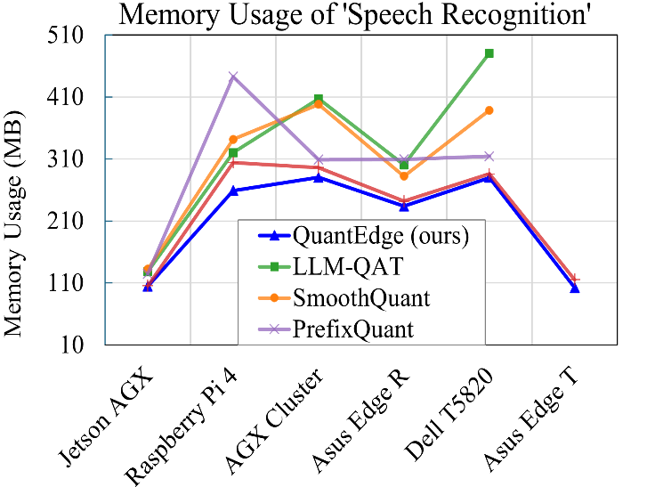
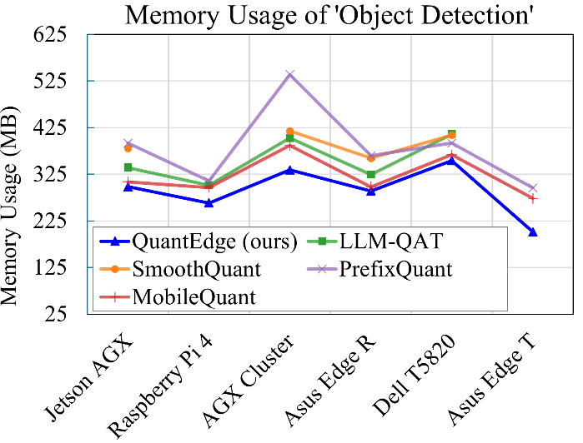
Memory Efficiency of Quantization Techniques
Goal: Evaluate memory footprint of different quantization methods across edge devices.
Key Insights:
QuantEdge consistently has the lowest memory usage across all tasks.
PrefixQuant has the highest memory usage, especially in Object Detection (~525MB).
Memory usage spikes significantly on Dell T5820 for Speech Recognition and Object Detection, indicating higher computational demand.
MobileQuant and SmoothQuant show moderate memory usage, balancing performance and efficiency.
QuantEdge reduces memory usage by up to ~35%, making it ideal for low-memory edge devices.

Slide 22
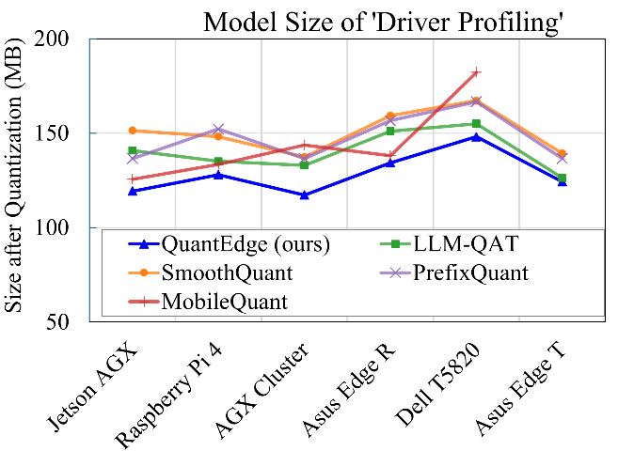
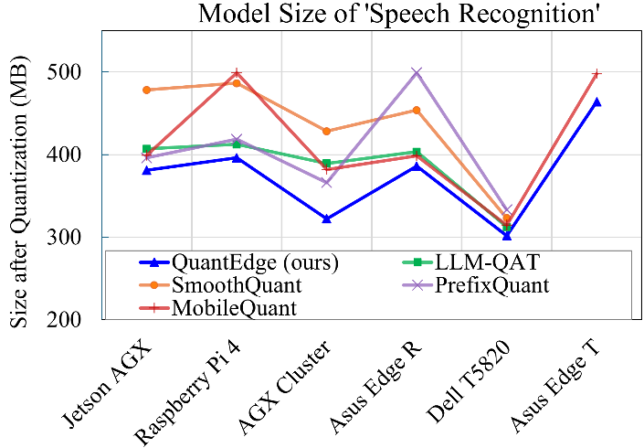
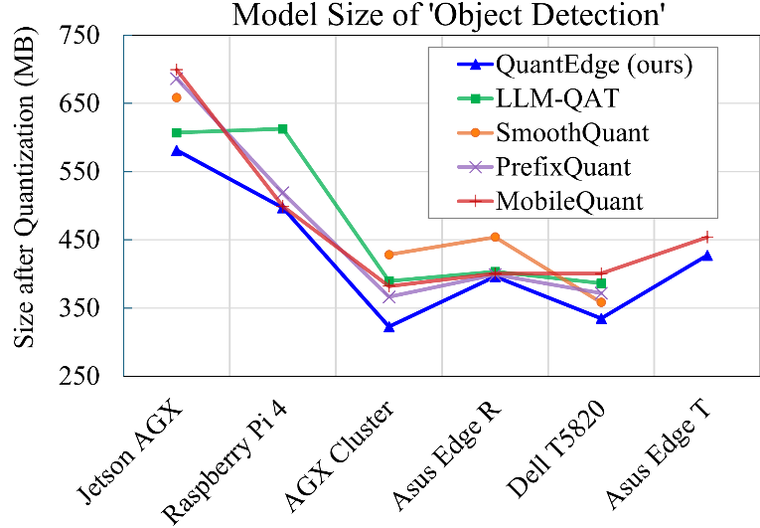
Model Size Comparison After Quantization
Goal: Evaluate the impact of quantization on model size across different techniques.
Key Insights:
QuantEdge produces the smallest models across all tasks, minimizing storage needs.
MobileQuant and PrefixQuant result in the largest models, particularly in Driver Profiling and Speech Recognition.
Speech Recognition models tend to be the largest, with some exceeding 500MB after quantization.
QuantEdge reduces model size by up to ~48%, making it ideal for deployment on storage-constrained edge devices.
AGX Cluster and Dell T5820 handle larger models efficiently, while smaller devices (e.g., Raspberry Pi 4) benefit most from reduced model sizes.

Slide 23
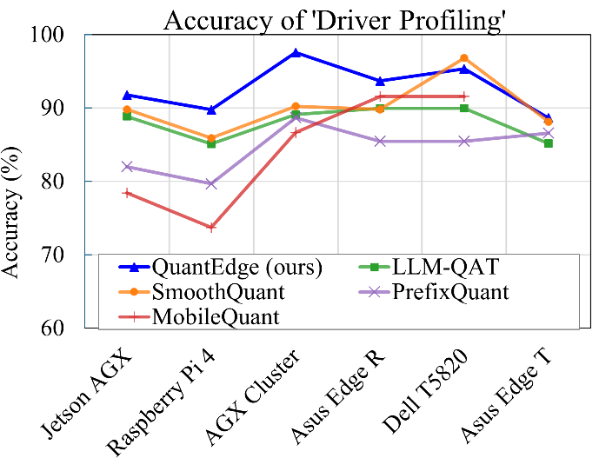
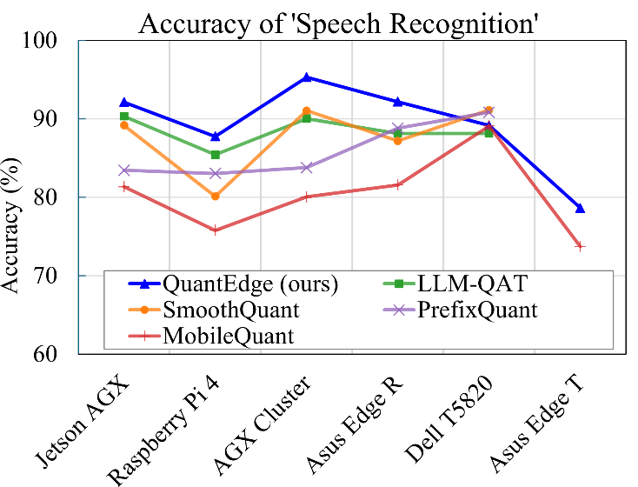
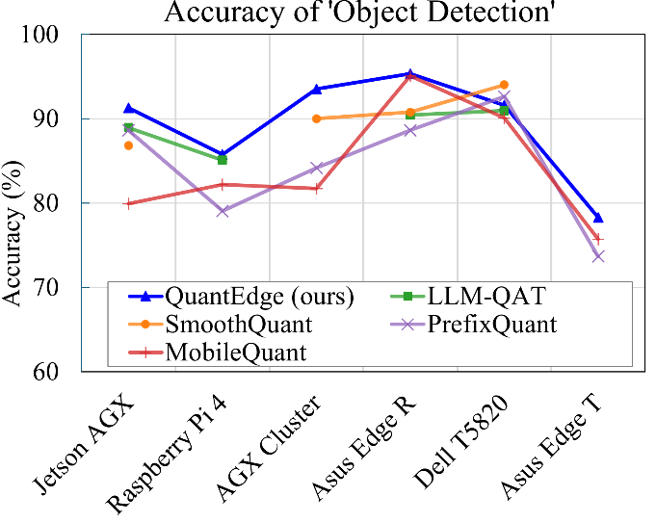
Accuracy Comparison of Quantization Methods
Goal: Assess how different quantization techniques impact model accuracy.
Key Insights:
QuantEdge maintains the highest accuracy overall, but certain methods outperform it in specific cases.
Driver Profiling (Dell T5820 Server): SmoothQuant achieves higher accuracy than QuantEdge due to its focus on precision.
Speech Recognition: PrefixQuant and SmoothQuant outperform QuantEdge, likely due to their optimization for preserving activation precision.
Object Detection: SmoothQuant achieves better accuracy on some devices as it focuses on activation smoothing rather than memory efficiency.
Trade-off: QuantEdge prioritizes memory efficiency, leading to slightly lower accuracy in a few cases.

Slide 24
Future Work & Research Directions
Improving Accuracy Without Sacrificing Memory Efficiency
  Explore adaptive precision techniques (e.g., mixed-precision quantization).
  Investigate knowledge distillation to enhance accuracy for tasks where SmoothQuant/PrefixQuant currently outperform QuantEdge even though the difference is less.
  Experiment with hardware-specific optimizations (e.g., better leveraging Tensor cores, FPGA accelerators).
Reducing Power Consumption Further
  Implement dynamic quantization switching based on PSU power availability.
  Optimize for low-power AI chips and mobile SoCs (Even more, e.g for TinyML).
  Investigate lightweight pruning techniques in combination with quantization.
Expanding Deployment & Real-World Applications
  Optimize for more edge devices, such as IoT sensors, smart cameras, and mobile devices.
  Apply QuantEdge to new AI domains (e.g., autonomous vehicles).
  Test on larger-scale AI models (e.g., LLaMA, Whisper) to validate its scalability.

Slide 25


Slide 26
References
SmoothQuant: Accurate and Efficient Post-Training Quantization for Large Language Models
  https://arxiv.org/abs/2211.10438
LLM-QAT: Data-Free Quantization Aware Training for Large Language Models
  https://arxiv.org/abs/2305.17888
PrefixQuant: Eliminating Outliers by Prefixed Tokens for Large Language Models Quantization
  https://arxiv.org/abs/2410.05265
MobileQuant: Mobile-friendly Quantization for On-device Language Models https://arxiv.org/abs/2408.13933/
EfficientQAT: Efficient Quantization-Aware Training for Large Language Models
  https://arxiv.org/abs/2407.11062
HAWQ-V3: Dyadic Neural Network Quantization
  https://proceedings.mlr.press/v139/yao21a/yao21a.pdf
ZeroQuant: Efficient and Affordable Post-Training Quantization for Large-Scale Transformers
  https://arxiv.org/abs/2206.01861

