Slide 1
Advanced Online Shopping System
Advanced Information Retrieval
Final Term Project
Presenter: Rasim Mahmudov
Student №: 22232356
Date: June 9, 2025
Domain URL: https://agar.uno

Slide 2
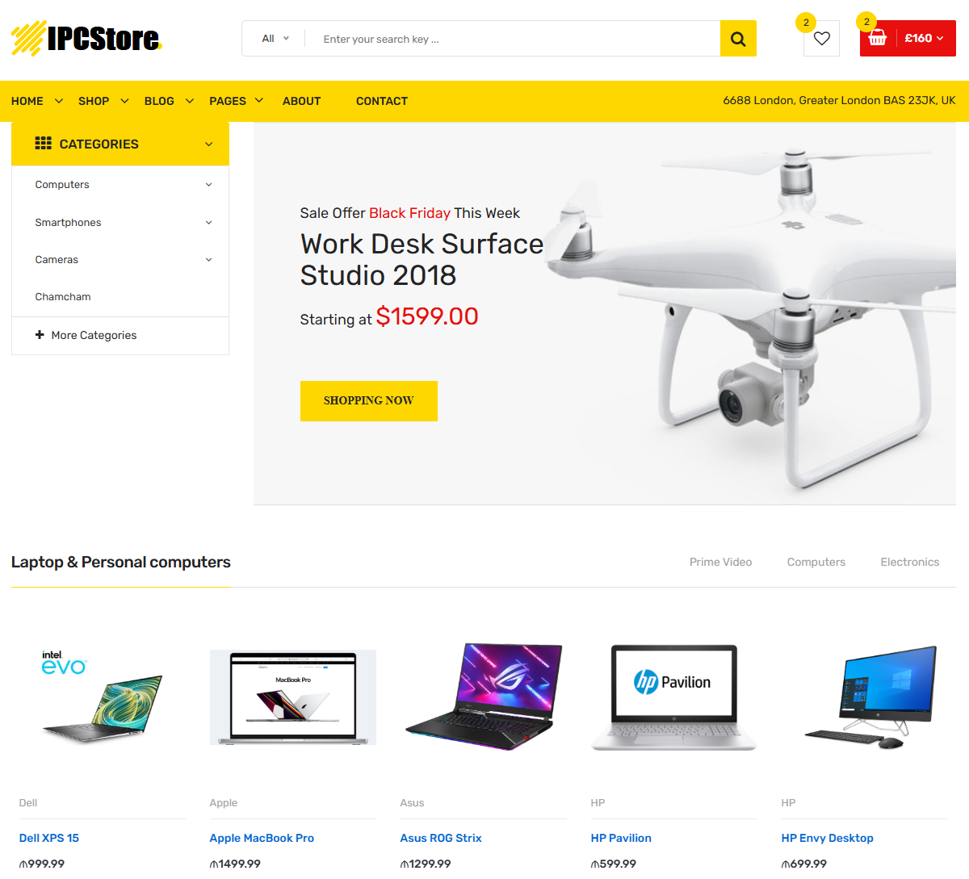
Project Overview (IPCStore)
Goal: To develop a full-featured online shopping system with inventory tracking, user personalization, and review/return handling.
Modules:
  Online Shopping Workflow
  User & Product Management
  Order & Payment System
  Inventory Logging
  Review & Return System

Slide 3
Target Domain
Domain: E-commerce System
Scope Includes:
  Product browsing and purchase
  Inventory/stock record maintenance
  Customer feedback and returns
Tools Used:
  PHP, MySQL, HTML/CSS
  Apache Web Server
  Bootstrap (UI Framework)
  Database Controller
  Custom SQL Tables

Slide 4
As-Is Process (Current Online Shopping Flow)
This follows the current (unoptimized) process of online shopping.
Steps
Browse Products (Customer searches items)
Add to Cart (Selects products)
Proceed to Checkout (Moves to payment page)
Enter Shipping Details (Inputs address)
Select Payment Method (Credit card, KakaoPay, PayPal, etc.)
Confirm Order (Order placed)
Payment Processing (Success or failure)
Order Sent to Warehouse (Stock check & packing)
Item is Shipped (Courier picks up order)
Customer Receives Order (Delivered)
Customer Accepts or Returns (Keep or return)

Slide 5
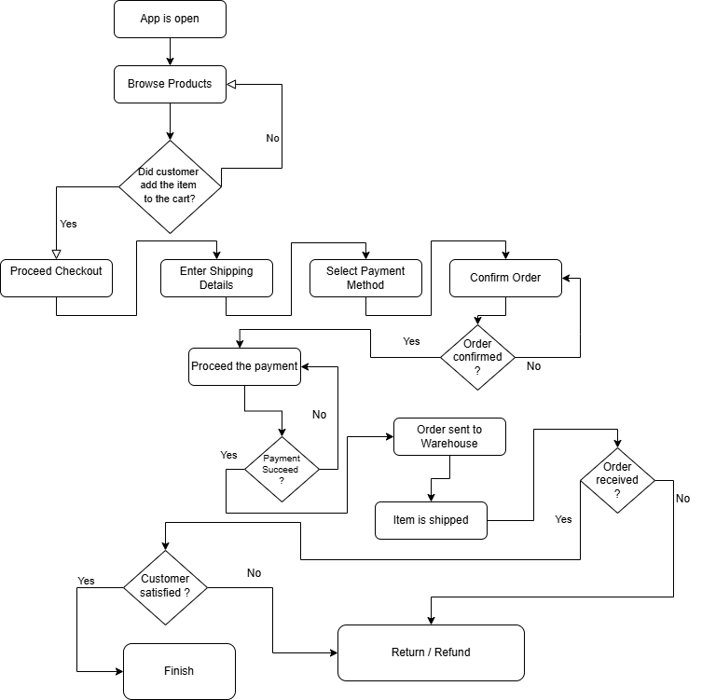
As-Is Online Shopping Process Flowchart

Slide 6
Identified Problems in the Current Process
X Issues & Solutions X
Cart Abandonment → Add a Cart Recovery System (reminder emails).
Slow Payment Processing → Introduce Fast Payment Gateway.
Warehouse Delays → Automate Order Processing.
Shipping Delays → Provide Multiple Shipping Options.
Return Complexity → Implement Self-Service Returns.

Slide 7
To-Be Process (Optimized Online Shopping Flow)
Steps with Improvements:
Browse Products
Add to Cart
Cart Recovery System (If items are left)
Proceed to Checkout
Enter Shipping Details
Select Payment Method
Confirm Order
Optimized Payment Processing (Instant confirmation)
Automated Order Processing
Faster Item Shipping (Multiple delivery options, multiple cargo companies - available)
Customer Receives Order
Accept Product or Easy Return Process

Slide 8
Website Architecture
Include major tables:
  users, products, orders, order_items
  stock_statement, reviews, wishlist
  categories, subcategories, product_images
Mention relationships:
  One user → many orders
  One product → many reviews
  One order → many order_items

Slide 9
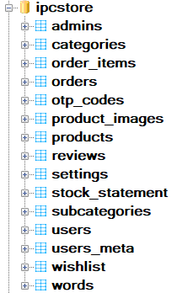
Key Database Tables
Database Scheme
Table Name | Purpose
users | Customer login & details
products | Item info, price, attributes
orders | Purchase transactions
order_items | Items inside each order
stock_statement | Inventory and delivery tracking
reviews | User feedback & ratings
wishlist | User’s saved products

Slide 10
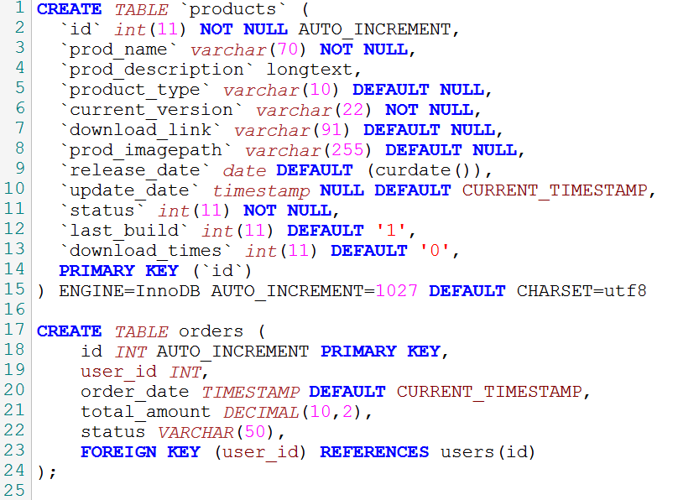
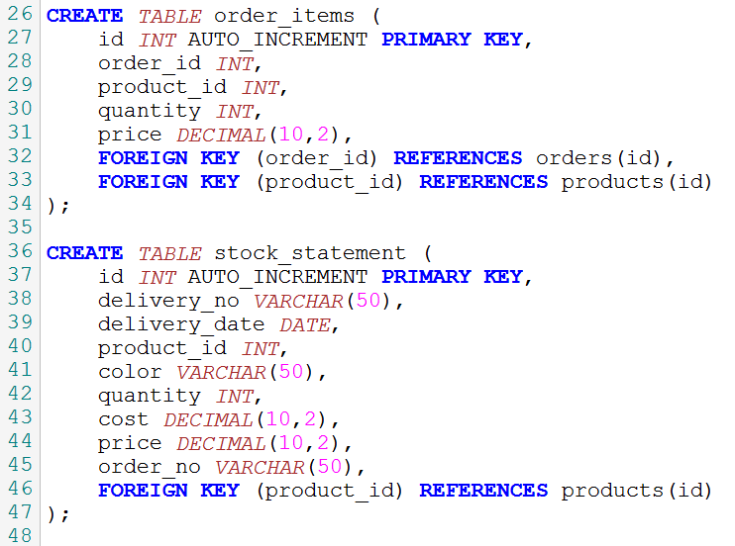
Example SQL Schema

Slide 11
Inventory Integration
Table: stock_statement
is used for:
  Tracking product deliveries
  Recording quantity, cost, and price
  Mapping delivery to orders
Integration: Linked via product_id with products table
Insert snippet of the stock form or admin interface if built.

Slide 12
Conceptual ER Diagram for stock_statement
Product
Manage at (1:M)
Staff
Stored at (1:M, Optional)
Delivered by (1:M)
Location
Entities: Product, Staff, Delivery, and Location.
Relationships:
  Staff manages Product (1:M, mandatory).
  Delivery delivers Product (1:M, mandatory).
  Product is stored at Location (1:M, optional).
Delivery

Slide 13
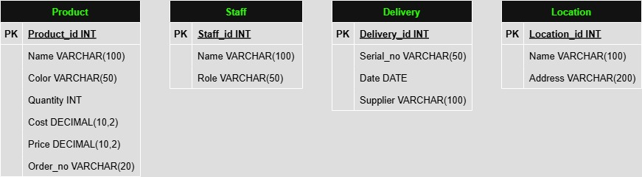
6. Conceptual ER data model

Slide 14
Applying 5W1H to Stock Statement
Manager
Who
Delivery
Product details
Why
How
What
Order
When
Where
Delivery
Storage /
Warehouse

Slide 15
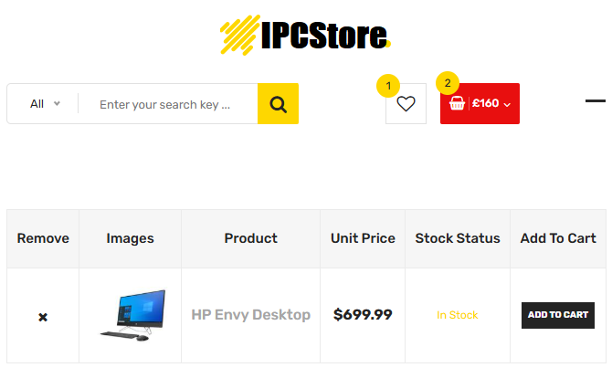
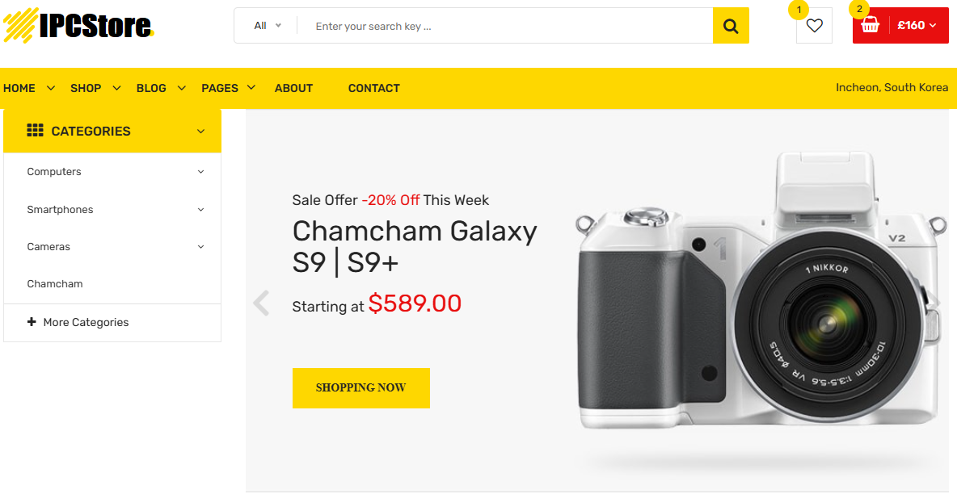
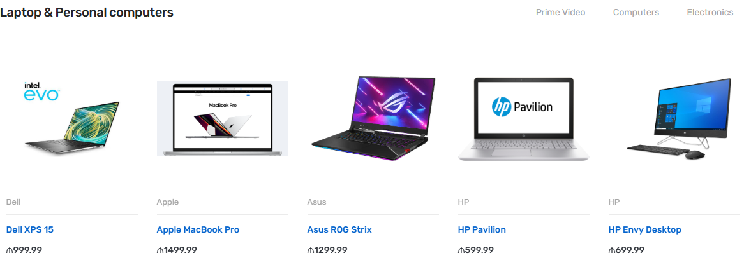
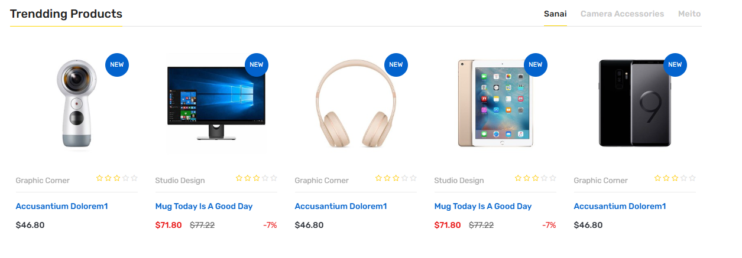
System Screenshots

Slide 16
Search & Retrieval Features
Search by name, category
Sort by price, availability
Wishlist functionality
Show best-rated products via reviews

Slide 17
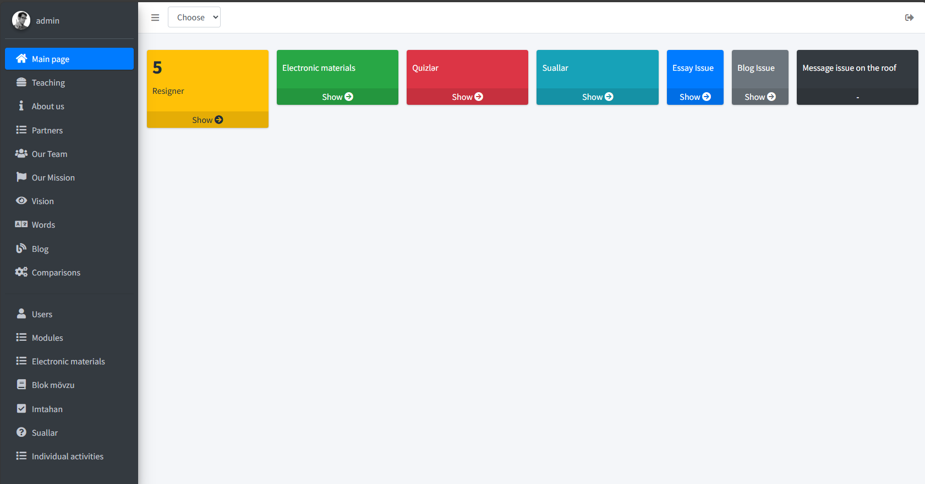
Results & Achievements
Developed a online shopping platform (IPCStore).
Designed and implemented relational DB.
Integrated user reviews and wishlists.
Simulated inventory tracking with stock_statement
Aligned process with TO-BE design model

Slide 18
Challenges & Lessons Learned
Challenges:
  Connecting stock to product logic
  Designing review submission system
  Securing admin operations
Lessons:
  Importance of relational modeling
  Optimizing user workflows
  Full-stack implementation under deadline

Slide 19
Future Work
🔄 Real payment integration (PayPal, Stripe)
📦 Shipment tracking with APIs
📈 Admin dashboard with analytics
📱 AI product recommendations

Slide 20



Slide 21
References
Exported sql file is available here: https://rasimmax.com/fsm/sqlbook/ipcstore.dc
Tools are used:
  MySql: https://www.mysql.com/
  PHP: https://www.php.net/
  Database Controller: https://products.agarmen.com/view/mysql-database-controller/
  VS Code: https://code.visualstudio.com/

