Slide 1
Lecture 6: file system - second part
- regular file, directory file
- inode, block location

Slide 2
regular file vs directory file
file system
files
S
.....
D
I
.....
G
Inode Table
/
/f1
inode
rec_len
name_len
file_type
name
korea
12
1
2
.
2
2
12
2
2
..
11
20
10
2
lost+found
12
980
2
1
f1
regular file
directory file

Slide 3
directory entry
ext2_dir_entry_2{
__u32 inode; // 4 byte
__u16 rec_len; // 2 byte
__u8 name_len; // 1 byte
__u8 file_type; // 1 byte
char name[]; // file name
}
file type=1 : regular file
file type=2 : directory file
rec_len: size of each entry

Slide 4
directory file
file system
files
S
.....
D
I
.....
G
Inode Table
/
/f1
.
..
inode
rec_len
name_len
file_type
name
12
1
2
.
f1
2
..
lost+found
2
12
2
2
11
20
10
2
lost+found
- A directory file has two
pre-existing files: "." and ".."
- "." is the current directory file
- ".." is the parent directory file.
- The parent of "/" is "/" itself.
- inode number of "/" is 2.
12
980
2
1
f1
directory file

Slide 5
location of / (inode 2)
file system
files
21
S
.....
D
I
.....
G
Inode Table
/
1
2
21
m_bloc[0]
inode
rec_len
name_len
file_type
name
1
2
.
2
12
2
12
2
2
..
11
20
10
2
lost+found
12
980
2
1
f1
directory file

Slide 6
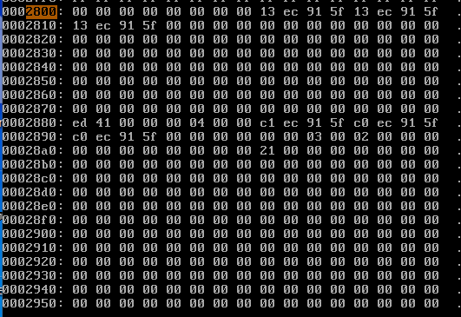
inode table(each inode=0x80 bytes)
beginning of inode table
inode 1
inode 2
("/")
inode 3
block location of "/" = 00 00 00 21 =21

Slide 7
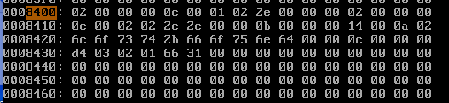
block 0x21 (dir file for "/")
block 0x21 => address 0x8400
ext2_dir_entry_2{
__u32 inode; // 4 byte
__u16 rec_len; // 2 byte
__u8 name_len; // 1 byte
__u8 file_type; // 1 byte
char name[]; // file name
}
file type=1 : regular file
file type=2 : directory file
rec_len: size of each entry
inode
rec_len
name_len
file_type
name
12
1
2
.
2
2
12
2
2
..
11
20
10
2
lost+found
12
980
2
1
f1
directory file

Slide 8
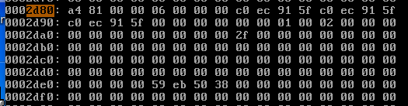
finding f1=>inode number of f1=> inode 12(0xc) in the inode table
=> located at 2800+80*(c-1)=>2d80
=>f1's block location is at m_block[0]
first block of this file=m_block[0]
2f 00 00 00 ==> 00 00 00 2f =>
2f*400 = bc00

