Slide 1
Lecture 3: Compiling Linux Kernel
- computer
- x86 cpu architecture
- cpu execution cycle
- booting sequence
- GRUB
- compiling Linux kernel

Slide 2
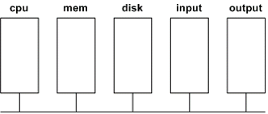
computer
ex1.c
ex1
ex1
vi ex1.c ==> ex1.c will be stored in "disk"
gcc -o ex1 ex1.c ==> ex1 will be stored in "disk"
./ex1 ==> ex1 will be loaded in "mem"

Slide 3
x86 cpu
registers
........
eax
........
ebx
1e
ecx
1c
........
edx
24
80483cb
ebp
00000000
mar
44
esp
ffffd5ec
80483ca
80483c4
mbr
c7
80483c9
eip
........
ec
80483c8
83
80483c7
e5
80483c6
89
80483c5
cntrl unit
55
80483c4
........
........
ALU
mem
instruction
register

Slide 4
cpu execution cycle:
fetch next instruction (pointed by eip)
update eip
execute fetched instruction
- Once power is on, the cpu will always run above execution cycle.
- Ask yourself always, where is cpu now?

Slide 5
x86 cpu
registers
........
eax
........
ebx
1e
ecx
1c
........
edx
24
80483cb
ebp
00000000
mar
44
esp
ffffd5ec
80483ca
80483c4
mbr
c7
80483c9
eip
........
ec
80483c8
83
80483c7
e5
80483c6
89
80483c5
cntrl unit
55
80483c4
........
........
ALU
mem
instruction
register

Slide 6
x86 cpu (after one cpu clock tick:fetch instruction)
registers
........
eax
........
ebx
1e
ecx
1c
........
edx
24
80483cb
ebp
00000000
mar
44
esp
ffffd5ec
80483ca
80483c4
mbr
c7
80483c9
eip
........
ec
80483c8
83
80483c7
e5
80483c6
89
80483c5
cntrl unit
55
80483c4
........
........
ALU
55
mem
instruction
register

Slide 7
x86 cpu (after another cpu clock tick:update eip)
registers
........
eax
........
ebx
1e
ecx
1c
........
edx
24
80483cb
ebp
00000000
mar
44
esp
ffffd5ec
80483ca
80483c5
mbr
c7
80483c9
eip
........
ec
80483c8
83
80483c7
e5
80483c6
89
80483c5
cntrl unit
55
80483c4
........
........
ALU
55
mem
instruction
register

Slide 8
x86 cpu (after another cpu clock tick:execute "push ebp")
registers
eax
ffffd5ec
ebx
00
ffffd5eb
00
ffffd5ea
ecx
00
ffffd5e9
edx
00
ffffd5e8
ebp
00000000
........
mar
esp
ffffd5e8
mbr
eip
80483c5
1e
........
1c
........
24
80483cb
44
80483ca
c7
80483c9
cntrl unit
ec
80483c8
83
80483c7
ALU
e5
80483c6
55
89
80483c5
instruction
register
55
80483c4
........
........
mem
........

Slide 9
x86 cpu (after another cpu clock tick:fetch next instruction)
registers
eax
ffffd5ec
ebx
00
ffffd5eb
00
ffffd5ea
ecx
00
ffffd5e9
edx
00
ffffd5e8
ebp
00000000
........
mar
esp
ffffd5e8
mbr
eip
80483c5
1e
........
1c
........
24
80483cb
44
80483ca
c7
80483c9
cntrl unit
ec
80483c8
83
80483c7
ALU
e5
80483c6
89 e5
89
80483c5
instruction
register
55
80483c4
........
........
mem
........

Slide 10
booting sequence
Power ON
cs=0xF000, ip=0xFFF0
==> first instruction is at 0xFFFFFFF0 : BIOS
BIOS(Basic Input Output System) starts
system test/initialization
load/execute 1st sector of boot disk: GRUB boot loader
(boot disk is searched in the order of A:, B:, C:, etc)
GRUB boot loader starts
load/execute OS: Linux
Linux starts
set interrupt descriptor table
initialize system data structure
generate system processes: the last one is login process
login program starts
print "login:" and wait for user
Notes:
Ddf

Slide 11
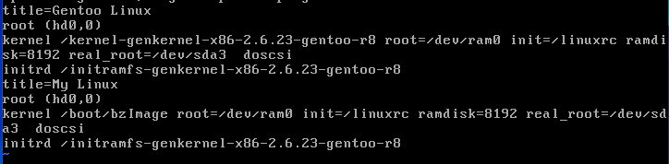
How GRUB(Grand Unified Bootloader) finds OS?
Find OS specified in /boot/grub/grub.conf
1)
2)
user selects Genoo Linux => load OS from 1)
user selects My Linux => load OS from 2) => /boot/bzImage
Notes:
Ddf

Slide 12

How GRUB(Grand Unified Bootloader) finds OS?
Find OS specified in /boot/grub/grub.conf
Notes:
Ddf

Slide 13
Linux File Tree
......
......
root
boot
linux-2.6.25.10
........
grub
bzImage
init
arch
grub.conf
kernel
main.c
x86
mips
........
grub loads Linux from here
boot
kernel
entry_32.S
i8259_32.c
....
Notes:
Ddf

Slide 14
Kernel compile and rebooting
Make some change in the kernel.
Go to the Linux top directory (/root/linux-2.6.25.10) and compile Linux.
# make bzImage
The Linux executable file (bzImage) will be made at:
arch/x86/boot/bzImage
So, you need to copy it to /boot/bzImage so that GRUB can load it.
# cp arch/x86/boot/bzImage /boot/bzImage
And reboot the system to boot with the new Linux
# reboot
Notes:
Ddf

Slide 15
Linux File Tree
......
......
root
boot
linux top directory
linux-2.6.25.10
........
grub
bzImage
init
arch
grub.conf
kernel
main.c
x86
mips
........
but grub loads Linux from here
....
boot
bzImage
Linux executable file is here
So, after each kernel compile, you should do copy:
cp arch/x86/boot/bzImage /boot/bzImage
Notes:
Ddf

