Slide 1
Windows
CLI
Commands
Rasim mahmudov

Slide 2
DIR
The DIR command is a powerful Windows Command Prompt function that lists all files and subdirectories contained in a specific directory. The DIR command also offers some switches that unlock some powerful functionality. Let’s take a look.
Display Based on File Attributes
You can add “/A” followed by a letter code after the DIR command to display files with a specific attribute. These letter codes include:
D: Displays all directories in the current path
R: Displays read-only files
H: Displays hidden files
A: Files that are ready for archiving
S: System files
I: Not content indexed files
L: Reparse points

Slide 3
So, for example, to display just the directories in the current path, you’d type the following command and then hit Enter:
dir /ad
You can combine those codes, too. For example, if you wanted to show only system files that are also hidden, you could use the following command:
dir /ash
You also can add a “-” (minus) in front of any of those letter codes to specify that the DIR command does not show that kind of file. So, for example, if you don’t want to see any directories in the results, you could use this command:
dir /a-d
One more tip: Instead of cramming the main switch and the letter code together the way we did in our examples, you can use a colon to separate the switch from its optional codes. Like this:
dir /a:d
*NOTE: It can make things a little easier to parse, but it’s entirely optional.

Slide 4
Netsh
Netsh is a command-line scripting utility that allows you to display or modify the network configuration of a computer that is currently running. Netsh commands can be run by typing commands at the netsh prompt and they can be used in batch files or scripts
Netsh also provides a scripting feature that allows you to run a group of commands in batch mode against a specified computer. With netsh, you can save a configuration script in a text file for archival purposes or to help you configure other computers.

Slide 5
EXAMPLES
netsh wlan show profile name=Google key=clear // Shows details about Google netword on cmd
netsh wlan show profile name=Google key=clear | findstr Key // Shows only key section
netsh wlan export profile name=Google C:\Users\RASIM\Desktop key=clear // Exports the details of Google network to Desktop of the user.

Slide 6
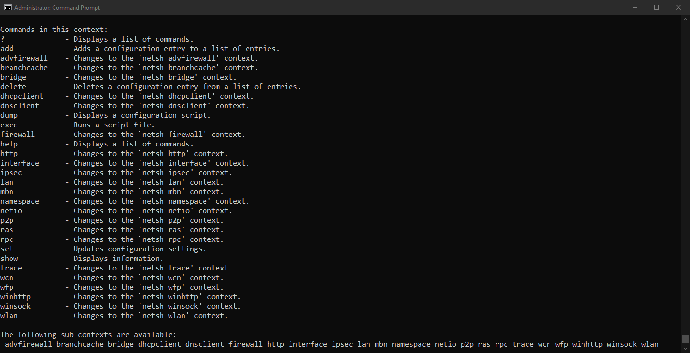

Slide 7
mkdiR / MD / CD
Creates a directory or subdirectory. Command extensions, which are enabled by default, allow you to use a single mkdir command to create intermediate directories in a specified path.
mkdir \Taxes
mkdir \Taxes\Property
mkdir \Taxes\Property\Current
CD – is used to change current directory: cd Desktop

Slide 8
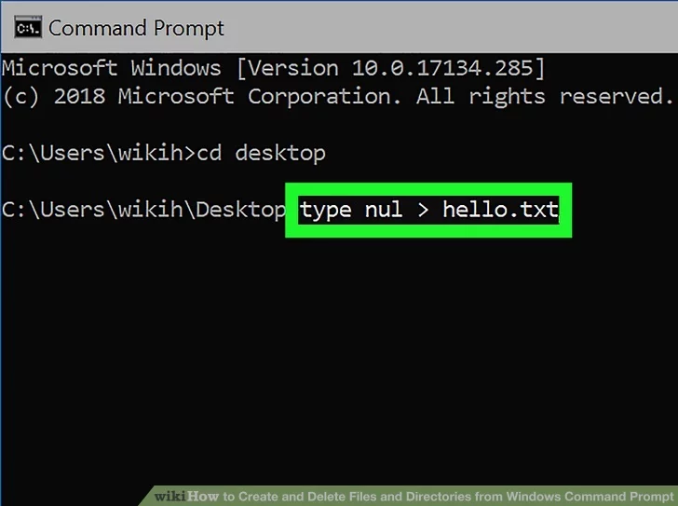
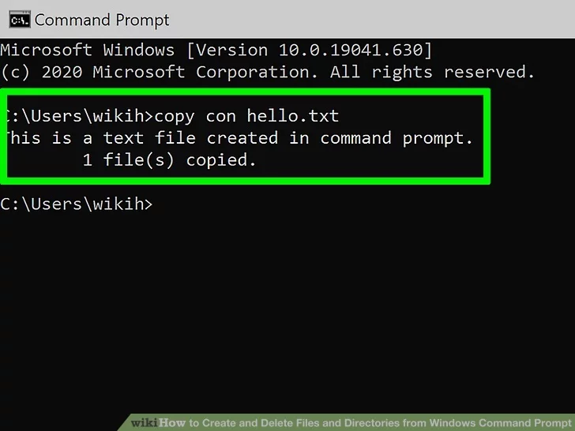
TYPE NUL / COPY COn

Slide 9
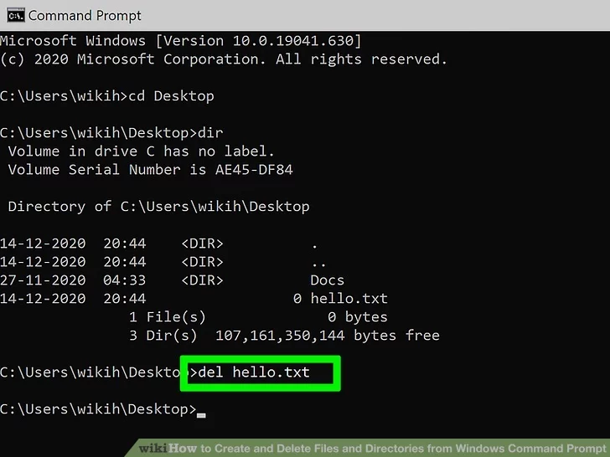
DEL
Type dir and press ↵ Enter.
This displays a list of all files in the current directory. You should see the file you want to delete in this list.
Using Command Prompt to delete files results in the files being deleted permanently rather than being moved to the Recycle Bin. Exercise caution when deleting files via Command Prompt.

Slide 10
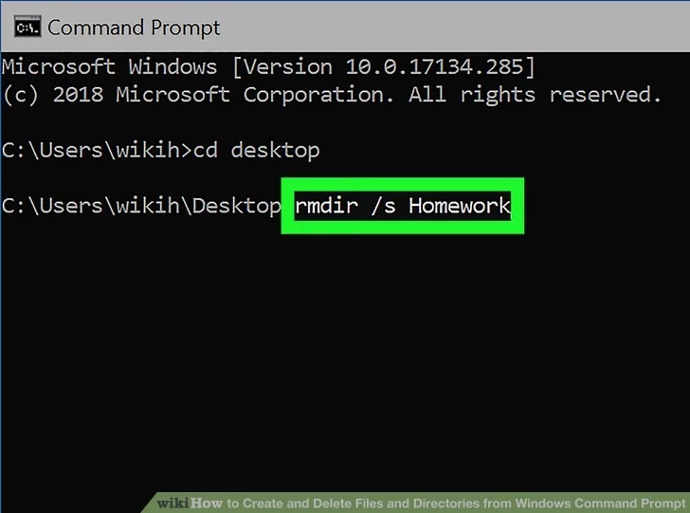
RMDIR
Go to the folder containing the directory you want to delete. The prompt will open to C:\Users\YourName by default.
If the directory you want to delete is somewhere else, type cd path_to_directory and press Enter.[11] Replace path_to_directory with the actual directory location.
For example, if you want to delete a directory from your Desktop, type cd desktop.
If the directory isn't in your user directory (e.g., C:\Users\YourName), you'll have to type in the whole path (e.g., C:\Users\SomeoneElse\Desktop\Files).

Slide 12
Ref: https://www.wikihow.com/Create-and-Delete-Files-and-Directories-from-Windows-Command-Prompt
https://learn.microsoft.com/en-us/windows-server/networking/technologies/netsh/netsh-contexts

