Slide 1
Operating Systems
(IGJ5040-001)
Week 5 / Lab 2
Web Server using Python on Ubuntu
Dept. of Electrical & Computer Engineering
Prof. KIM DEOKHWAN

Slide 2
Content
Find your username and password
Connecting to server
Find your unique port number
Start your web server
Practices

Slide 3


Development Environment
Putty (Remote access)
MicroServer (Ubuntu 20.04)

Slide 4
Find Your Username
Note: Using only the assigned user is important for parallel working with the server
NO. | Student ID | Full name | Username | Password
1 | 52221055 | 정준민 | s01 | p01
2 | 52232007 | 정성제 | s02 | p02
3 | 52241047 | 조우석 | s03 | p03
4 | 52241063 | 유창현 | s04 | p04
5 | 52221106 | 강지훈 | s05 | p05
6 | 52241114 | 전성욱 | s06 | p06
7 | 52241118 | 조훈 | s07 | p07
8 | 52242002 | 전찬희 | s08 | p08
9 | 52251040 | 김성민 | s09 | p09
10 | 25551042 | 임철현 | s10 | p10
11 | 52251043 | 전제훈 | s11 | p11
Required credentials

Slide 5
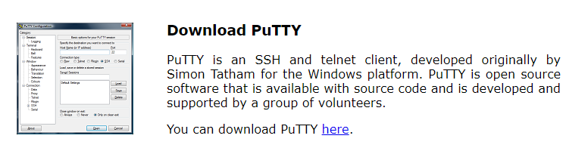
Connecting to Server
Download putty.exe from https://www.putty.org/ :
Install putty.exe into your system

Slide 6
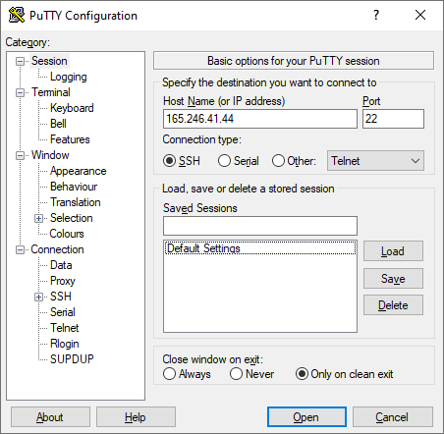
Connecting to Server
Open Putty and input the server credentials and click “Open”:
IP: 165.246.41.44
Port: 22
Connection: SSH

Slide 7
What is Web Server ?
🌐 What is a Web Server?
A web server is a program (or a computer running that program) that:
✅ Receives requests from web browsers (like Chrome, Firefox)
✅ Finds the right file (like index.html, images, etc.)
✅ Sends it back over the internet using the HTTP protocol
🔁 How it Works (in simple steps):
You visit http://localhost:8080
Your browser sends a GET request to the server
The server checks your folder for index.html
It sends that file back
The browser displays it

Slide 8
What Web Servers are available ?
💡 Common Web Servers
Python’s http.server (great for learning!)
Apache
Nginx
Node.js (Express)
Flask, Django (Python web frameworks with server components)

Slide 9

Let’s start

Slide 10
Web server installation
Web server installation using Python
First of all, remember your specific port number:
NO. | Student ID | Full name | Defined Port
1 | 52221055 | 정준민 | 8055
2 | 52232007 | 정성제 | 8007
3 | 52241047 | 조우석 | 8047
4 | 52241063 | 유창현 | 8063
5 | 52221106 | 강지훈 | 8006
6 | 52241114 | 전성욱 | 8014
7 | 52241118 | 조훈 | 8018
8 | 52242002 | 전찬희 | 8002
9 | 52251040 | 김성민 | 8040
10 | 25551042 | 임철현 | 8042
11 | 52251043 | 전제훈 | 8043
Hint: The last two digits of the port number are same with the last two digits of your student number.

Slide 11
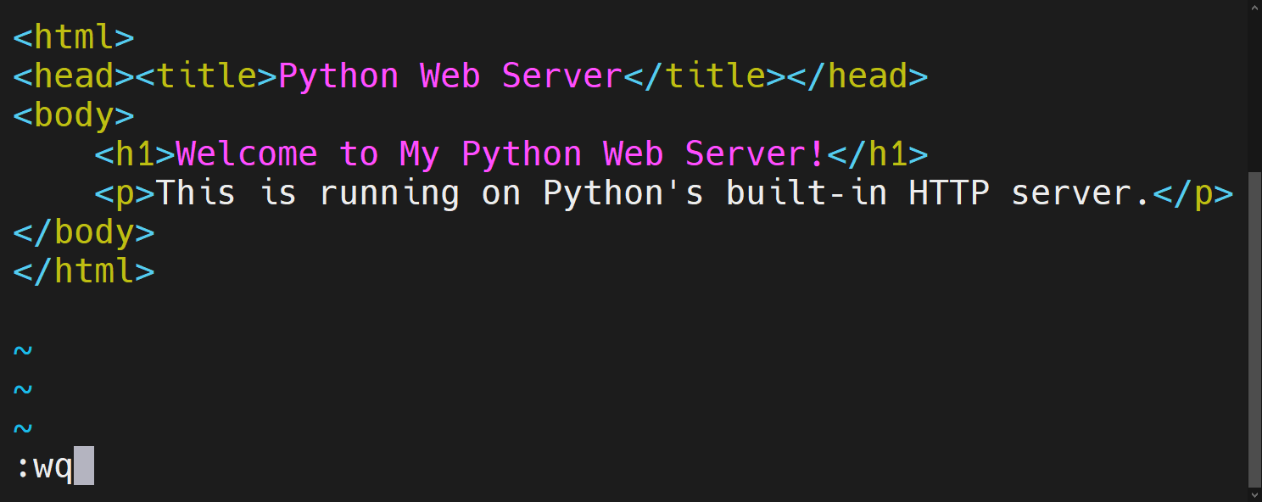
Make a local directory
mkdir public_html - Create directory for web page
cd ~/public_html - Go inside the director
Create a new file named index.html
Write the content below and save the file.

Slide 12
Run webserver
Make sure you are already in the public_html directory.
Give permissions to the directory: chmod -R 755 ~/public_html
Start web server: python3 -m http.server port_number
Note* ~ indicates home directory for current user.
Example: cd ~/Documents

Slide 13
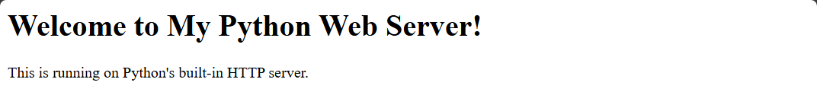
How to access to the web page ?
Open web browser (Edge, Chrome, ..etc)
Go to URL section and type IP Address and port number of the Ubuntu server
Example: http://165.246.41.44:8080/
http
165.246.41.44
8080
Protocol
Server IP
Port number
If everything is fine, you will see the following response on browser

Slide 14

Server monitoring
Why monitor your server?
Ensure it's running
See if people are connecting
Watch for errors or suspicious activity
Check the terminal output to see
Who accessed your page
What time they accessed it
What they tried to load
Look for:
⚠️ 404 — page not found
🚫 403 — permission denied
🟢 200 — OK!

Slide 15
Deep monitoring
python3 -m http.server 8080 > access.log 2>&1
1 = stdout → normal output
2 = stderr → error messages
Part | Meaning
> | Redirect stdout
access.log | Where stdout goes
2>&1 | Redirect stderr (2) to same place as stdout (1)
Now you can bring the content of access.log file to the console using
cat access.log

Slide 16
Task
Steps:
Rename existing public_html to public_html2
Download ready web-page zip file from the CDN (Content Delivery Network) wget https://cdn.agarmen.com/os/page.zip
Unzip it (extract)
Make a new public_html directory
Copy the extracted files into public_html
Start the new web server with access.log, log file
Use ls command to view the sizes of files.
Use cat command to view the content of the log file.

Slide 17
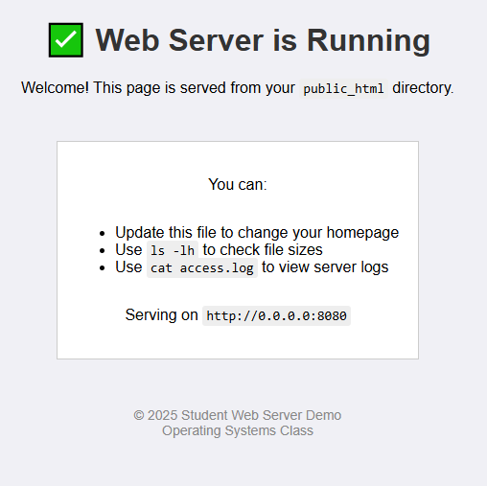
Demo
You should see this result in your browser. (see image)
If it’s same, you have successfully completed the task.
If there are any errors/warnings start over may help to fix.

Slide 18
Solution
mv ~/public_html ~/public_html2
wget https://cdn.agarmen.com/os/page.zip
unzip page.zip
mkdir ~/public_html
cp -r page/* ~/public_html/
cd ~/public_html
python3 -m http.server 8080 > access.log 2>&1
ls -lh ~/public_html
cat ~/public_html/access.log
Content is hidden
Click to unhide

Slide 19

Questions?
Contact TA if you have questions
Name: RASIM
E-mail : rmax@inha.edu
Intelligent Embedded System Lab. (H-813)

