Slide 1
Operating Systems
(ECE3325-001)
Week 14 / Lab 5
Thread Programming
Dept. of Electrical & Computer Engineering
Prof. KIM DEOKHWAN
Lab Assistant: RASIM

Slide 2


Development Environment
Putty (Remote access)
MicroServer (Ubuntu 20.04)

Slide 3
Development Environment
Note: Using only the assigned user is important for parallel working with the server
NO. | Student ID | Full name | Username | Password
1 | 52221055 | 정준민 | s01 | p01
2 | 52232007 | 정성제 | s02 | p02
3 | 52241047 | 조우석 | s03 | p03
4 | 52241063 | 유창현 | s04 | p04
5 | 52221106 | 강지훈 | s05 | p05
6 | 52241114 | 전성욱 | s06 | p06
7 | 52241118 | 조훈 | s07 | p07
8 | 52242002 | 전찬희 | s08 | p08
9 | 52251040 | 김성민 | s09 | p09
10 | 25551042 | 임철현 | s10 | p10
11 | 52251043 | 전제훈 | s11 | p11
Required credentials

Slide 4
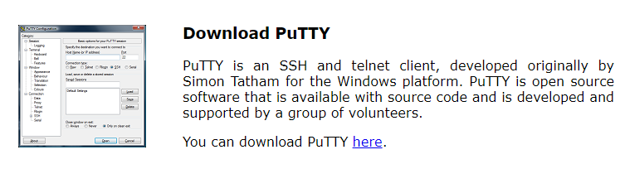
Development Environment
Download putty.exe from https://www.putty.org/ :
Install putty.exe in your system

Slide 5
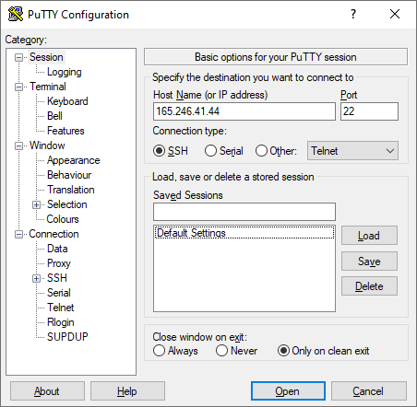
Development Environment
Open Putty and input the server credentials and click “Open”:
IP: 165.246.41.44
Port: 22
Connection: SSH

Slide 6
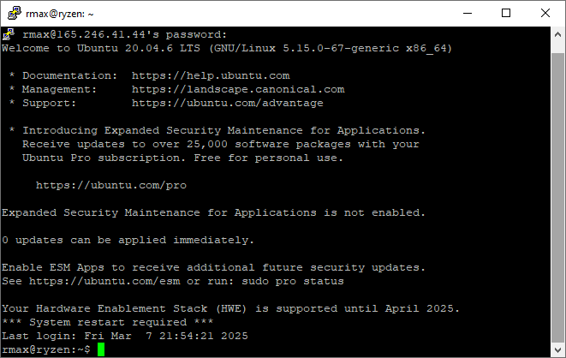
Development Environment
Use your assigned username and password to login:
Note: You don’t see the characters when you type password. Don’t worry, it is normal.
Congratulations! Now you have successfully connected to Ubuntu Server!

Slide 7
Multithreading in C
What is a Thread?
  Single stream in a process, with some of the process properties
  Lightweight processes
Process vs Thread
  Process is independent, thread is not!
  Shares: code, data, OS resources
  Independent: program counter, register set, stack
Why Multithreading?
  Faster creation
  Faster context switching
  Faster inter-thread communication
  Faster termination

Slide 8
Concurrency
Concepts:
  Multi-threading
  Critical section
  Race condition
Mutex lock
Semaphores
Deadlock

Slide 9
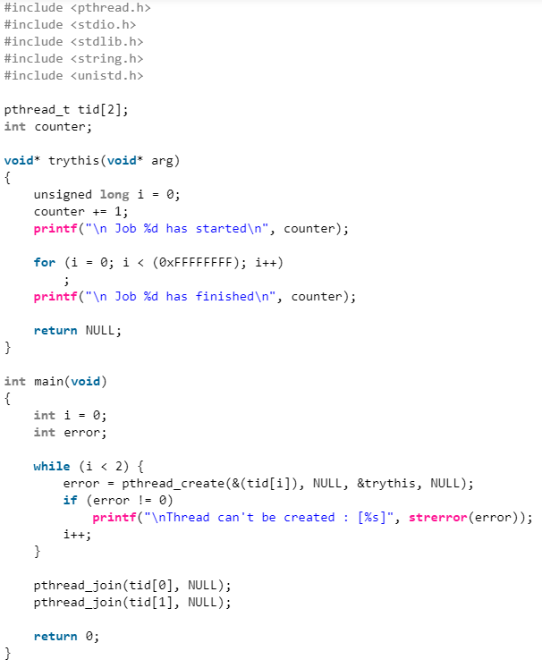
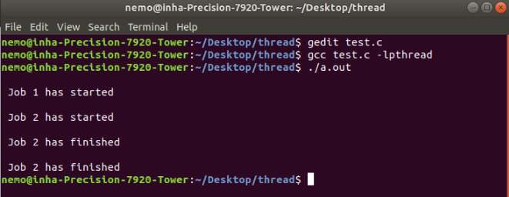
Mutex
Hex to Decimal
0xFFFFFFFF = 4,294,967,295
Parameter | Description
&(tid[i]) | Pointer to a pthread_t variable where the thread ID will be stored.
NULL | Thread attributes (optional). NULL = default attributes.
&trythis | Function pointer to the thread function. Must take void* as an argument and return void*.
NULL | Argument passed to the thread function. Here, it's NULL because the function doesn’t need any input.

Slide 10
Code
#include <pthread.h>
#include <stdio.h>
#include <stdlib.h>
#include <string.h>
#include <unistd.h>
pthread_t tid[2];
int counter;
void* trythis(void* arg)
{
unsigned long i = 0;
counter += 1;
printf("\n Job %d has started\n", counter);
for (i = 0; i < (0xFFFFFFFF); i++)
;
printf("\n Job %d has finished\n", counter);
return NULL;
}
int main(void)
{
int i = 0;
int error;
while (i < 2) {
error = pthread_create(&(tid[i]), NULL, &trythis, NULL);
if (error != 0)
printf("\nThread can't be created : [%s]", strerror(error));
i++;
}
pthread_join(tid[0], NULL);
pthread_join(tid[1], NULL);
return 0;
}

Slide 11
Mutex
  Question:
  Why is Job 2 finished twice?
  Answer:
  Actually no, Job 2 finished only once
  However, when Job 1 finished, the variable was set to 2!
  Concurrency!

Slide 12
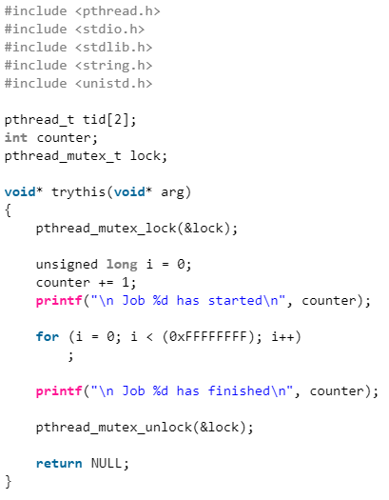
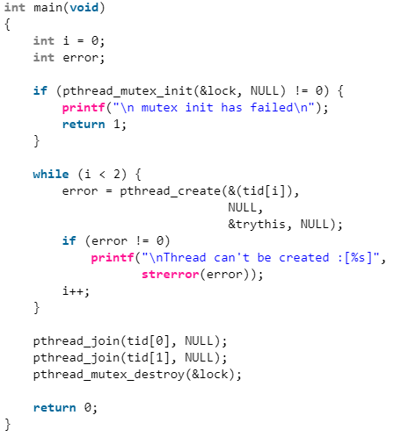
Solution Mutex
2
1
3
4
5
Step | Action | Code Snippet / Description
1 | Declare a mutex | Add: pthread_mutex_t lock; globally.
2 | Initialize the mutex before creating threads | if (pthread_mutex_init(&lock, NULL) != 0) { printf("Mutex init failed\n"); return 1; }
3 | Lock the mutex before accessing shared data (counter) | pthread_mutex_lock(&lock);
4 | Unlock the mutex after done with shared data | pthread_mutex_unlock(&lock);
5 | Destroy the mutex after all threads finish | pthread_mutex_destroy(&lock);

Slide 13
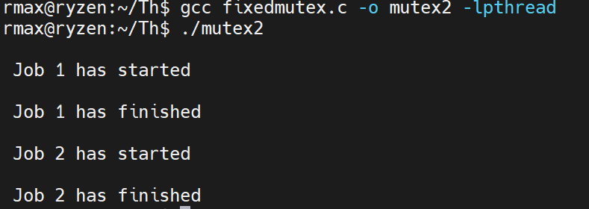
Code
#include <pthread.h>
#include <stdio.h>
#include <stdlib.h>
#include <string.h>
#include <unistd.h>
pthread_t tid[2];
int counter;
pthread_mutex_t lock;
void* trythis(void* arg)
{
pthread_mutex_lock(&lock);
unsigned long i = 0;
counter += 1;
printf("\n Job %d has started\n", counter);
for (i = 0; i < (0xFFFFFFFF); i++)
;
printf("\n Job %d has finished\n", counter);
pthread_mutex_unlock(&lock);
return NULL;
}
int main(void)
{
int i = 0;
int error;
if (pthread_mutex_init(&lock, NULL) != 0) {
printf("\n mutex init has failed\n");
return 1;
}
while (i < 2) {
error = pthread_create(&(tid[i]), NULL, &trythis, NULL);
if (error != 0)
printf("\nThread can't be created : [%s]", strerror(error));
i++;
}
pthread_join(tid[0], NULL);
pthread_join(tid[1], NULL);
pthread_mutex_destroy(&lock);
return 0;
}
Compile: gcc fixedmutex.c -o mutex2 -lpthread

Slide 14
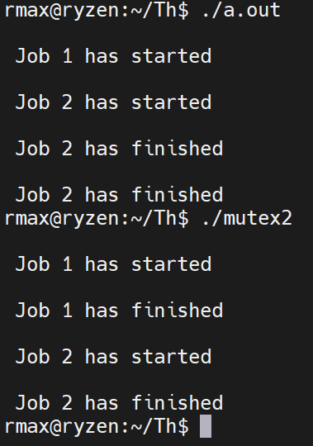
Solution Mutex
Without mutex
With mutex

Slide 15
Mutex: Concept
A Mutex is a lock that we set before using a shared resource and release after using it.
When the lock is set, no other thread can access the locked region of code.
So, we see that even if thread 2 is scheduled while thread 1 was not done accessing the shared resource and the code is locked by thread 1 using mutexes then thread 2 cannot even access that region of code.
So, this ensures synchronized access of shared resources in the code.
Mutex functions return values:
  Success: 0
  Fail: -1

Slide 16
Semaphore
Concept: Single variable shared by all threads
Types:
  Binary semaphore: Mutex lock
  Counting semaphore
Useful in creating smart applications
Unlimited number of access controls
Vulnerability: deadlock!

Slide 17
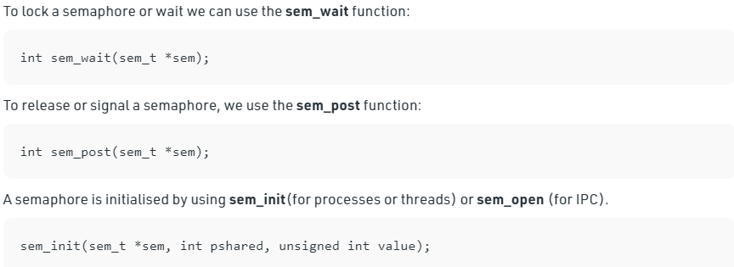
Semaphore

Slide 18
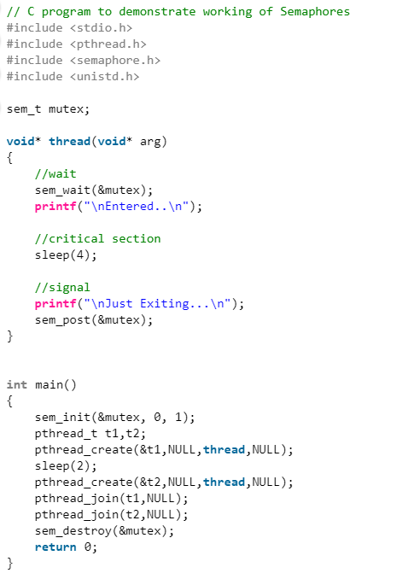
Semaphore
Component | Description
sem_t mutex; | Declares a semaphore variable.
sem_init(&mutex, 0, 1); | Initializes it as a binary semaphore (value 1), meaning one thread can access at a time.
sem_wait(&mutex); | Decrements the semaphore. If the value is 0, the thread waits (blocks).
sleep(4); | Simulates a critical section.
sem_post(&mutex); | Increments the semaphore, allowing another thread to enter.
sleep(2); | In main(), it delays creation of t2 so that t1 enters and holds the semaphore first.
sem_destroy(&mutex); | Cleans up the semaphore once done.

Slide 19
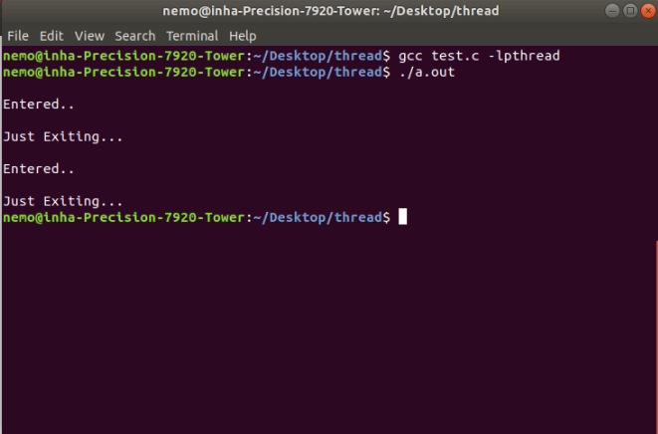
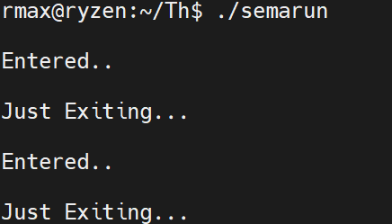
Code
// C program to demonstrate working of Semaphores
#include <stdio.h>
#include <pthread.h>
#include <semaphore.h>
#include <unistd.h>
sem_t mutex;
void* thread(void* arg)
{
// wait
sem_wait(&mutex);
printf("\nEntered..\n");
// critical section
sleep(4);
// signal
printf("\nJust Exiting...\n");
sem_post(&mutex);
return NULL;
}
int main()
{
sem_init(&mutex, 0, 1); // 1 = binary semaphore (acts like a mutex)
pthread_t t1, t2;
pthread_create(&t1, NULL, thread, NULL);
sleep(2); // Delay to let t1 enter critical section
pthread_create(&t2, NULL, thread, NULL);
pthread_join(t1, NULL);
pthread_join(t2, NULL);
sem_destroy(&mutex);
return 0;
}

Slide 20
Mutex vs Semaphore
Mutex:
  Locking mechanism
  Object
  Accesses one at a time
  Accessible only by one process at a time
Semaphore:
  Signaling mechanism
  Integer variable
  Multiple processes and finite accesses
  Accessible by all threads but modified by only one

Slide 21
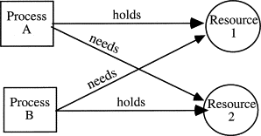
Deadlock
Deadlock is a situation where a set of processes are blocked because each process is holding a resource and waiting for another resource acquired by some other process.
Consider an example when two trains are coming toward each other on the same track and there is only one track, none of the trains can move once they are in front of each other.

Slide 22
Core Threading Concepts
Term | What It Is ? | Real-World Analogy | Used For
Thread | A lightweight process — runs independently inside a program | Like two cooks working in the same kitchen | Doing tasks in parallel (e.g., downloading and processing)
Critical Section | Code that accesses shared resources (like a global variable) | One cook using the knife station | Needs protection to avoid conflicts
Race Condition | When threads change shared data at the same time | Two cooks write on the same whiteboard at once | Causes bugs, wrong data
Mutex (Mutual Exclusion) | A lock that only one thread can hold at a time | A key to the kitchen drawer — only one cook can hold it | Protects critical section
Semaphore | A counter-based lock — controls how many threads can access | 3 parking spots — only 3 cars allowed | Limit access (e.g., max 3 threads allowed)
Deadlock | Two threads waiting for each other forever | Two cars blocking each other at a 1-lane bridge | Happens when locks are used incorrectly

Slide 23
Practice
Producer-Consumer Problem:
  The producer and consumer share a fixed-size buffer used as a queue.
  The producer’s job is to generate data and put this in the buffer.
  The consumer’s job is to consume the data from this buffer, one at a time.
Problem:
  The producer should produce data only when the buffer is not full. If the buffer is full, then the producer shouldn't be allowed to put any data into the buffer.
  The consumer should consume data only when the buffer is not empty. If the buffer is empty, then the consumer shouldn't be allowed to take any data from the buffer.
  The producer and consumer should not access the buffer at the same time

Slide 24
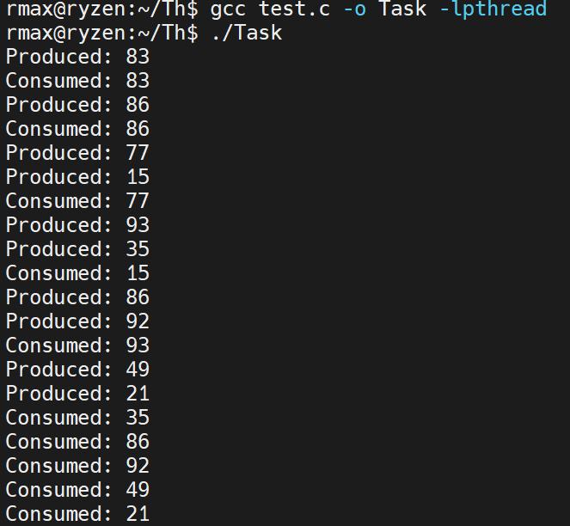
Result

Slide 25
Code
#include <stdio.h>
#include <stdlib.h>
#include <pthread.h>
#include <semaphore.h>
#include <unistd.h>
#define SIZE 5 // buffer size
int buffer[SIZE];
int in = 0; // next free position in buffer
int out = 0; // next item to consume
pthread_mutex_t mutex;
sem_t full;
sem_t empty;
void* producer(void* arg) {
int item;
for (int i = 0; i < 10; i++) {
item = rand() % 100;
sem_wait(&empty); // wait for empty slot
pthread_mutex_lock(&mutex); // lock buffer
buffer[in] = item;
printf("Produced: %d\n", item);
in = (in + 1) % SIZE;
pthread_mutex_unlock(&mutex); // unlock buffer
sem_post(&full); // increase full count
sleep(1); // simulate time
}
return NULL;
}
void* consumer(void* arg) {
int item;
for (int i = 0; i < 10; i++) {
sem_wait(&full); // wait for item
pthread_mutex_lock(&mutex); // lock buffer
item = buffer[out];
printf("Consumed: %d\n", item);
out = (out + 1) % SIZE;
pthread_mutex_unlock(&mutex); // unlock buffer
sem_post(&empty); // increase empty count
sleep(2); // simulate time
}
return NULL;
}
int main() {
pthread_t prod, cons;
pthread_mutex_init(&mutex, NULL);
sem_init(&empty, 0, SIZE); // initially buffer is empty
sem_init(&full, 0, 0); // no items yet
pthread_create(&prod, NULL, producer, NULL);
pthread_create(&cons, NULL, consumer, NULL);
pthread_join(prod, NULL);
pthread_join(cons, NULL);
pthread_mutex_destroy(&mutex);
sem_destroy(&empty);
sem_destroy(&full);
return 0;
}
Part 1
Part 2

Slide 26
Explanation
Component | Code | Purpose | Explanation
Buffer | int buffer[SIZE]; | Shared queue | Holds items produced and consumed
Indexes | in, out | Track positions | in for producer, out for consumer (circular)
Mutex | pthread_mutex_t mutex; | Synchronization | Ensures only one thread accesses the buffer at a time
Semaphores | sem_t full, empty; | Counting slots | empty: available slots, full: items ready to consume
Init Semaphores | sem_init(&empty, 0, SIZE); sem_init(&full, 0, 0); | Initial state | Buffer starts empty: all slots free, no items to consume
Producer (Loop) | sem_wait(&empty); pthread_mutex_lock(&mutex); buffer[in] = item; in = (in+1) % SIZE; pthread_mutex_unlock(&mutex); sem_post(&full); | Produces item | Waits for slot, locks buffer, inserts item, unlocks, signals full
Consumer (Loop) | sem_wait(&full); pthread_mutex_lock(&mutex); item = buffer[out]; out = (out+1) % SIZE; pthread_mutex_unlock(&mutex); sem_post(&empty); | Consumes item | Waits for item, locks buffer, removes item, unlocks, signals empty
Sleep | sleep(1); sleep(2); | Delay | Simulates real-time production and consumption
Threads | pthread_create()pthread_join() | Concurrent execution | Runs producer and consumer in parallel
Cleanup | pthread_mutex_destroy(&mutex); sem_destroy(&empty); sem_destroy(&full); | Resource cleanup | Destroys mutex and semaphores after use

Slide 27

Questions?
Contact TA if you have questions
Name: RASIM
E-mail : rmax@inha.edu
Intelligent Embedded System Lab. (H-813)

