Slide 1
HTML Lists
Web Technologies – Rasim mahmudov
BEU - 2022

Slide 2

HTML Lists
This slide explains how to create different types of lists: unordered, ordered, and description lists in HTML.

Slide 3
A list refers to any information displayed in a logical or linear form. It is a series of items written together in a meaningful group or sequence and marked by bullet points, numbers, etc. In HTML, there are three list types, each with a specific purpose and tag. In this guide, we will explore lists in HTML. We will understand different HTML list tags and how to create HTML lists.

Slide 4
What is an HTML List?
HTML Lists help to display a list of information semantically. There are three types of lists in HTML:
Unordered list or Bulleted list (ul)
Ordered list or Numbered list (ol)
Description list or Definition list (dl)

Slide 5
HTML Unordered List or Bulleted List
In HTML unordered list, the list items have no specific order or sequence. An unordered list is also called a Bulleted list, as the items are marked with bullets. It begins with the <ul> tag and and closes with a </ul> tag. The list items begin with the <li> tag and end with </li> tag.
Syntax: <ul>List of Items</ul>

Slide 6
Example of HTML Unordered List
<h2>List of Fruits</h2>
<ul>
<li>Apple</li>
<li>Mango</li>
<li>Banana</li>
<li>Grapes</li>
<li>Orange</li>
</ul>

Slide 7
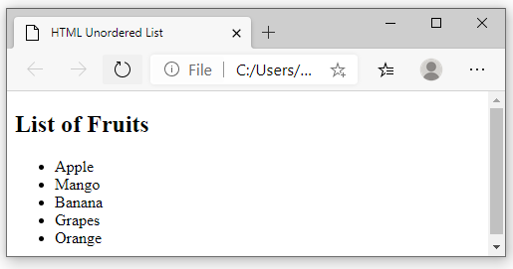
Output for unordered

Slide 8
Ordered List or Numbered List (ol)
In HTML, all the list items in an ordered list are marked with numbers by default instead of bullets. An HTML ordered list starts with the <ol> tag and ends with the </ol> tag. The list items start with the <li> tag and end with </li> tag.
Syntax: <ol>List of Items</ol>

Slide 9
Example of HTML Ordered List
<h2>List of Fruits</h2>
<ol>
<li>Apple</li>
<li>Mango</li>
<li>Banana</li>
<li>Grapes</li>
<li>Orange</li>
</ol>

Slide 10
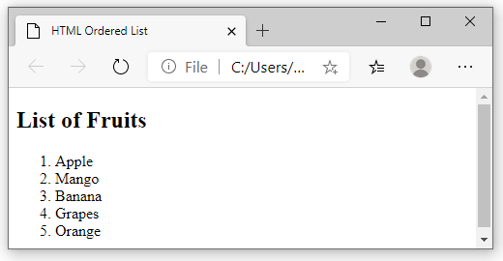
Output for numbered or ordered

Slide 11
Different Types of Ordered Lists in HTML
Instead of numbers, you can mark your list items with the alphabet: A, B, C or a,b,c, or roman numerals: i, ii, iii, etc. You can do this by using the type attribute in the <ol> tag. Let’s explore how to order lists with alphabets and roman numbers.
To mark the list items with letters A, B, C, etc., you will have to specify A as the type attribute’s value in the <ol> tag.

Slide 12
Here is an example to show the use of Upper case letters to list the items.
<h2>List of Fruits</h2>
<ol type="A">
<li>Apple</li>
<li>Mango</li>
<li>Banana</li>
</ol>

Slide 13
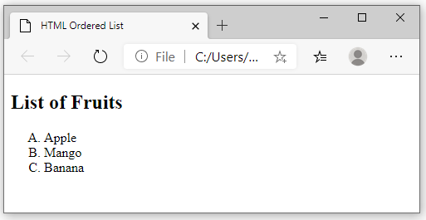
Output for upper case ordered

Slide 14
Here is an example to show the use of Lower case letters to list the items.
<h2>List of Fruits</h2>
<ol type="a">
<li>Apple</li>
<li>Mango</li>
<li>Banana</li>
</ol>

Slide 15
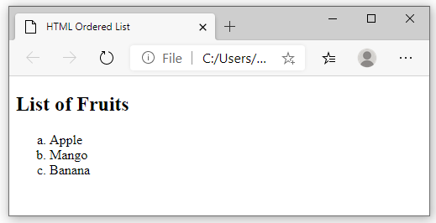
Output for lower case ordered list

Slide 16
Here is an example to show the use of Roman numerals to list the items.
<h2>List of Fruits</h2>
<ol type="i">
<li>Apple</li>
<li>Mango</li>
<li>Banana</li>
</ol>

Slide 17
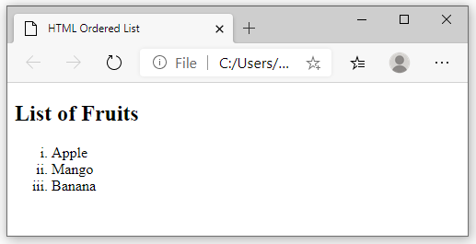
Output for Roman numerals

Slide 18
HTML Description List or Definition List
In an HTML Description list or Definition List, the list items are listed like a dictionary or encyclopedia. Each item in the description list has a description. You can use a description list to display items like a glossary. You will need the following HTML tags to create a description list:
<dl> (Definition list) tag – Start tag of the definition list
<dt> (Definition Term) tag – It specifies a term (name)
<dd> tag (Definition Description) – Specifies the term definition
</dl> tag (Definition list) – Closing tag of the definition list

Slide 19
Example of HTML Description List
<body>
<dl>
<dt><b>Apple</b></dt>
<dd>A red colored fruit</dd>
<dt><b>Honda</b></dt>
<dd>A brand of a car</dd>
<dt><b>Spinach</b></dt>
<dd>A green leafy vegetable</dd>
</dl>
</body>

Slide 20
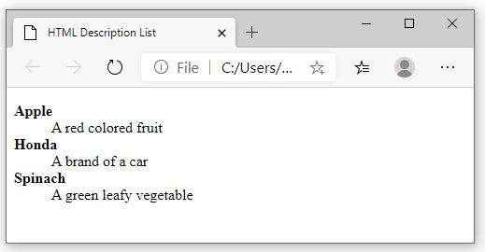
Output for description list

Slide 21
HTML Nested Lists
An HTML Nested list refers to a list within another list. We can create a nested ordered list, a nested unordered list, or a nested ordered list inside an unordered list.
Let us explore some examples of HTML lists within lists:

Slide 22
Example of an HTML Nested Ordered List
<body>
<ol>
<li>Banana</li>
<li> Apple
<ol>
<li>Green Apple</li>
<li>Red Apple</li>
</ol>
</li>
<li>Pineapple</li>
<li>Orange</li>
</ol>
</body>

Slide 23
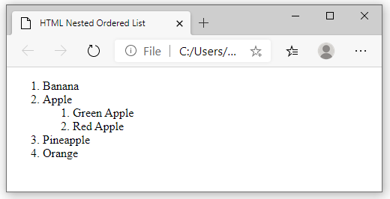
Output for nested ordered list

Slide 24
Example of an HTML Nested Unordered List
<ul>
<li>Fruits</li>
<ul>
<li>Apple</li>
<li>Banana</li>
<li>Mango</li>
<li>Orange</li>
</ul>
<li>Vegetables</li> ........

Slide 25
<ul>
<li>Spinach</li>
<li>Cauliflower</li>
<li>Beetroot</li>
</ul>
<li>Cereals</li>
<li>Nuts</li>
</ul>

Slide 26
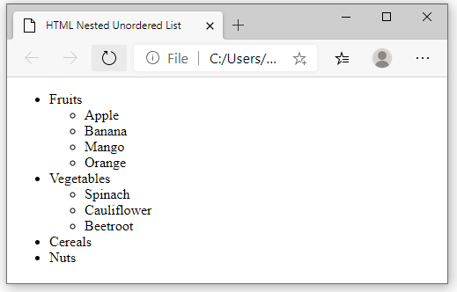

Slide 27
Conclusion
HTML lists help users display a list of data or information on a web page. The items in a list are related pieces of information. An HTML list shows these related items in an easy-to-read manner. In HTML, a list may contain one or more list items.

Slide 28
References
https://www.w3schools.com/html/html_lists.asp
https://www.w3docs.com/learn-html/html-lists.html
https://www.naukri.com/learning/articles/html-lists-ordered-unordered-lists-with-examples/

