Slide 1
Introduction to C#
What is C#?
C# is pronounced "C-Sharp".
It is an object-oriented programming language created by Microsoft that runs on the .NET Framework.
C# has roots from the C family, and the language is close to other popular languages like C++ and Java.
The first version was released in year 2002. The latest version, C# 10, was released in 2021. (11 in 2022)

Slide 2
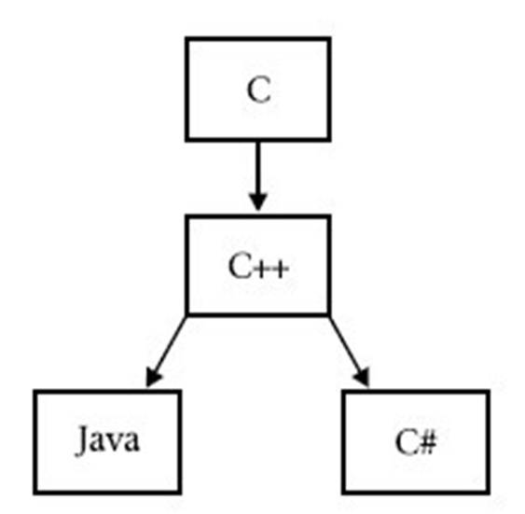

Slide 3
C# is used for:
Mobile applications
Desktop applications
Web applications
Web services
Web sites
Games
VR
Database applications
And much, much more!

Slide 4
Why Use C#?
↓ BECAUSE ↓
It is one of the most popular programming language in the world
It is easy to learn and simple to use
It has a huge community support
C# is an object oriented language which gives a clear structure to programs and allows code to be reused, lowering development costs.
As C# is close to C, C++ and Java, it makes it easy for programmers to switch to C# or vice versa.

Slide 5
C# IDE
The easiest way to get started with C#, is to use an IDE.
An IDE (Integrated Development Environment) is used to edit and compile code.
*Q: What was the name of IDE we should use ?

Slide 6
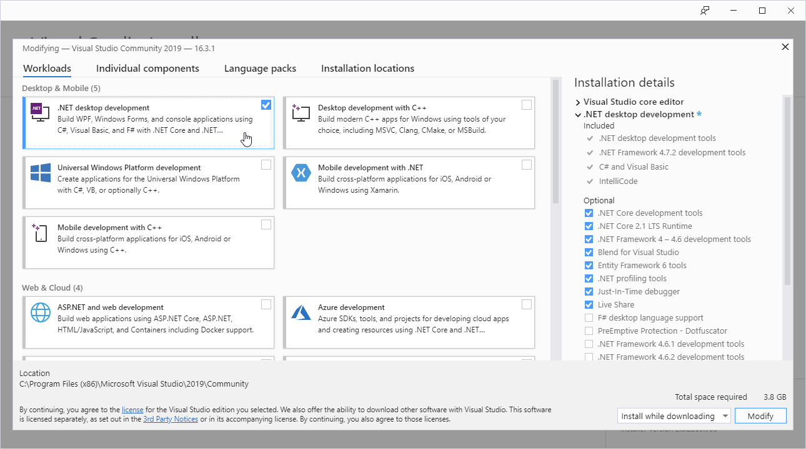
Visual Studio Installation

Slide 7
First code in C#
using System;
namespace PrintHelloWorld
{
class Program
{
static void Main(string[] args)
{
Console.WriteLine("Hello World!");
}
}
}

Slide 8
*Q
using ***;
namespace PrintHelloWorld
{
class Program
{
static void ****(string[] args)
{
*****.********("Hello World!");
}
}
}

Slide 9
C# Comments
Comments can be used to explain C# code, and to make it more readable. It can also be used to prevent execution when testing alternative code.
Single-line comments start with two forward slashes (//)
Any text between (//) and the end of the line is ignored by C# (will not be executed).
For example:
// Console.WriteLine("Hello World!");
Console.WriteLine("Hello World!");

Slide 10
C# Variables
Variables are containers for storing data values.
In C#, there are different types of variables (defined with different keywords), for example:
int - stores integers (whole numbers), without decimals, such as 123 or -123
double - stores floating point numbers, with decimals, such as 19.99 or -19.99
char - stores single characters, such as 'a' or 'B'. Char values are surrounded by single quotes
string - stores text, such as "Hello World". String values are surrounded by double quotes
bool - stores values with two states: true or false

Slide 11
int aNum = 50; // Integer (whole number)
double aDoubleNum= 5.23; // Floating point number char letter = 'a'; // Character
bool aBool = true; // Boolean
string aText = "Hello"; // String

Slide 12
A data type specifies the size and type of variable values. It is important to use the correct data type for the corresponding variable;
Data Type | Size | Description
int | 4 bytes | Stores whole numbers from -2,147,483,648 to 2,147,483,647
long | 8 bytes | Stores whole numbers from -9,223,372,036,854,775,808 to 9,223,372,036,854,775,807
float | 4 bytes | Stores fractional numbers. Sufficient for storing 6 to 7 decimal digits
double | 8 bytes | Stores fractional numbers. Sufficient for storing 15 decimal digits
bool | 1 bit | Stores true or false values
char | 2 bytes | Stores a single character/letter, surrounded by single quotes
string | 2 bytes per character | Stores a sequence of characters, surrounded by double quotes

